Slide 1
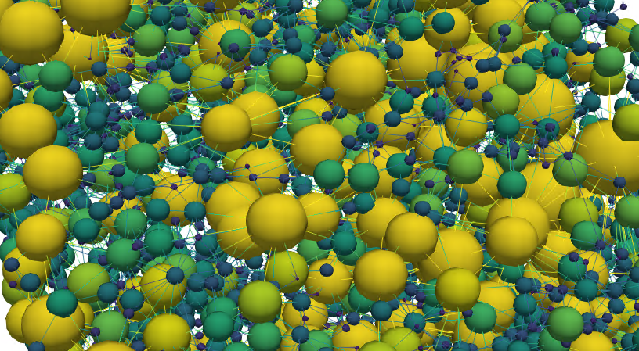
Starting from the bottom: Coupling a genetic algorithm and a pore network model for porous electrode design
Maxime van der Heijden, Rik van Gorp, Gabor Szendrei, Victor de Haas, Mohammad Amin Sadeghi, Jeffrey Gostick, and Antoni Forner Cuenca
Columbia Presentation
June 10th, 2023

Slide 2
Redox flow batteries as an option for large scale energy storage
Tanks
  Electrolyte: active species, supporting salt, and solvent
Reactor
  Electrodes
  Membrane
  Flow fields
  Current collectors
Load
Rechargeable
Decoupled energy (tank size) and power (reactor size): upscaling possibilities
Currently too expensive
e⁻
Anode
Cathode
A^{n+}
A^{n+}
Current collector
Membrane
e⁻
Anolyte
Catholyte
A^{(n-1)+}
A^{(n-1)+}
Ions
Ions
Pump
Pump

Slide 3
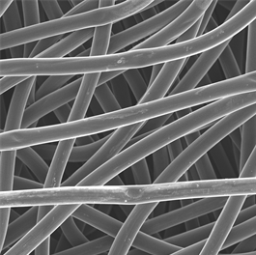

Porous electrode engineering is a complex multiscale optimization problem
Key properties:
Surface area ↑
Mass transport ↑
Pressure drop ↓
Mechanical properties ↑
Electrochemical activity ↑
(Electro)chemical stability ↑
Load
e⁻
Anode
Cathode
100 $\text{μm}$
A^{n+}
A^{n+}
Current collector
Membrane
e⁻
Anolyte
Catholyte
A^{(n-1)+}
A^{(n-1)+}
Ions
Ions
A^{(n-1)+} → A^{n+} + e⁻
Pump
Pump

Slide 4
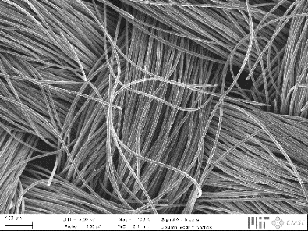
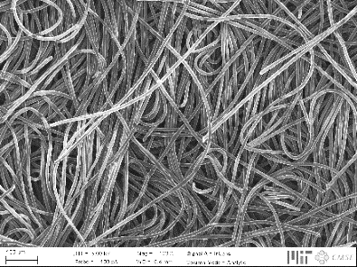
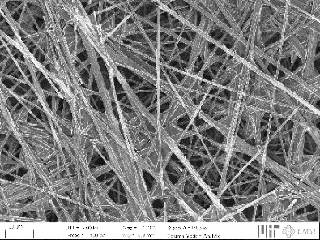
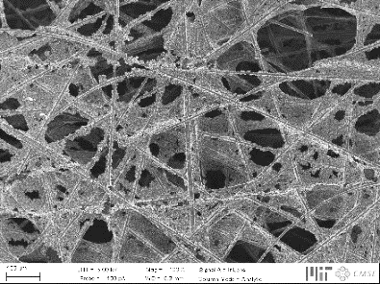
Tailored electrodes for all-liquid systems
Current generation not optimized, affecting three major losses:
↓ Pressure drop
↑ Electrochemical performance
Activation losses
Ohmic losses
Mass transport losses
Hierarchical organization
200 μm

Slide 5

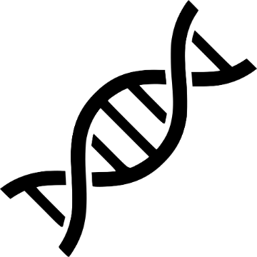
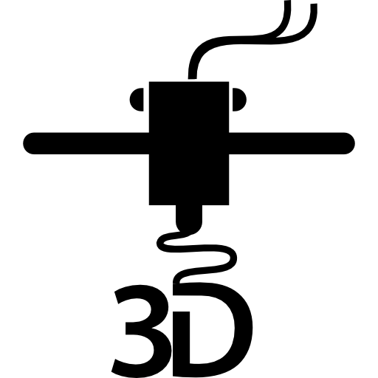

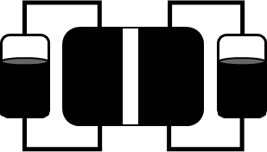
Bottom-up design of porous electrodes
Experimental
characterization
Pore network
model
Genetic
optimization
Advanced
manufacturing
Device
implementation
Battery tests
Chemistries
Imaging
Network extraction
Pore simulations
Parameter analysis
Bottom-up
Theory of evolution
Self-evolving
3D printing
Phase separation
Carbonization
Post-treatment
Durability
Cost analysis

Slide 6
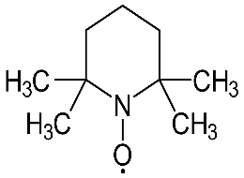
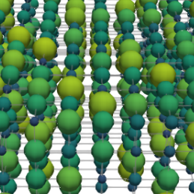
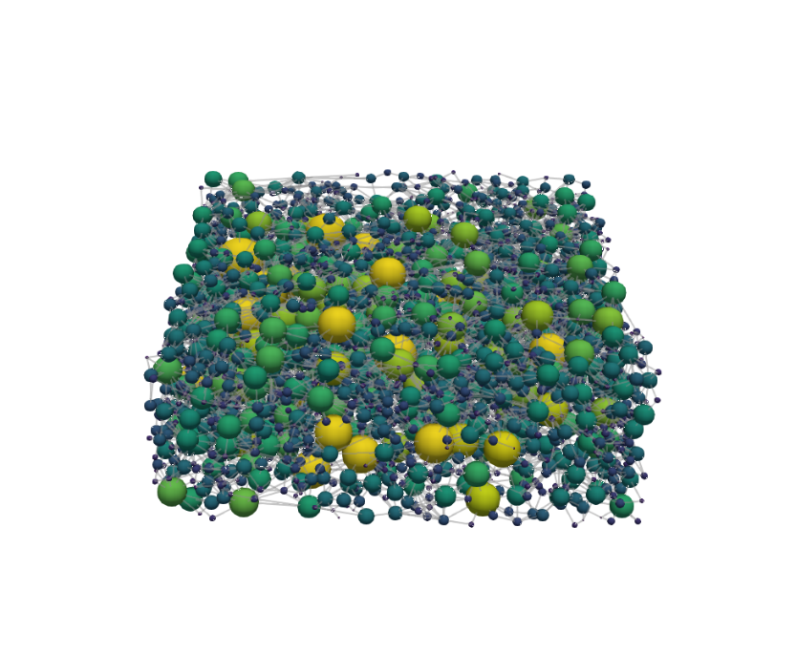

Developing a genetic algorithm using the theory of evolution
System and parameter selection
Initial network
Initial population
Iterative algorithm
System and parameter selection
Initial network
Initial population
Merging and splitting
Scaling
Electrochemical PNM
Mutation
Fitness function
Fe²⁺
VO²⁺
Fe³⁺
Crossover
Selection
Termination criterion
VO₂⁺
Chemistry
FTFF
IDFF
Termination
Cubic
Extracted

Slide 7

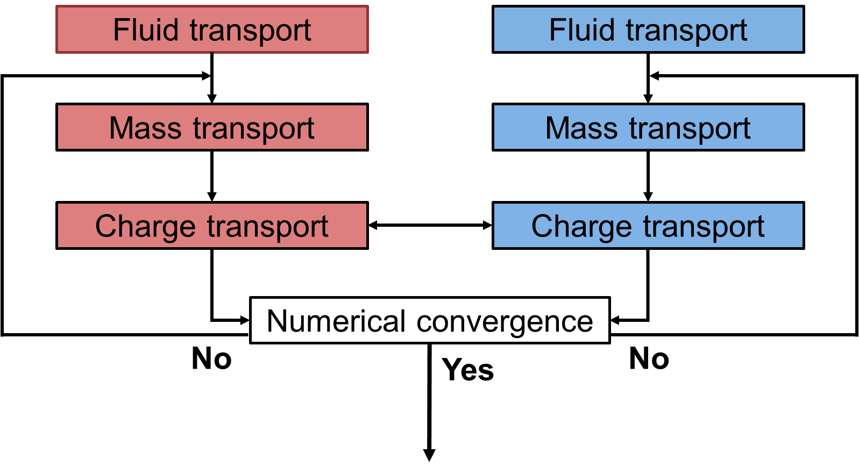

Genetic evolution using a pore network model
Scaling
Electrochemical pore network model
Fitness function
Termination
System and parameter selection
Initial network
Initial population
Merging and splitting
Scaling
Electrochemical PNM
Anode
Cathode
$Fitness= \frac{P_{theory}−P_{el}}{P_{theory}+P_{pump}}$
$P_{theory}=1.26 V ∗I$
$P_{el}=η∗I$ → $η=0.5 V$
$P_{pump}=\frac{Q∗∆p}{η_{pump}}$
Mutation
Fitness function
= 1000 ?
Crossover
Selection
Termination criterion
Termination

Slide 8
Iterative genetic algorithm scheme using the theory of evolution
Selection
Crossover
Mutation
Merging and splitting
System and parameter selection
Initial network
Initial population
Merging and splitting
Scaling
Electrochemical PNM
Mutation
Fitness function
= 1000
Crossover
Selection
Termination criterion
Termination
or

Slide 9


Iterative genetic algorithm scheme for proof of principle
VO²⁺
e⁻
System and parameter selection
VO₂⁺
Chemistry
Flow through
Cubic
Initial network
Initial population
= 50
= 10
Scaling
Electrochemical PNM
$$Fitness=\frac{P_{theory}−P_{el}}{P_{theory}+P_{pump}}$$
Mutation
Fitness function
Crossover
Selection
Termination criterion
Termination
= 1000

Slide 10

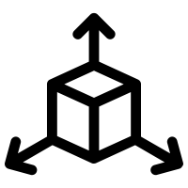
Proof of principle
0.2 M Vanadium, 0.5 V, 1.5 cm s⁻¹
= 50
= 10
= 1000
= [13x13x4]
$$Fitness=\frac{P_{theory}−P_{el}}{P_{theory}+P_{pump}}$$
+ 75% Fitness
- 72% P_{pump}
+ 42% P_{el}
Fitness
Pumping power, P_{pump}
Electrical power, P_{el}

Slide 11

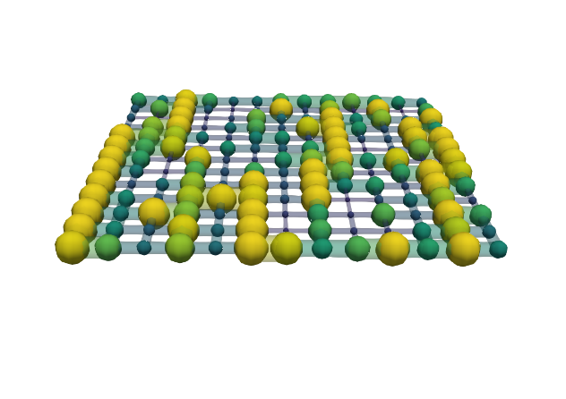
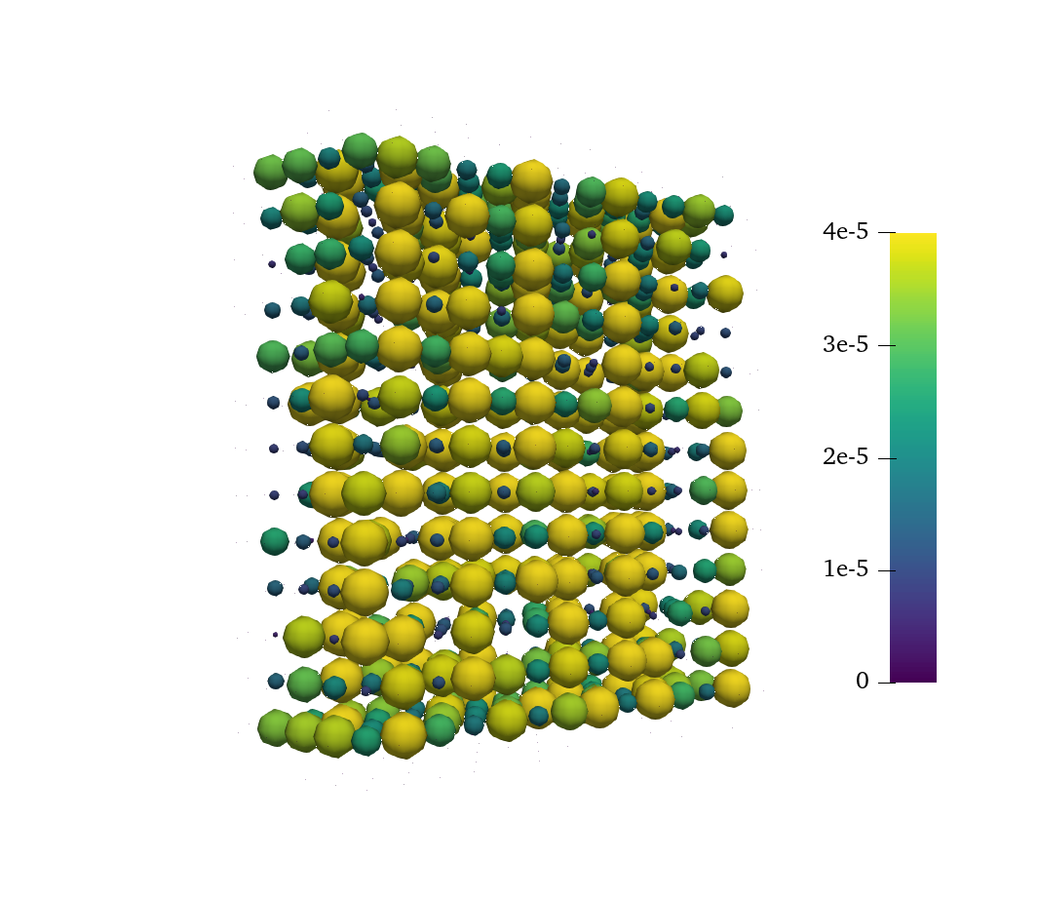
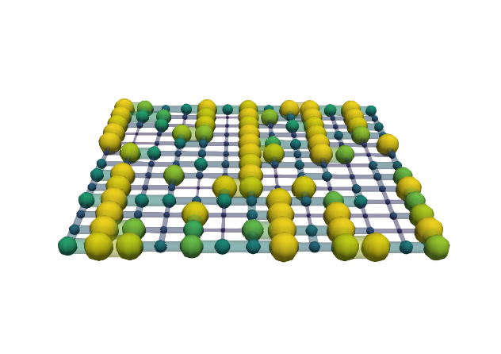
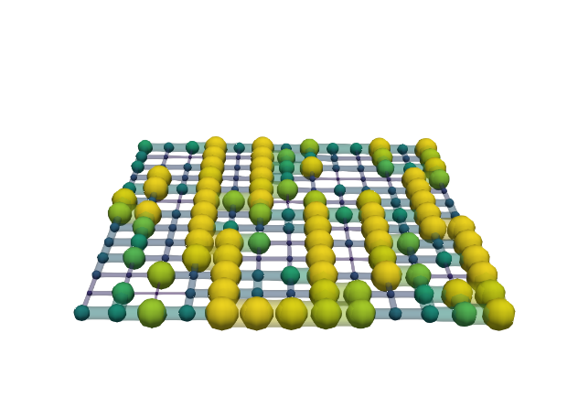
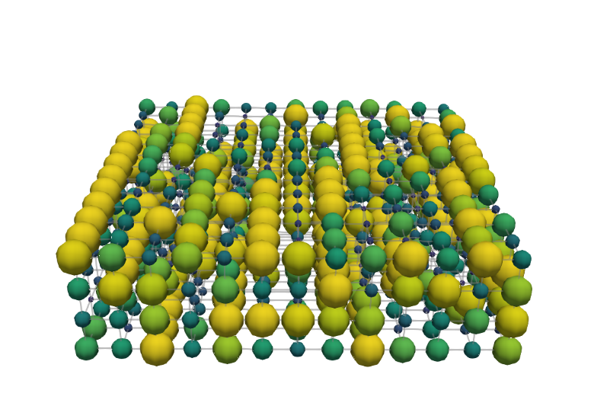
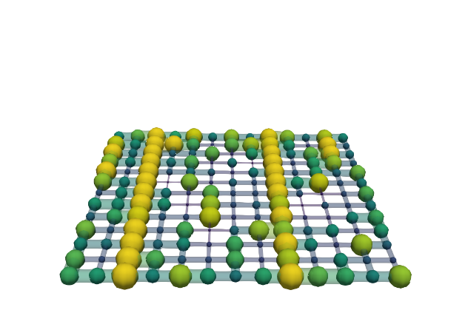
Structure evolution
0.2 M Vanadium, 0.5 V, 1.5 cm s⁻¹
= 50
= 10
= 1000
= [13x13x4]
Generation 0
Can we optimize more realistic structures?
Membrane
Pore diameter [μm]
0 10 20 30 40
Thickness
Current collector
100 μm
Generation 999
Throat radius [μm]
0 4 8 12 16
Flow direction

Slide 12
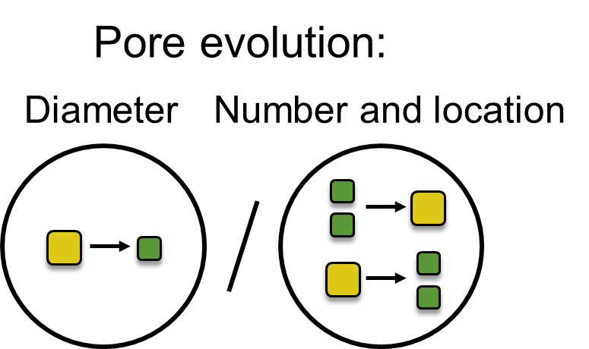
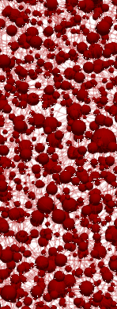
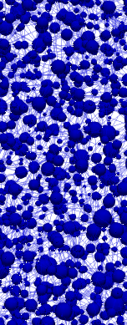
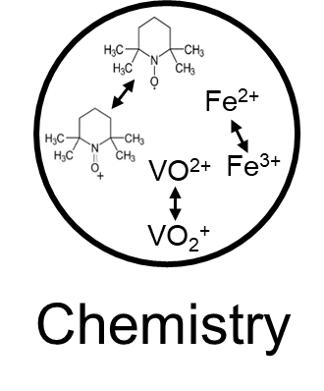
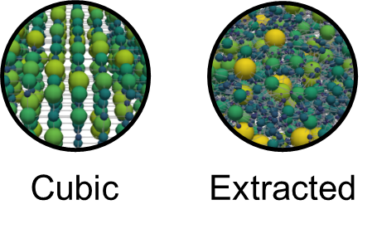
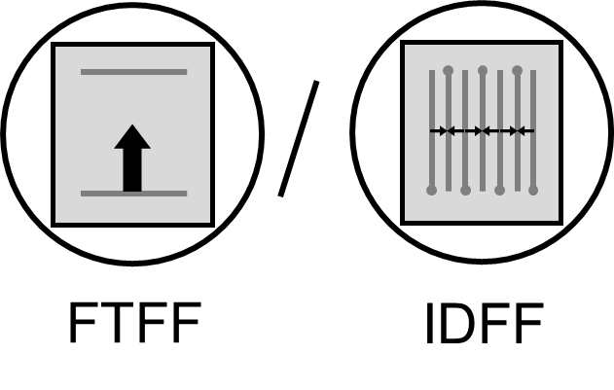
Towards complex electrode structures
Load
e⁻
Anode
Cathode
e⁻
e⁻
A^{(n-1)+}
A^{(n-1)+}
e⁻
Membrane
e⁻
A^{n+}
A^{n+}

Slide 13
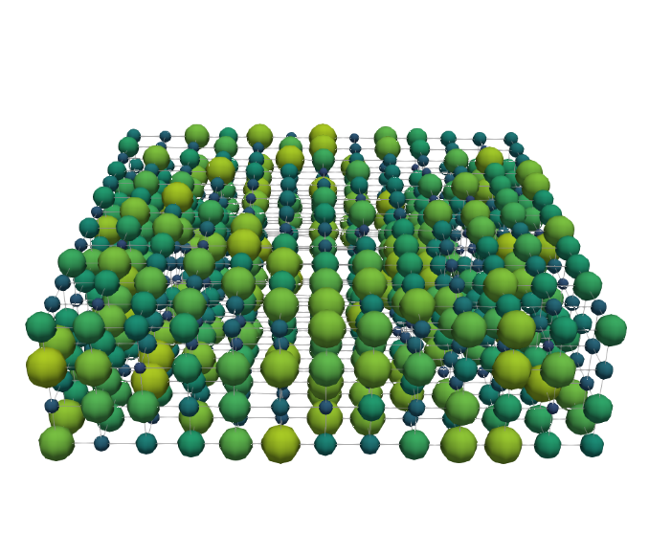
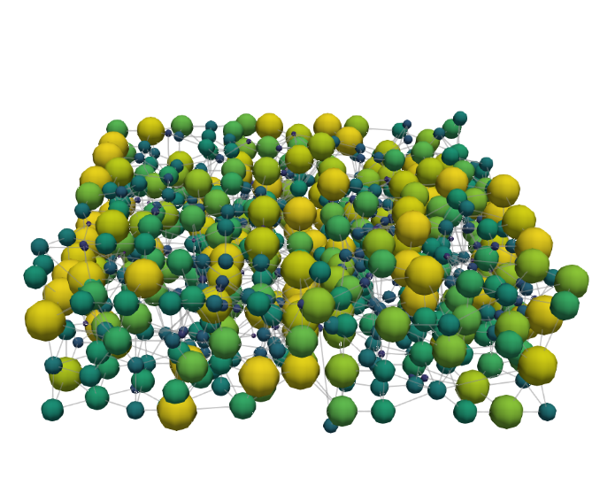
Incorporating design flexibility by pore merging and splitting
0.2 M Vanadium, 0.5 V, 1.5 cm s⁻¹
Pore diameter evolution
+ 39% Fitness
- 56% P_{pump}
+ 9% P_{el}
+ Merging and splitting
Generation 0
Diameter
Generation 0
Merging
100 μm
Generation 999
Generation 999
Splitting
Pore diameter [μm]
0 10 20 30 40
Flow direction

Slide 14
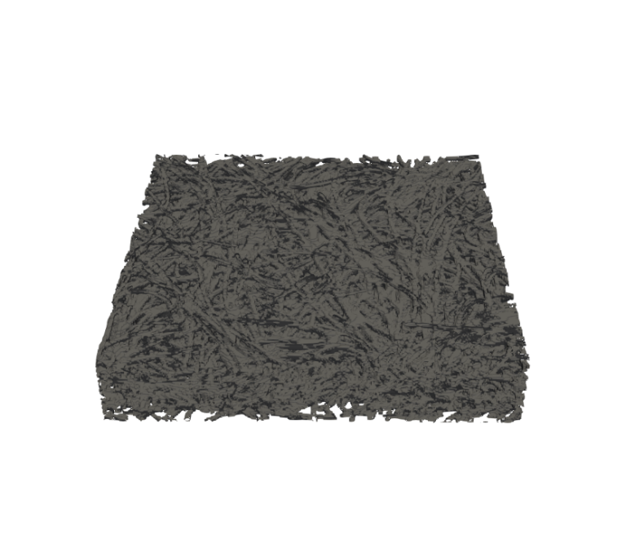
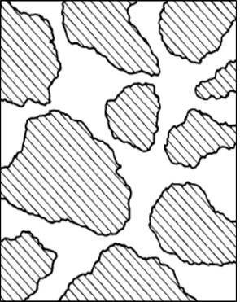

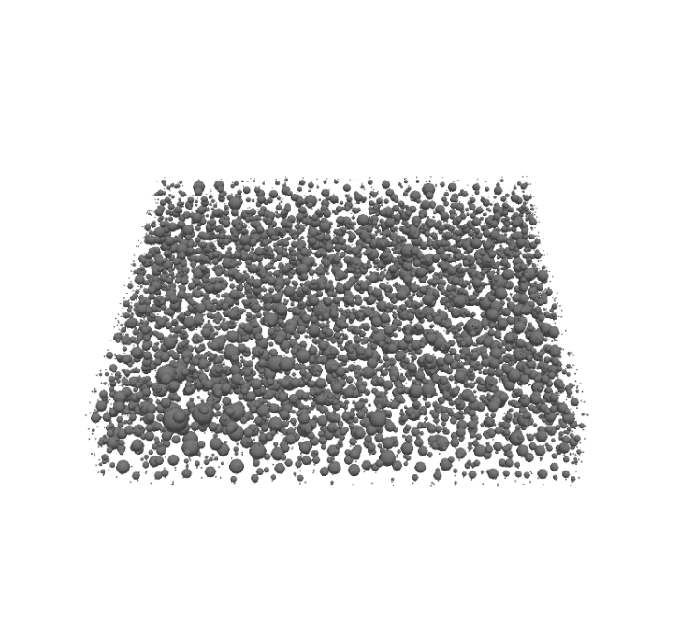
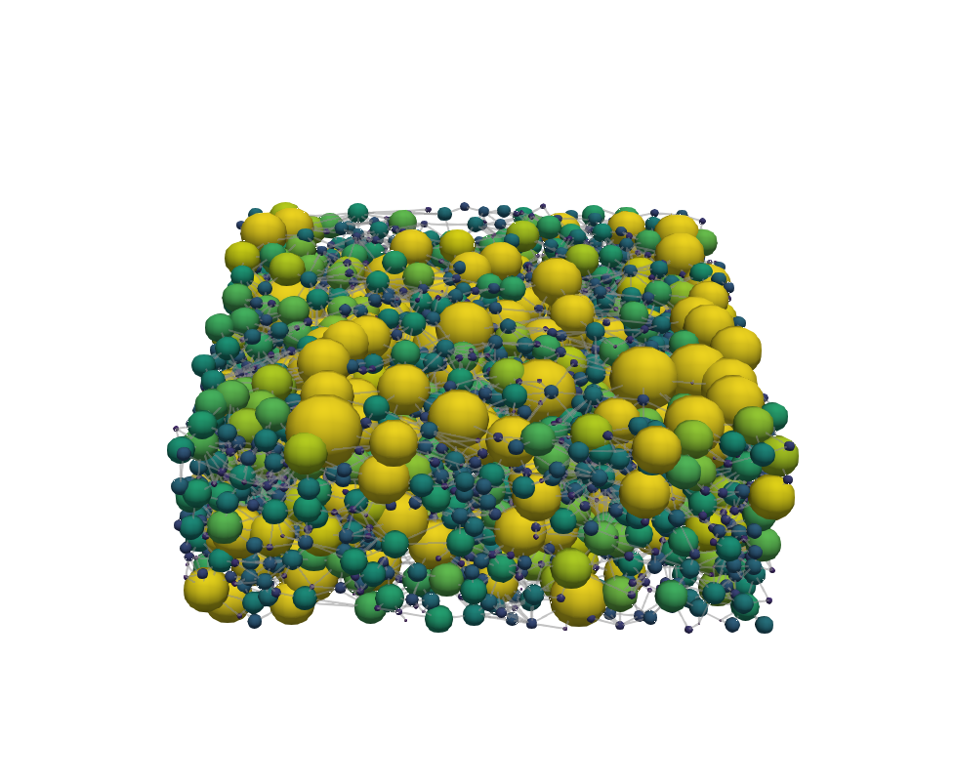
The evolution of extracted networks
0.2 M Vanadium, 0.5 V, 1.5 cm s⁻¹
Cubic lattice
Cubic lattice
+ 11% Fitness
- 33% P_{pump}
+ 0% P_{el}
Carbon paper
Generation 0
Generation 0
X-ray tomography
+
SNOW algorithm
Void
Solid
100 μm
Generation 999
Generation 499
Pore diameter [μm]
0 10 20 30 40
Flow direction

Slide 15
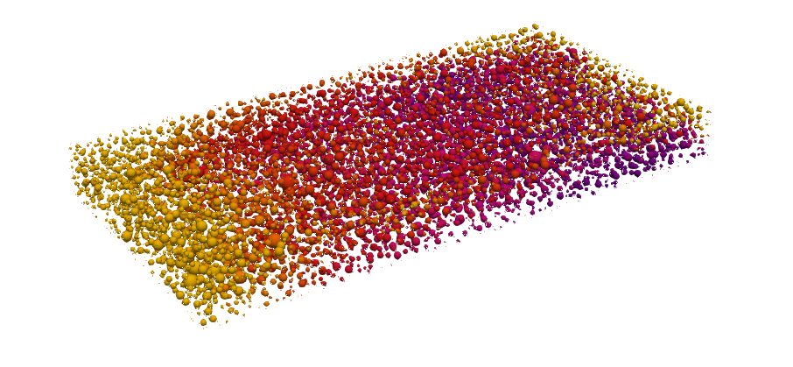
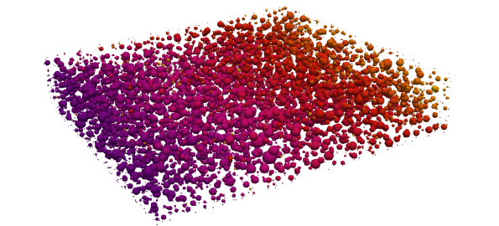
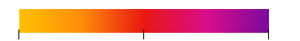
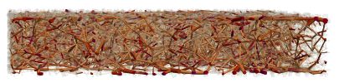
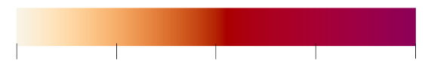
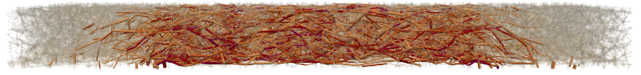
The influence of flow field induced flow pathways in the electrode
Flow-through flow field
Interdigitated flow field
Outlet
Outlet
Membrane
Outlet
Membrane
Inlet
Inlet
z
Inlet
Inlet
500 μm
Rib
80
90
100
y
x
Concentration [mol m⁻³]
Outlet
Membrane
Membrane
Inlet
Outlet
z
0
0.05
0.1
0.15
0.2
Absolute velocity [cm s⁻¹]
Outlet
Rib
Inlet
y

Slide 16
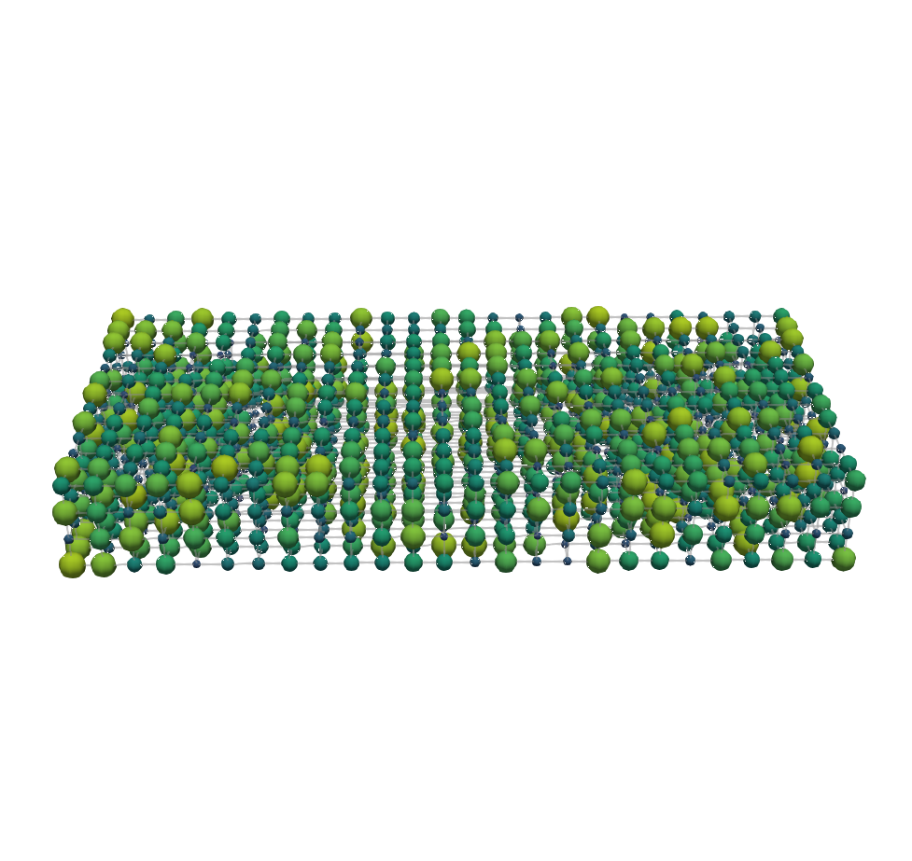
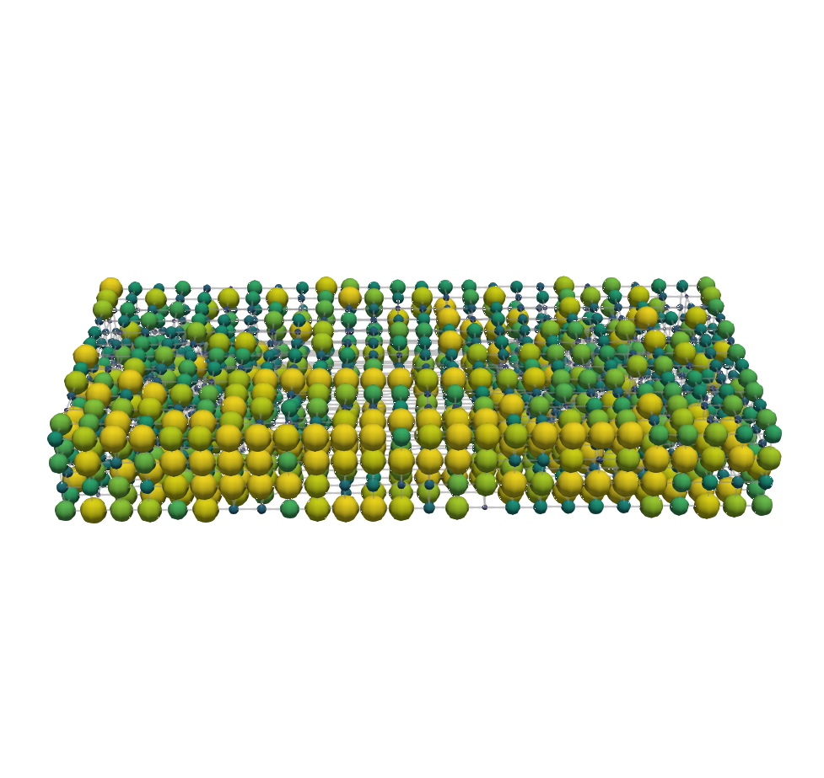
The influence of flow field induced flow pathways on the evolution
0.2 M Vanadium, 0.5 V, 1.5 cm s⁻¹
Flow-through flow field
+ 88% Fitness
- 75% P_{pump}
+ 24% P_{el}
Interdigitated flow field
Generation 0
Generation 0
100 μm
Generation 999
Generation 486
Pore diameter [μm]
0 10 20 30 40
Outlet
Rib
Inlet
Flow direction

Slide 17
Towards complex electrode structures
Load
e⁻
Anode
Cathode
e⁻
e⁻
A^{(n-1)+}
A^{(n-1)+}
e⁻
Membrane
e⁻
A^{n+}
A^{n+}

Slide 18

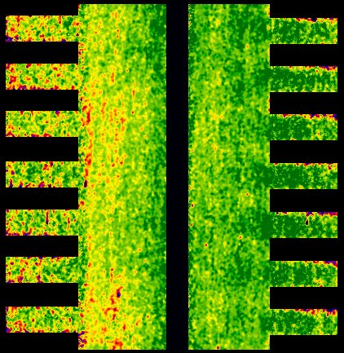
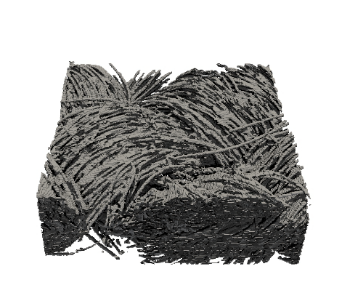
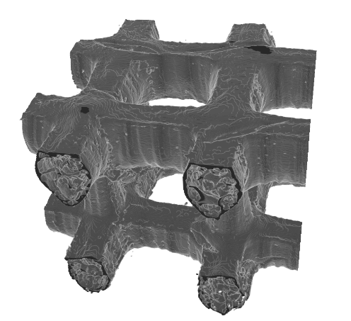
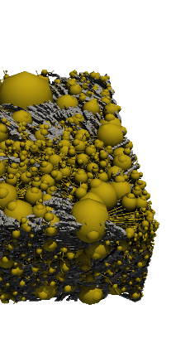

The big picture
Experimental
characterization
Pore network
model
Genetic
optimization
Advanced
manufacturing
Device
implementation
+
+
+
500 μm
500 μm

Slide 19

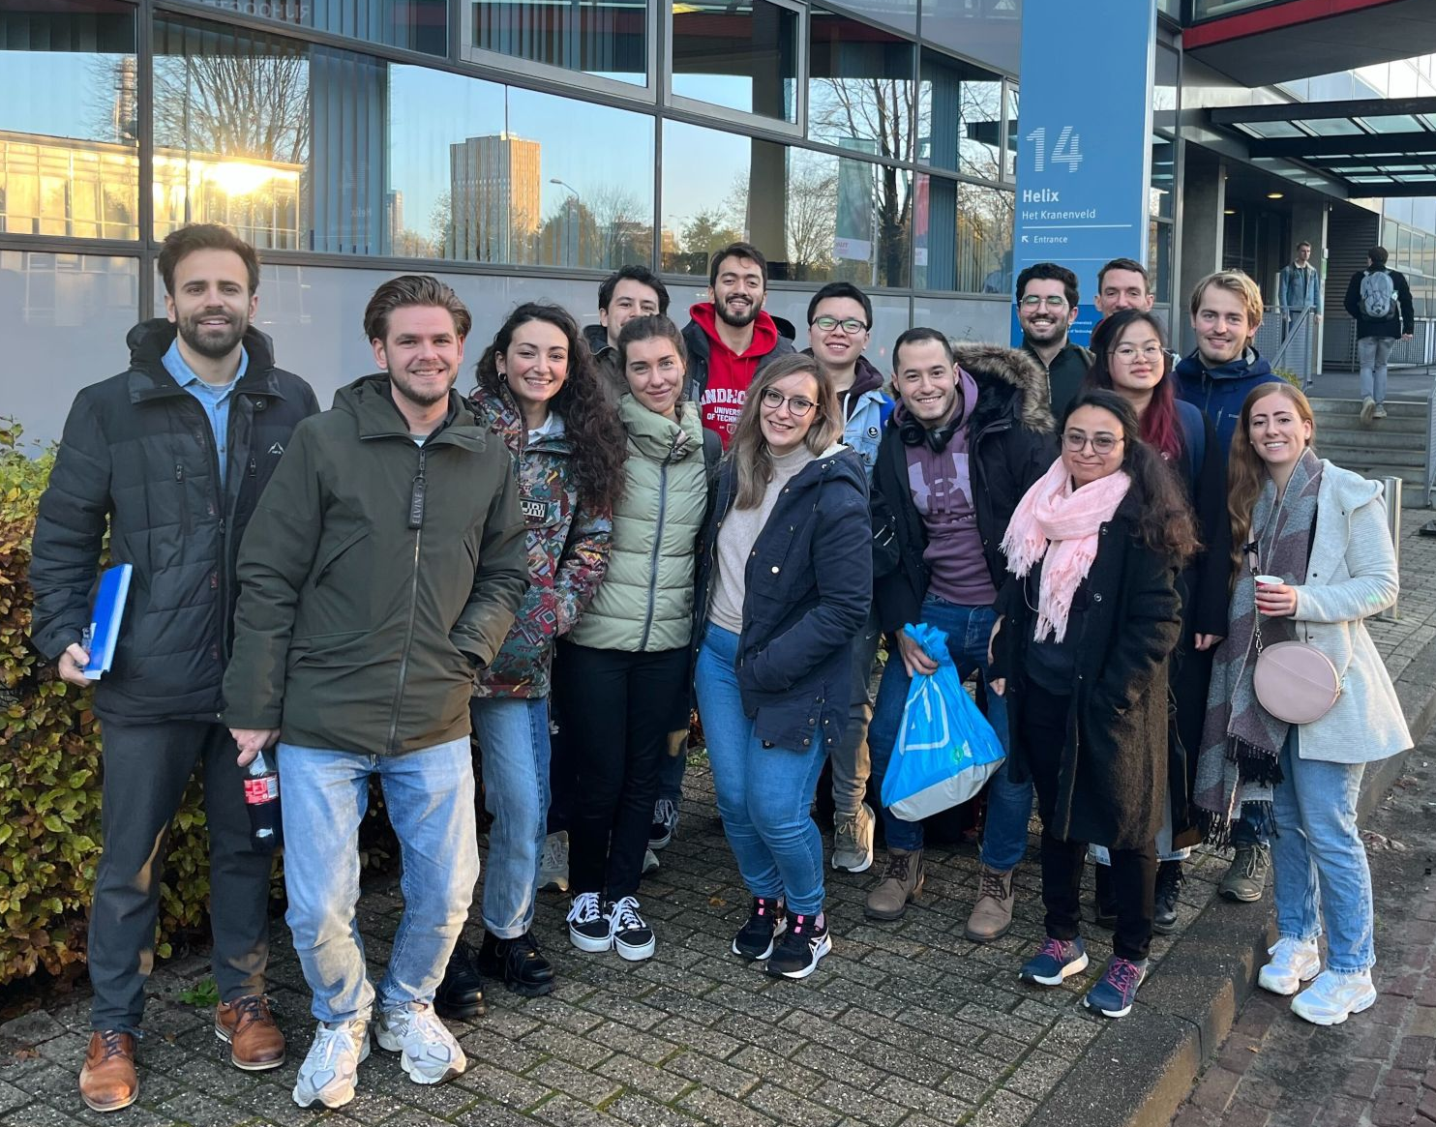

Acknowledgments
Contact:
m.v.d.heijden@tue.nl

