Slide 1
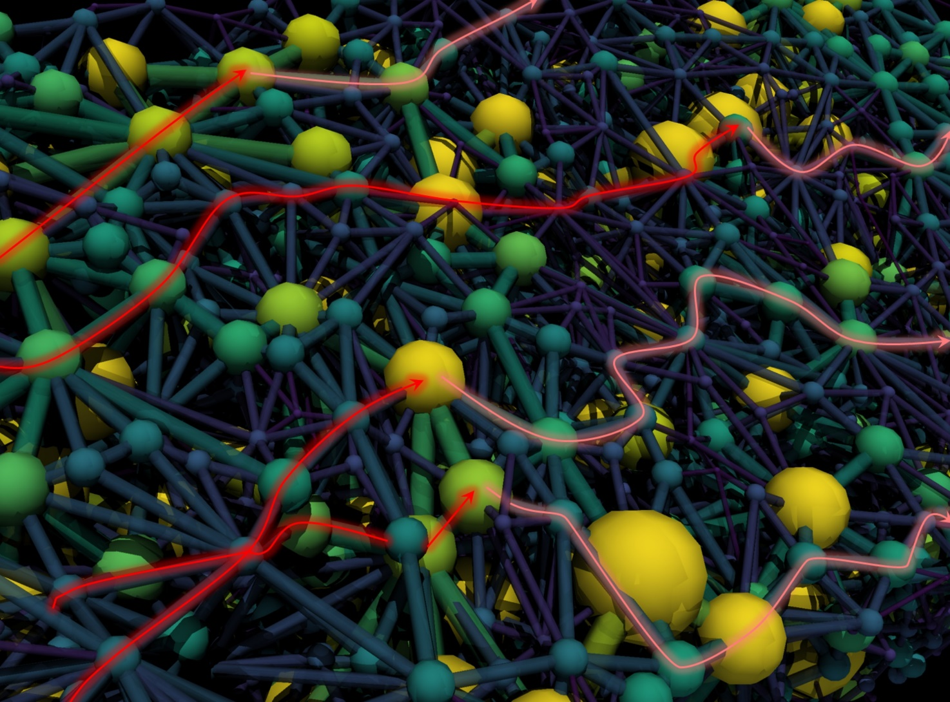

Engineering Porous Electrodes for Redox Flow Batteries
Modeling, Diagnostics, and Manufacturing
Maxime van der Heijden
Amcel Symposium
November 1st, 2024

Slide 2
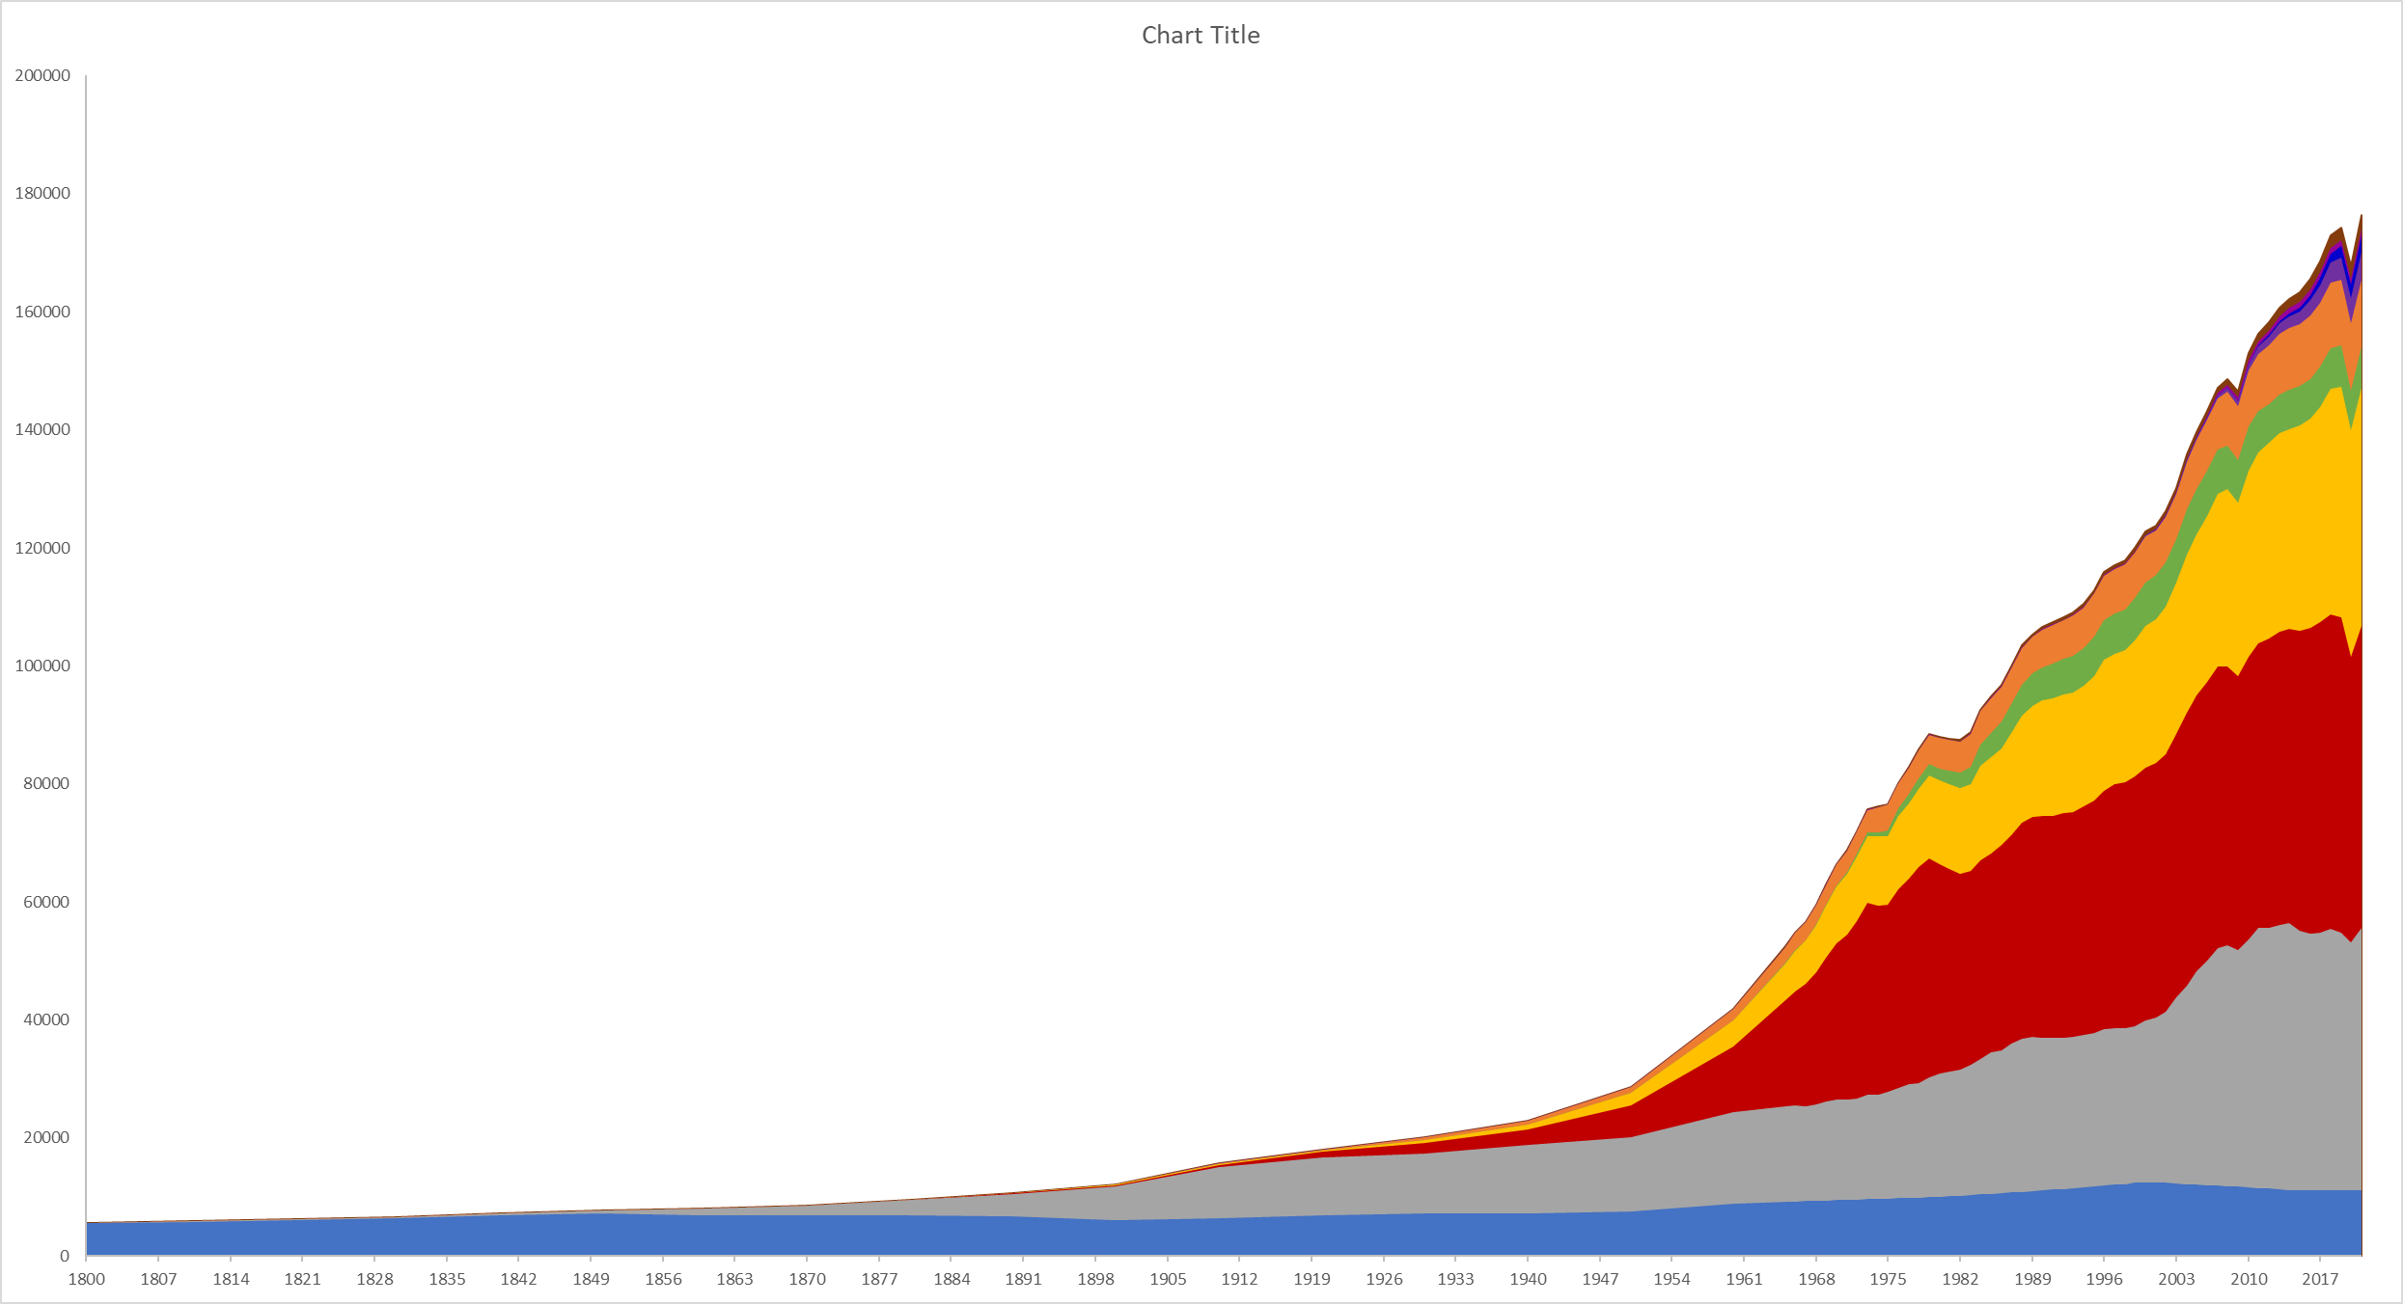

Urgent need for renewable technologies and energy storage at a large scale
Redox flow batteries for energy storage on a daily basis
160
Renewable energy
120
Solar energy
The Netherlands:
~100 GW renewable energy required
Todays storage: ~50 MW
Increase storage 1000x
~150 MW/month energy storage required
Energy consumption x 10³ [TWh]
Demand
80
40
0
Sunrise
Midday
Sunset
1800
1900
2021
Year

Slide 3
Urgent need for renewable technologies and energy storage at a large scale
Efficiency losses hamper widespread implementation
Load
e⁻
Anode
Cathode
A^{n+}
A^{n+}
Current collector
Membrane
e⁻
Anolyte
Catholyte
A^{(n-1)+}
A^{(n-1)+}
Ions
Ions
Pump
Pump

Slide 4
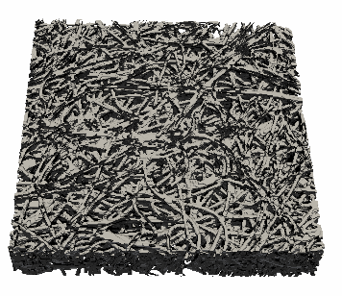
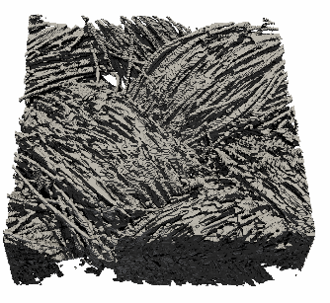
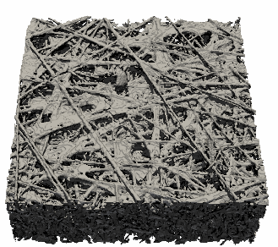
Urgent need for renewable technologies and energy storage at a large scale
We need tailored electrode microstructures for redox flow batteries
Porous electrodes
Load
e⁻
Anode
Cathode
A^{n+}
A^{n+}
250 μm
250 μm
250 μm
Current collector
Membrane
e⁻
Anolyte
Catholyte
Key properties:
- Surface area
- Permeability
- Mass transport
- Conductivity
A^{(n-1)+}
A^{(n-1)+}
Ions
Ions
Pump
Pump
A^{(n-1)+} → A^{n+} + e⁻

Slide 5
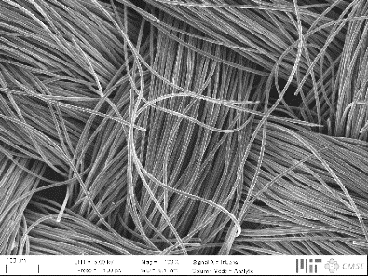
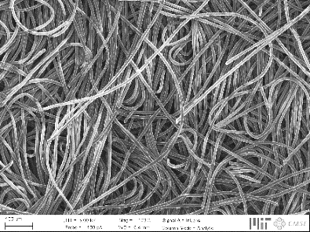
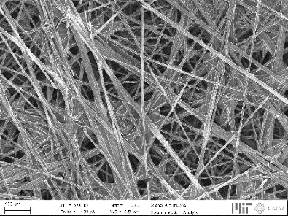
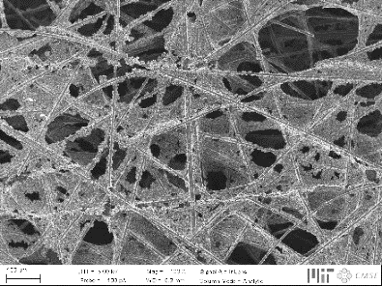
Urgent need for renewable technologies and energy storage at a large scale
Engineering porous materials for electrochemical devices
Current generation not optimized, affecting three major losses:
↓ Pressure drop
↑ Electrochemical performance
Activation losses
Ohmic losses
Mass transport losses
Hierarchical organization
200 μm

Slide 6
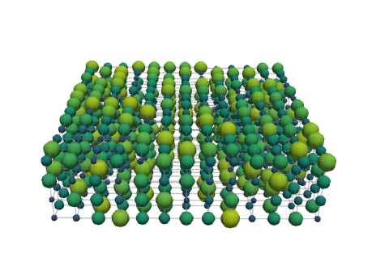
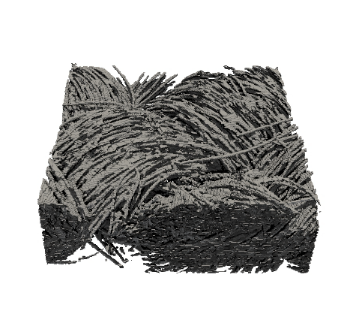
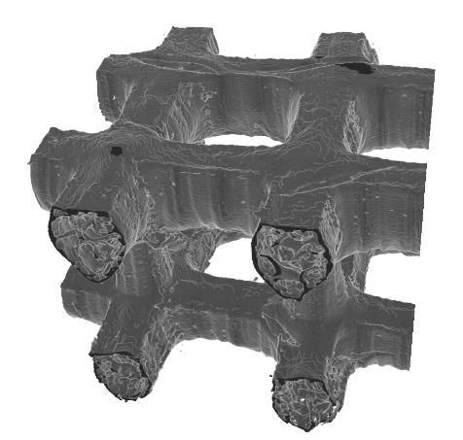
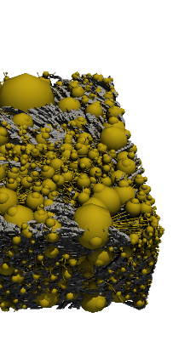
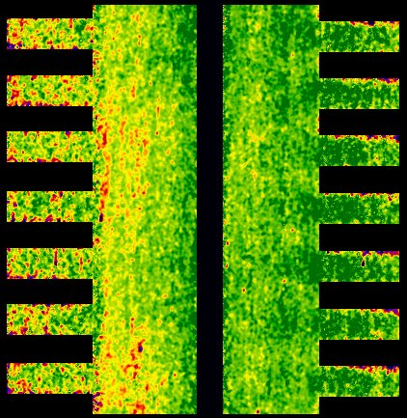
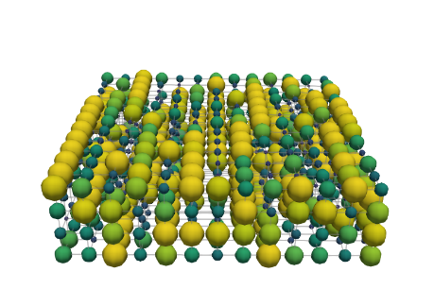
Engineering porous electrodes for redox flow batteries
Bottom-up design of porous electrodes
Pore network
model
Genetic
optimization
Cell-level
imaging
Additive
manufacturing
500 μm
500 μm
Network extraction
Pore simulations
Parameter analysis
Bottom-up design
Pore-level
Self-evolving
Operando
Neutron radiography
Redox chemistries
3D printing
Structural freedom
Carbon electrodes

Slide 7
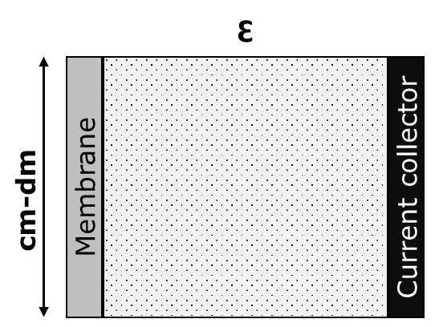
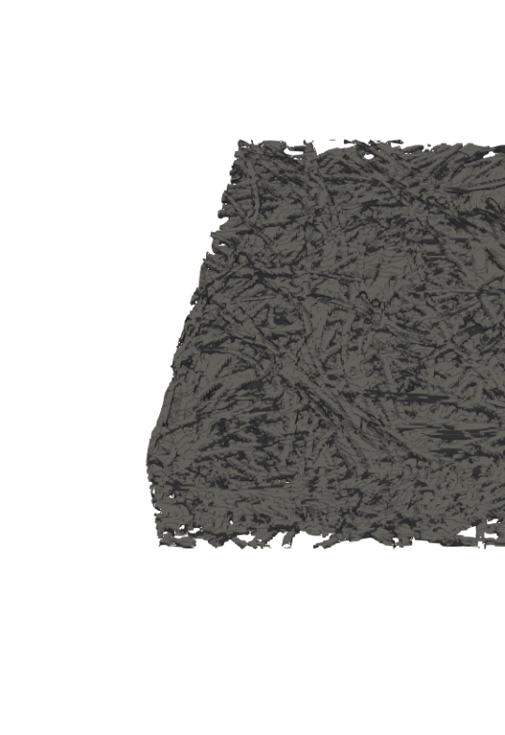
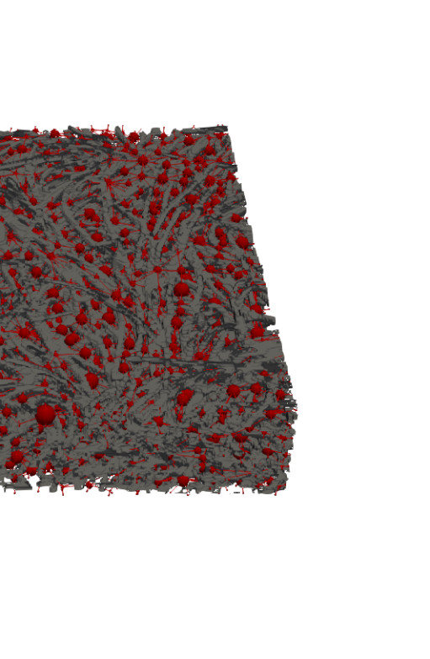
All models are wrong, but some are useful
Pore-scale modeling
Level of complexity and detail
Concentration map
0.3 mm
1.0 mm
[mol m⁻³]
Macroscopic continuum model
Pore network model
Lattice Boltzmann model

Slide 8
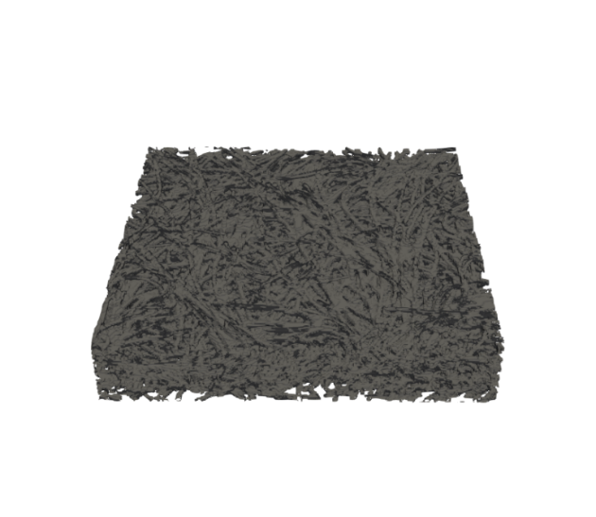
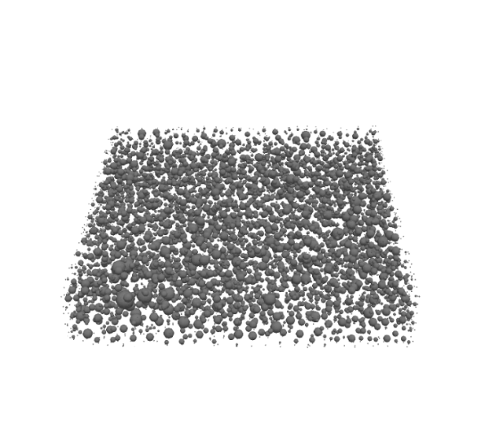
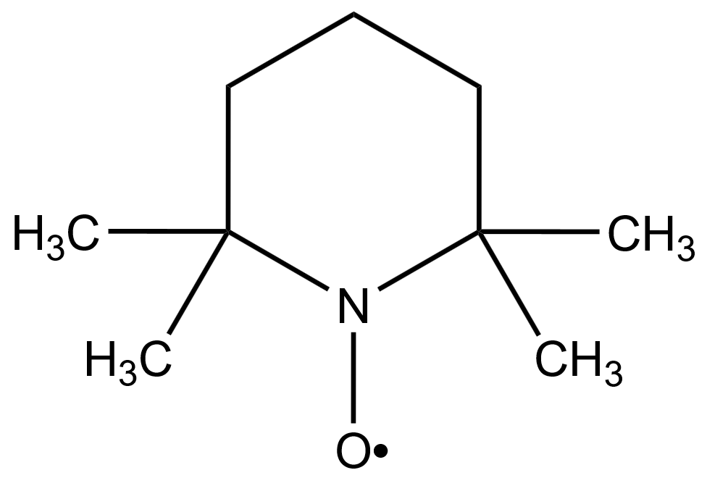
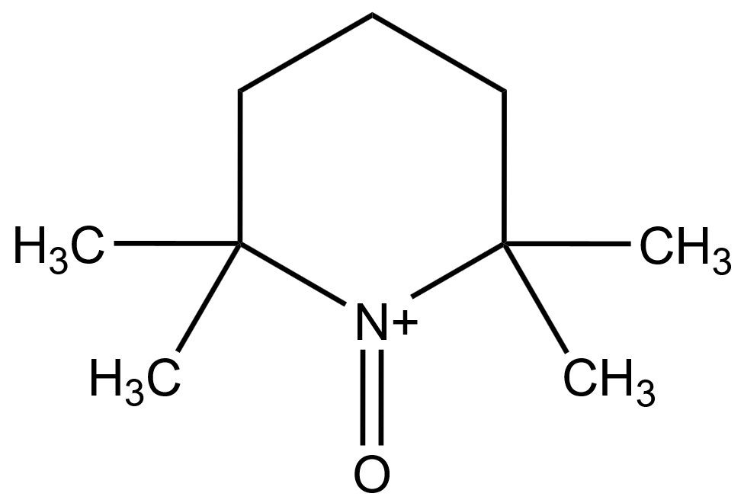
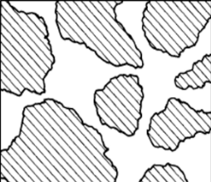




Assessing the versatility of pore network models
Pore network models connect microstructural effects with resulting battery performance
Network
extraction
Organic electrolyte:
Aqueous electrolyte:
$${ Fe}^{2+} _{←}^{→} {Fe}^{3+}+ e^{−}$$
$_{←}^{→}$ $+ e^{−}$
Void
Solid
Iterative algorithm:
1. Fluid transport
2. Species transport
3. Charge transport

Slide 9
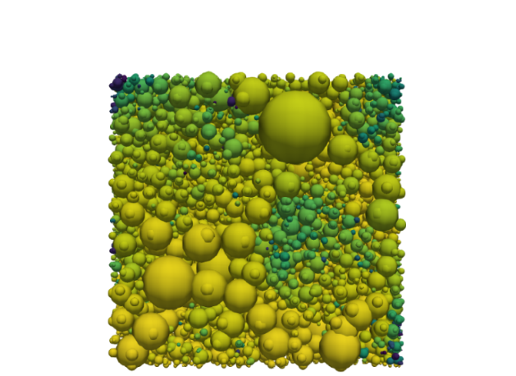
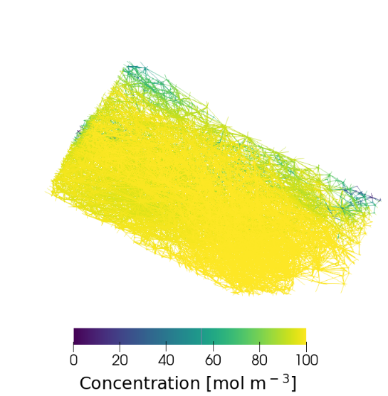
Assessing the versatility of pore network models
Pore network models connect microstructural effects with resulting battery performance
Network
extraction
Current profile:
Concentration profile:
Void
Length [-]
Current [-]
Solid
Iterative algorithm:
1. Fluid transport
2. Species transport
3. Charge transport
Thickness [-]
Flow direction
250 μm
Current [A m⁻³]
Concentration [mol m⁻³]
10³ 10⁵
0 100

Slide 10
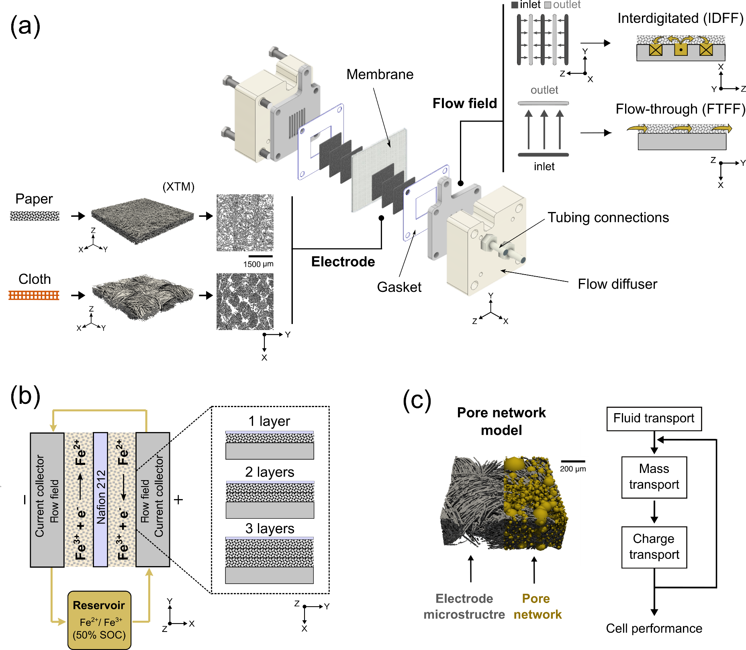
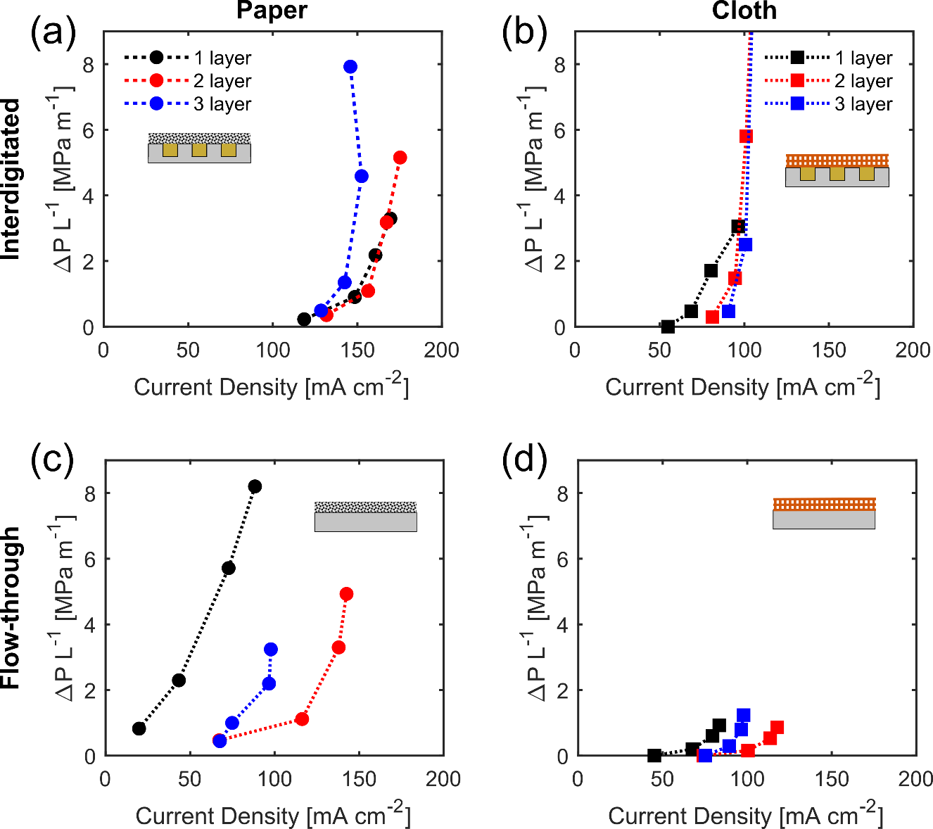


The influence of the flow field and electrode thickness
Co-design of electrode and flow field geometry is necessary for efficient system operation

Slide 11
Engineering porous electrodes for redox flow batteries
Bottom-up design of porous electrodes
Pore network
model
Genetic
optimization
Cell-level
imaging
Additive
manufacturing
500 μm
500 μm
Network extraction
Pore simulations
Parameter analysis
Bottom-up design
Pore-level
Self-evolving
Operando
Neutron radiography
Redox chemistries
3D printing
Structural freedom
Carbon electrodes

Slide 12
Genetic optimization of electrode structures
Bimodal pore size distribution enhances the performance
Generation
Selection
Crossover
Increased fitness:
↑ Electrochemical power
↓ Pumping power
Genes
Selection
Mutation
Generation
Termination
How does the optimized electrode look like?
Fitness
Pumping power
Electrical power
Generation
Generation
Generation

Slide 13


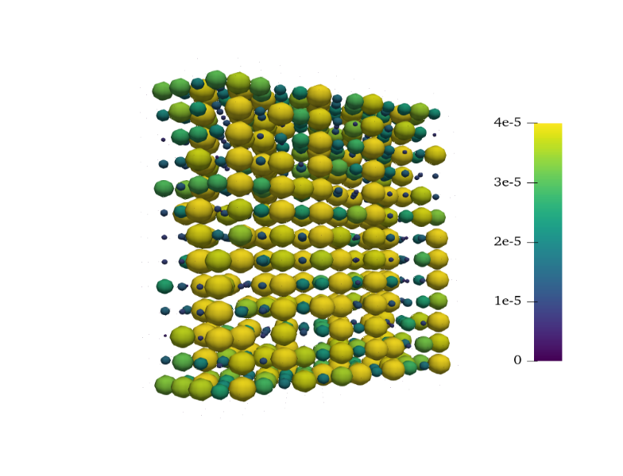
Genetic optimization of electrode structures
Bimodal pore size distribution enhances the performance
Generation
Selection
Crossover
Increased fitness:
↑ Electrochemical power
↓ Pumping power
Genes
Selection
Mutation
Generation
Termination
Can we optimize more realistic structures?
1000 generations
Membrane
Pore diameter [μm]
Thickness
0 10 20 30 40
Current collector
Flow direction
100 μm

Slide 14
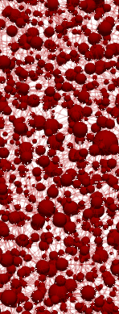
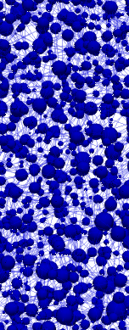
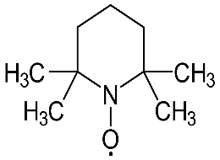
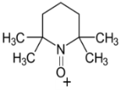
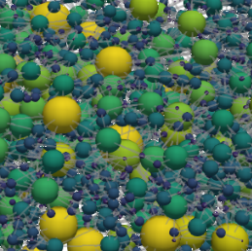
Towards realistic battery operation
Unique electrode structures are needed for a given reactor design and operating conditions
Microstructural freedom:
Reactor parameters:
Load
Diameter
change
Merging and
splitting
Chemistry
e⁻
Anode
Cathode
VO²⁺
e⁻
e⁻
A^{(n-1)+}
A^{(n-1)+}
VO₂⁺
Membrane
e⁻
Flow field
A^{n+}
A^{n+}
Ordered
Random
Flow-through Interdigitated

Slide 15
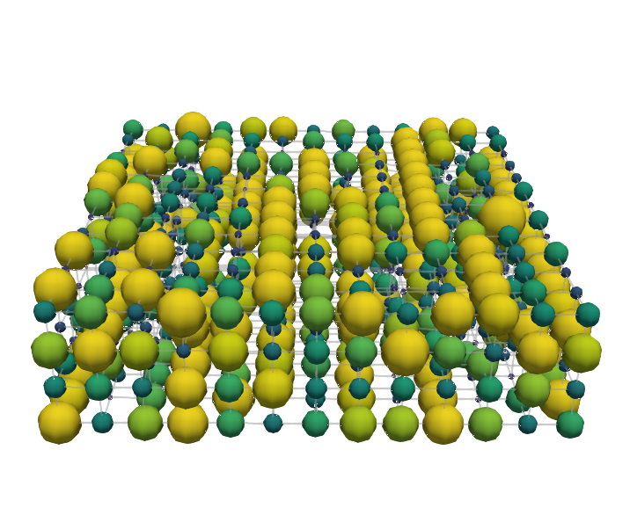

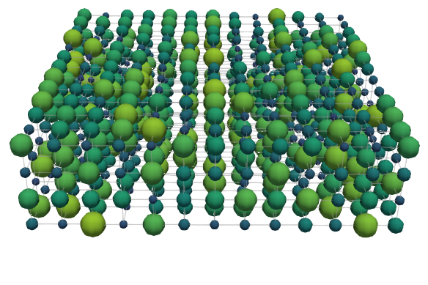
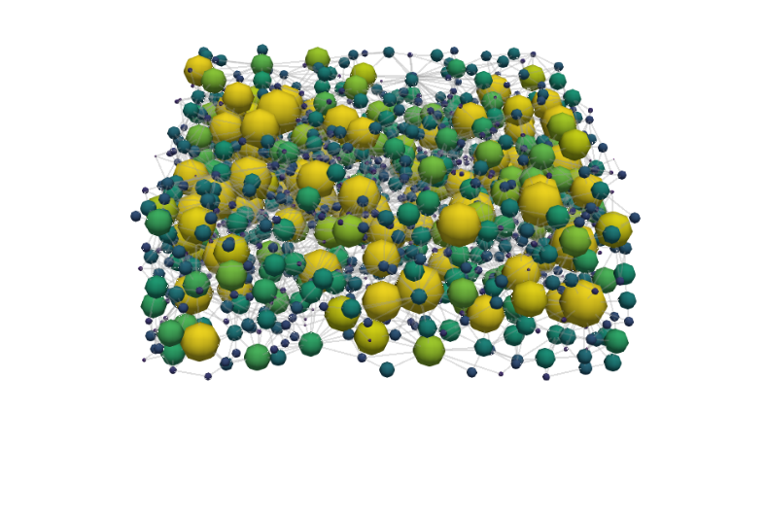
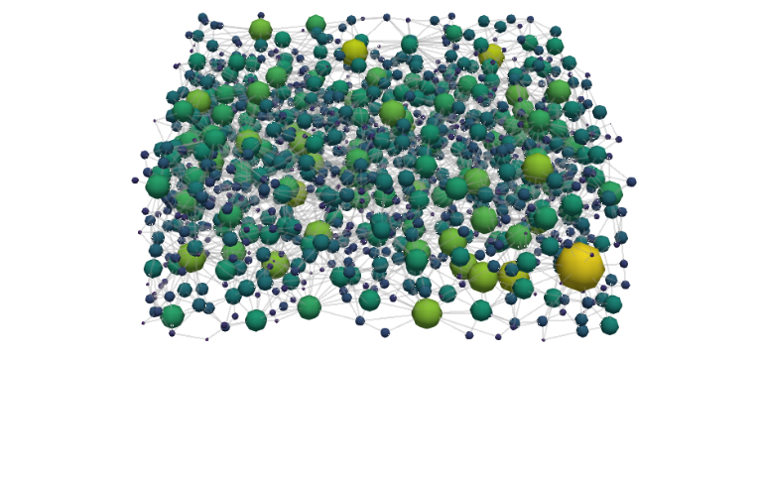
Towards realistic battery operation
Enhancing the performance of conventional electrode designs
Cubic electrode
Vanadium electrolyte:
Generation 1
Generation 1000
v = 1.5 cm s⁻¹
1000 generations
Pore diameter [μm]
z
0 10 20 30 40
y
x
Flow direction
100 μm
Conventional electrode
100 μm

Slide 16
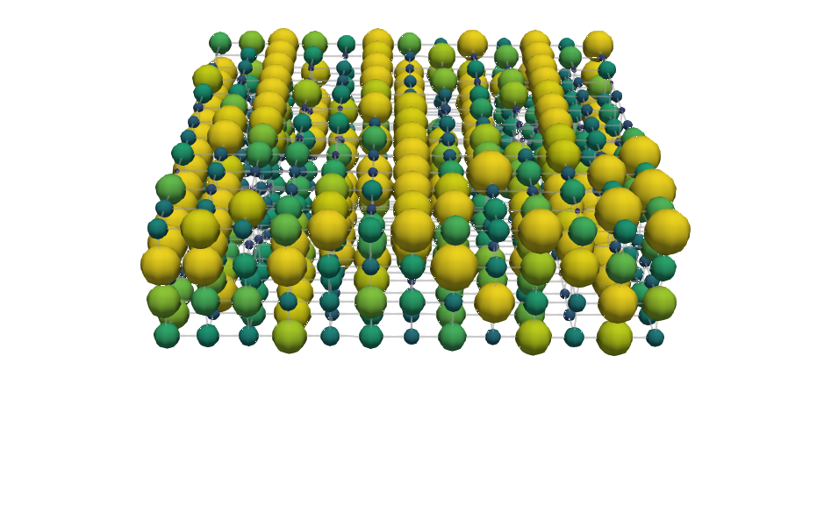
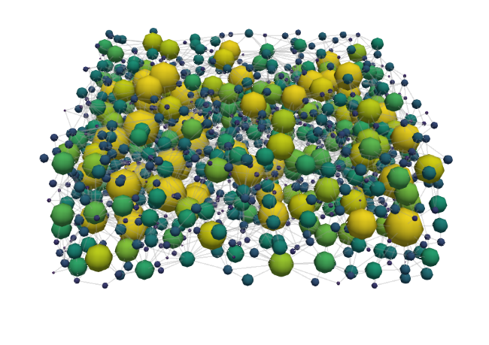
The effect of the electrolyte chemistry on the electrode optimization
The trade-off between electrochemically active surface area and through-plane conductivity
Vanadium electrolyte
TEMPO electrolyte
Generation 1000
v = 1.5 cm s⁻¹
Cubic electrode
Flow direction
100 μm
Conventional
100 μm

Slide 17
Engineering porous electrodes for redox flow batteries
Bottom-up design of porous electrodes
Pore network
model
Genetic
optimization
Cell-level
imaging
Additive
manufacturing
500 μm
500 μm
Network extraction
Pore simulations
Parameter analysis
Bottom-up design
Pore-level
Self-evolving
Operando
Neutron radiography
Redox chemistries
3D printing
Structural freedom
Carbon electrodes

Slide 18
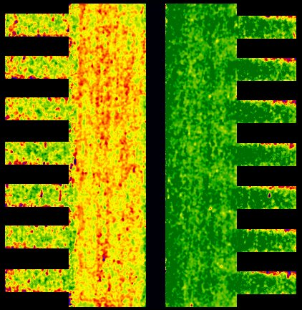
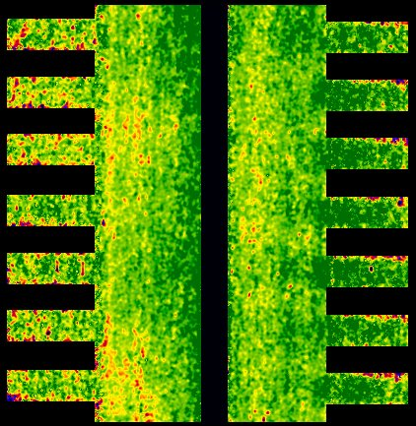
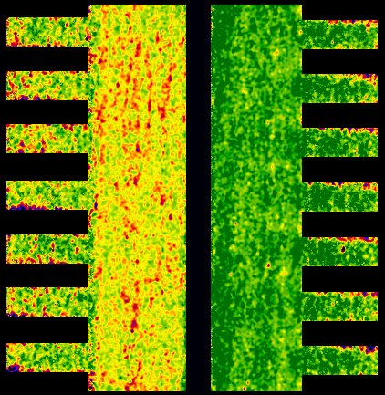
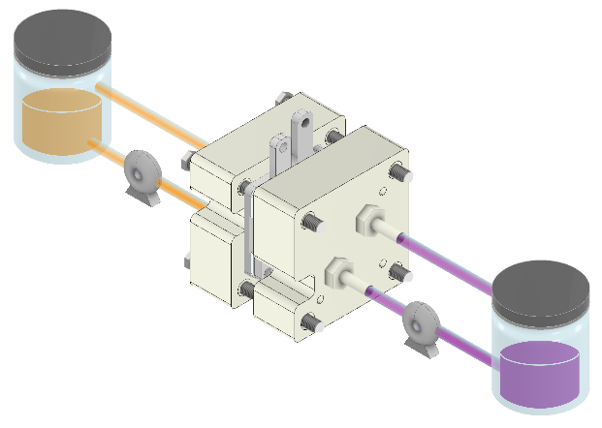
Novel operando neutron radiography approach
Concentration profiles under a voltage bias can be visualized
Cumulative concentration
0.0 M
1.0 M
+
-
+
-
Detector
Tank 1
Reactor
Tank 2
Neutron beam

Slide 19
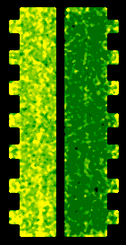
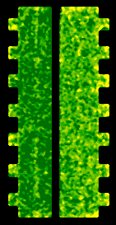
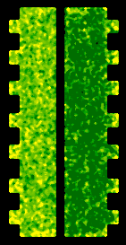
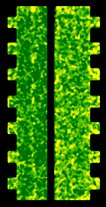
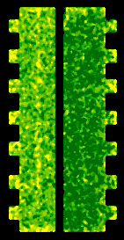
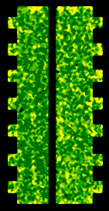



Novel operando neutron radiography approach
Concentration profiles under a voltage bias can be visualized
Supporting electrolyte concentration
[BF₄⁻]
0.0 M
0.5 M
MCP Detector
Flight tube
Pulsed
beam
$$ω$$
Reactor
Chopper
Time of Flight
based energy
separation
Neutron
beam

Slide 20
Engineering porous electrodes for redox flow batteries
Bottom-up design of porous electrodes
Pore network
model
Genetic
optimization
Cell-level
imaging
Additive
manufacturing
500 μm
500 μm
Network extraction
Pore simulations
Parameter analysis
Bottom-up design
Pore-level
Self-evolving
Operando
Neutron radiography
Redox chemistries
3D printing
Structural freedom
Carbon electrodes

Slide 21



From 3D printing plastic to conductive electrodes
Customized and tunable 3D printed electrodes can be manufactured
1 cm
Oxidation
Printing platform
Carbonization
Cured
model
Liquid resin
Flow cell testing
Resin tank
UV light
Light source
Mirror
Lens

Slide 22












From 3D printing plastic to conductive electrodes
Customized and tunable 3D printed electrodes can be manufactured
Compared to commercial electrodes
Pillar structures
Paper
Cloth
Square
Triangle
100 $\text{μm}$
100 $\text{μm}$
1 cm
Oxidation
3D print
2 mm
Cylinder
Helix
Carbonization
1000 $\text{μm}$
Flow cell testing

Slide 23







Engineering porous electrodes for redox flow batteries
Additive manufacturing of porous electrodes
Additive
manufacturing
Metal
3D printing
Topology
optimization
Cell-level
imaging
500 μm
100 μm
Structural freedom
Carbon electrodes
Advanced designs
Metal electrodes
Stereolithography
Reduction
Bottom-up design
Flow fields
Continuum
Operando
Confocal imaging
Cell design

Slide 24





Next step - Engineering porous electrodes for redox flow batteries
Additive manufacturing of porous electrodes
Pillar design impacts mass transport
Advanced designs - TPMS
Square
Triangle
Gyroid
IWP
1 cm
Oxidation
Cubic
lattice
2 mm
Primitive
Diamond
Cylinder
Helix
Carbonization
1 mm
Flow cell testing

Slide 25


January 1st – Assistant Professor at the University of Waterloo, Canada
Advanced Manufacturing of Electrochemical Devices
Multiphase mass transport
Component optimization
Advanced manufacturing
e⁻
Multi-layers
Platform
Flooding
Integrated
Tank
Light source
Electrochemical devices
Microreactors
–
Imaging approaches
Computational fluid dynamics
Reactor design and operation
conditions dependent optimized
transport layers
–
Computational optimization
Layer integration
Manufacturing techniques
Materials engineering
–
Structure design
Surface chemistry
25

Slide 26










Acknowledgments
Antoni Forner-Cuenca, Rik van Gorp, Vanesa Muñoz Perales (UC3M), Rémy Jacquemond, and Emre Burak Boz
Gabor Szendrei, Victor de Haas, Marit Kroese, Jacky Olinga, Mojtaba Barzegari, Zandrie Borneman, and the rest of EMS
UW: Jeff Gostick, Mohammad Amin Sadeghi
PSI: Pierre Boillat, Eric Ricardo Carreon Ruiz
MIT: Fikile Brushett, Kevin Tenny, Katharine Greco
Contact:
m.v.d.heijden@tue.nl
maximeheijden@outlook.nl
https://maximevdheijden.github.io/
Till December 31st: Starting January 2025:

