Slide 1
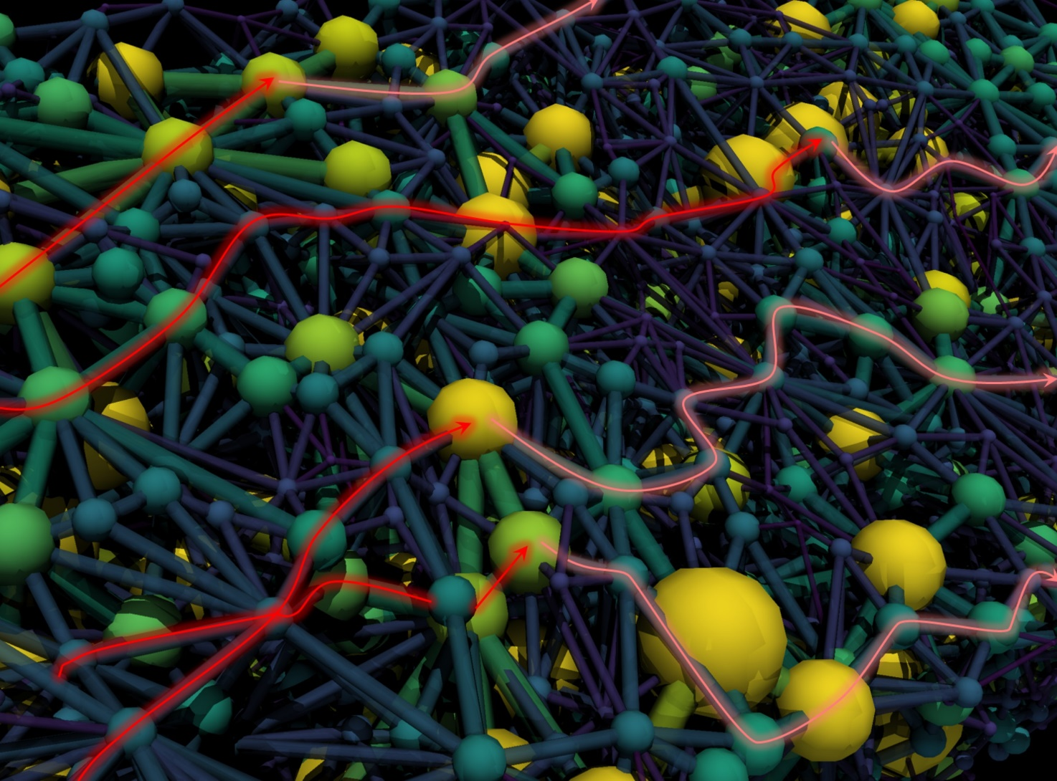

A Versatile Optimization Framework for Porous Electrode Design: Coupling a Genetic Algorithm and a Pore Network Model
Maxime van der Heijden, Gabor Szendrei, Victor de Haas, and Antoni Forner Cuenca
2024 AIChE Annual Meeting
October 29th, 2024

Slide 2
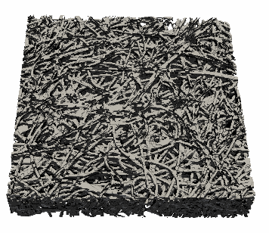
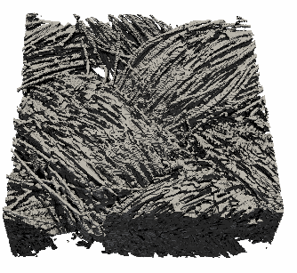
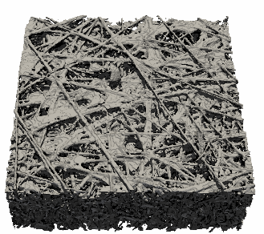
Urgent need for renewable technologies and energy storage at a large scale
We need tailored electrode microstructures for redox flow batteries
Porous electrodes
Load
e⁻
Anode
Cathode
A^{n+}
A^{n+}
250 μm
250 μm
250 μm
Current collector
Membrane
e⁻
Anolyte
Catholyte
Key properties:
- Surface area
- Permeability
- Mass transport
- Conductivity
A^{(n-1)+}
A^{(n-1)+}
Ions
Ions
Pump
Pump
A^{(n-1)+} → A^{n+} + e⁻

Slide 3
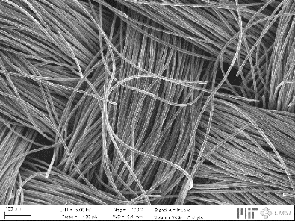
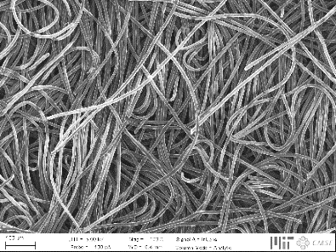
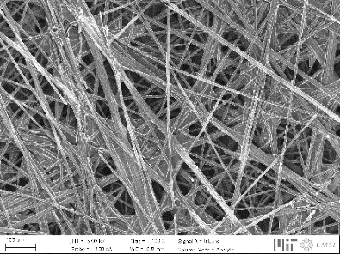
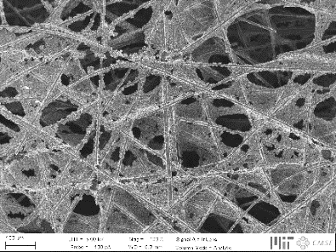
Urgent need for renewable technologies and energy storage at a large scale
Engineering porous materials for electrochemical devices
Current generation not optimized, affecting three major losses:
↓ Pressure drop
↑ Electrochemical performance
Activation losses
Ohmic losses
Mass transport losses
Hierarchical organization
200 μm

Slide 4
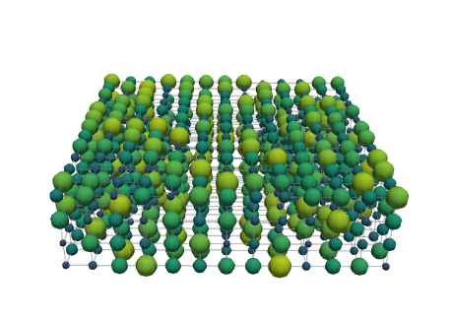
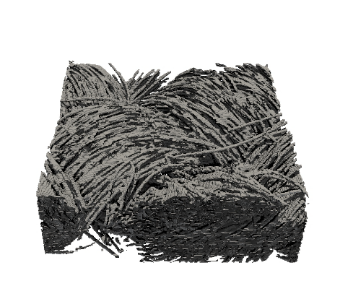
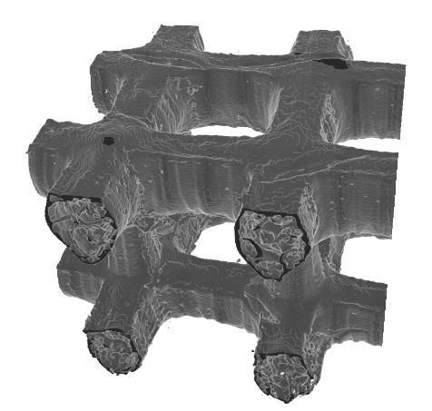
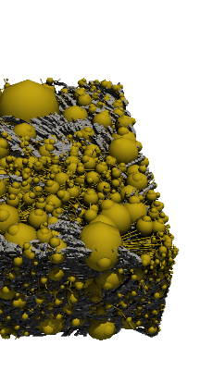
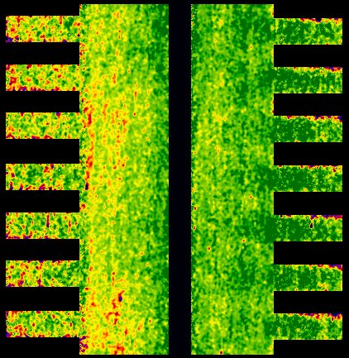
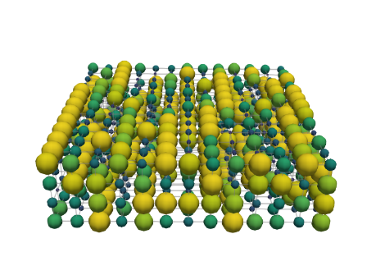
Engineering porous electrodes for redox flow batteries
Bottom-up design of porous electrodes
Pore network
model
Genetic
optimization
Cell-level
imaging
Additive
manufacturing
500 μm
500 μm
Network extraction
Pore simulations
Parameter analysis
Bottom-up design
Pore-level
Self-evolving
Operando
Neutron radiography
Redox chemistries
3D printing
Structural freedom
Carbon electrodes

Slide 5
Genetic optimization of electrode structures
Bimodal pore size distribution enhances the performance
Generation
Selection
Crossover
Increased fitness:
↑ Electrochemical power
↓ Pumping power
Genes
Selection
Mutation
Generation
Termination
How does the optimized electrode look like?
Fitness
Pumping power
Electrical power
Generation
Generation
Generation

Slide 6


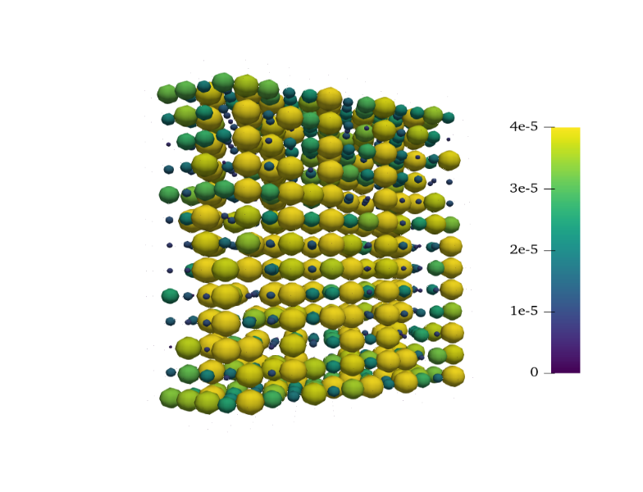
Genetic optimization of electrode structures
Bimodal pore size distribution enhances the performance
Generation
Selection
Crossover
Increased fitness:
↑ Electrochemical power
↓ Pumping power
Genes
Selection
Mutation
Generation
Termination
Can we optimize more realistic structures?
1000 generations
Membrane
Pore diameter [μm]
Thickness
0 10 20 30 40
Current collector
Flow direction
100 μm

Slide 7
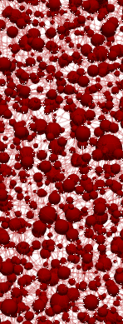
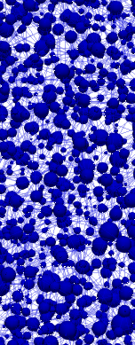
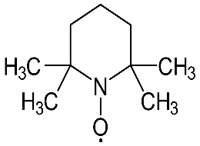
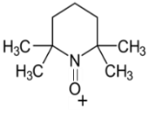
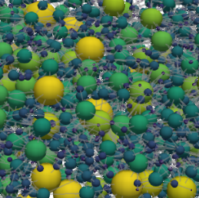
Towards realistic battery operation
Unique electrode structures are needed for a given reactor design and operating conditions
Microstructural freedom:
Reactor parameters:
Load
Diameter
change
Merging and
splitting
Chemistry
e⁻
Anode
Cathode
VO²⁺
e⁻
e⁻
A^{(n-1)+}
A^{(n-1)+}
VO₂⁺
Membrane
e⁻
Flow field
A^{n+}
A^{n+}
Ordered
Random
Flow-through Interdigitated

Slide 8
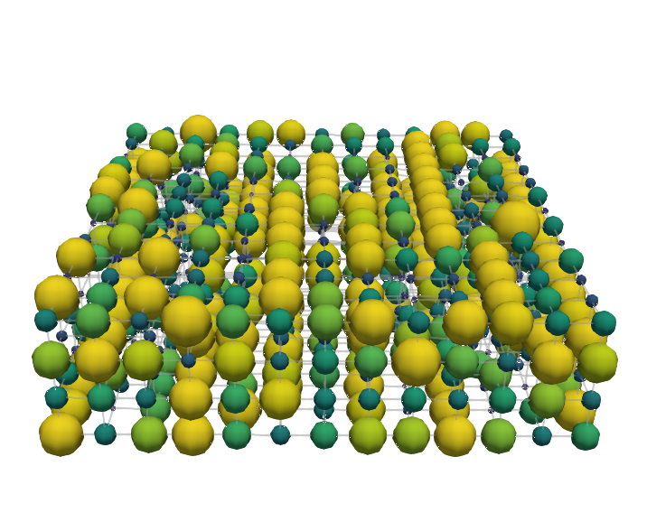

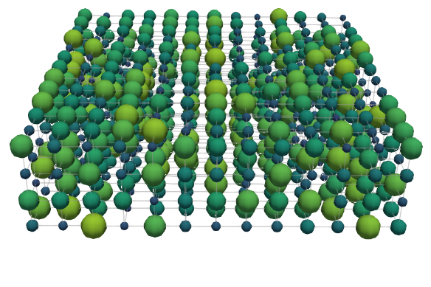
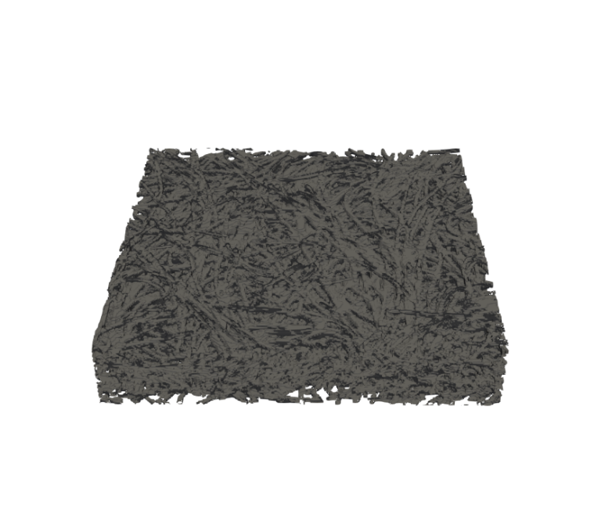
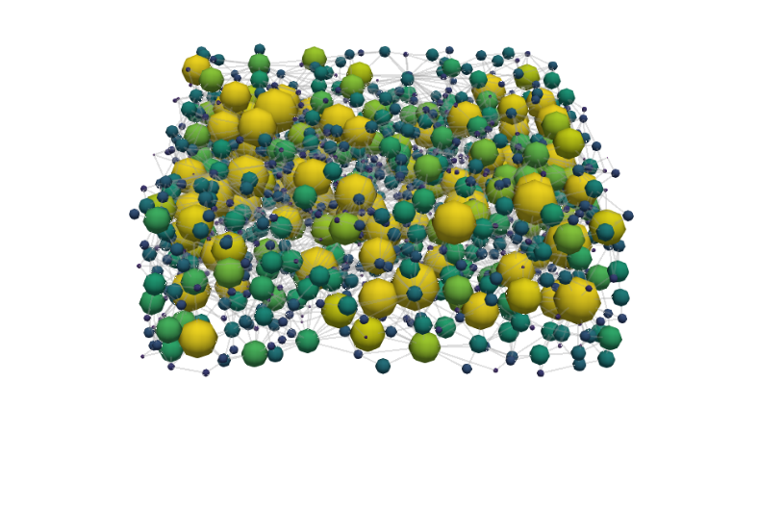
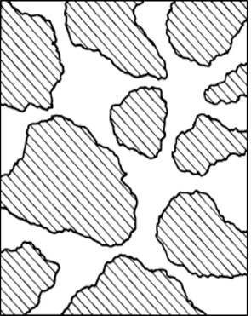

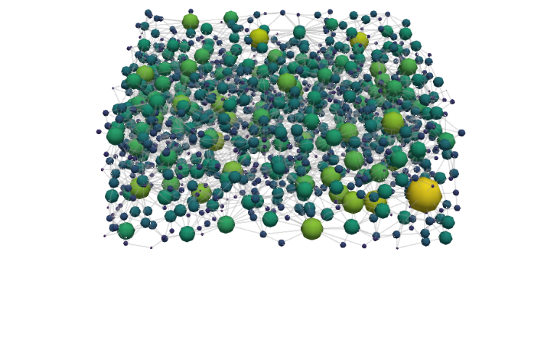
Towards realistic battery operation
Enhancing the performance of conventional electrode designs
Cubic electrode
Vanadium electrolyte:
Generation 1
Generation 1000
v = 1.5 cm s⁻¹
1000 generations
Pore diameter [μm]
z
0 10 20 30 40
y
x
Flow direction
100 μm
Conventional electrode
Void
X-ray tomography
Watershed segmentation
Solid
100 μm

Slide 9
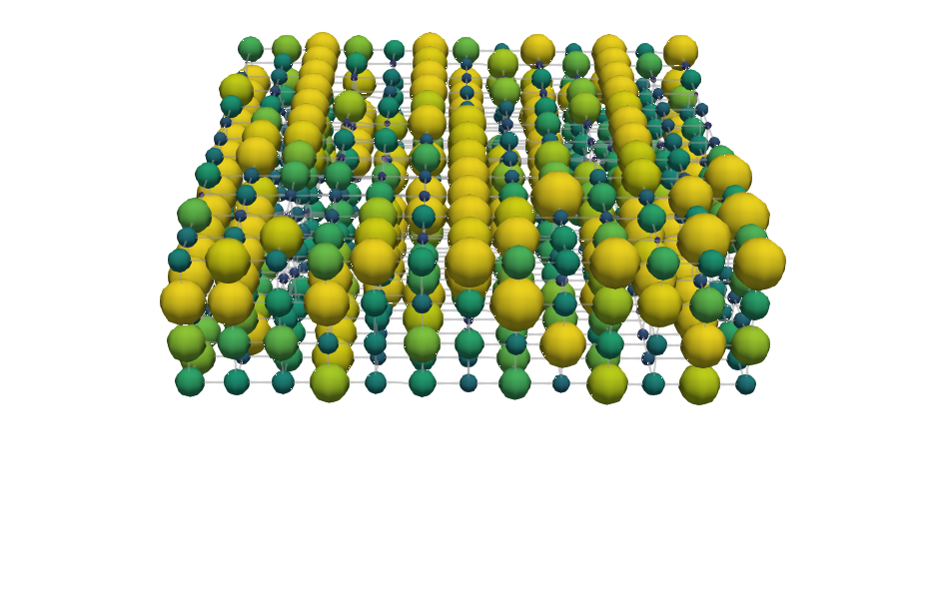
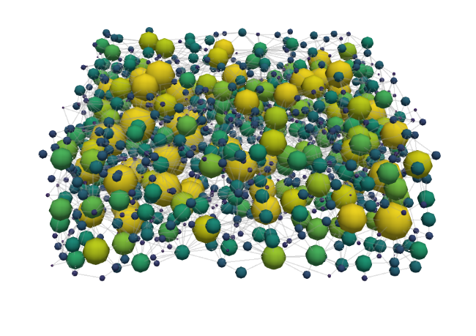
The effect of the electrolyte chemistry on the electrode optimization
The trade-off between electrochemically active surface area and through-plane conductivity
Vanadium electrolyte
TEMPO electrolyte
Generation 1000
v = 1.5 cm s⁻¹
Cubic electrode
Flow direction
100 μm
Conventional
100 μm

Slide 10
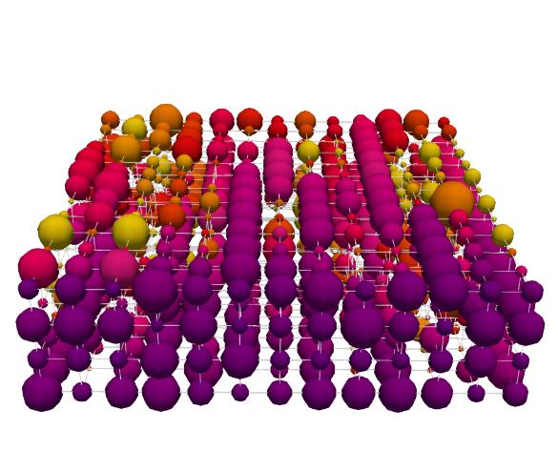
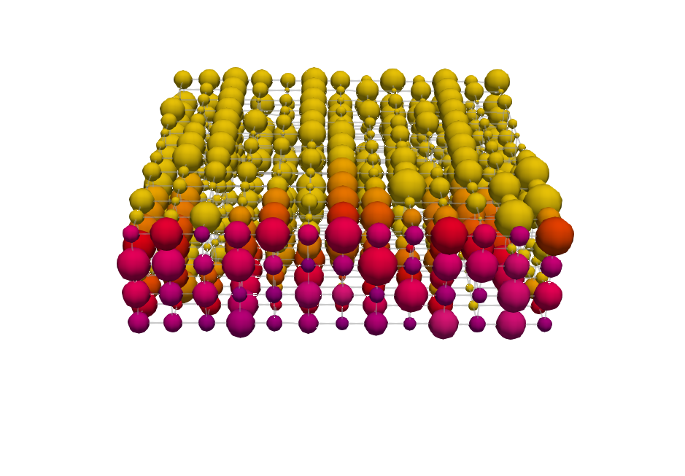
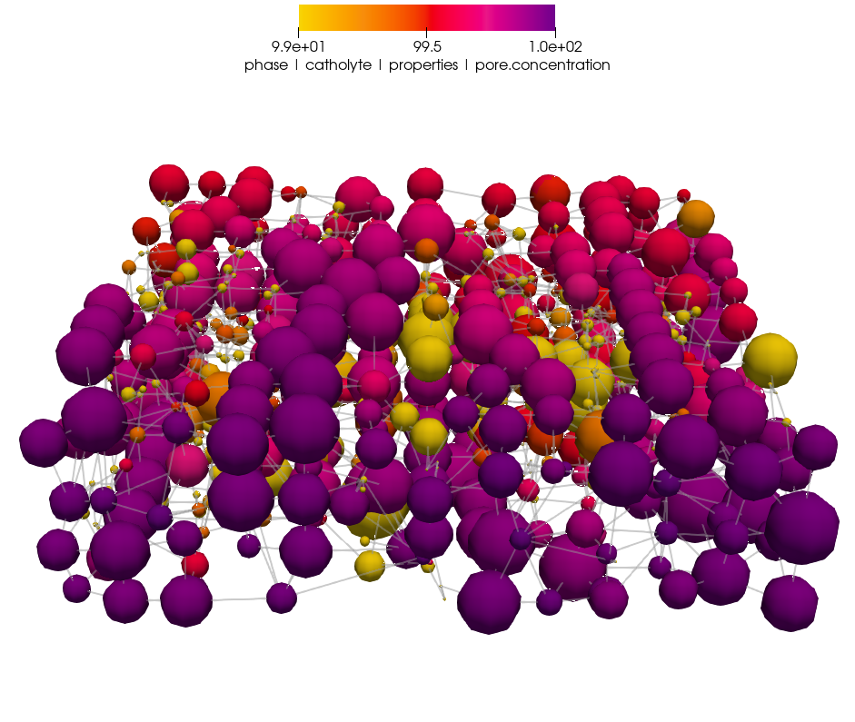
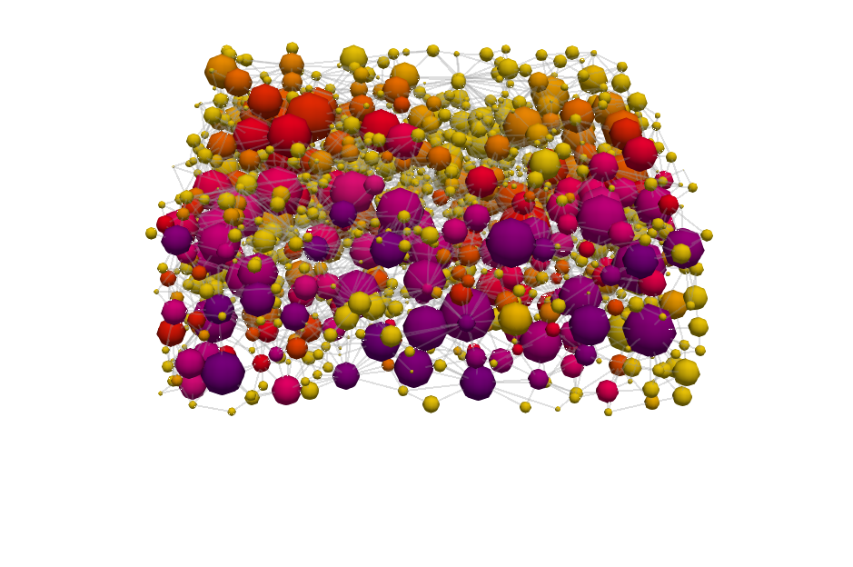
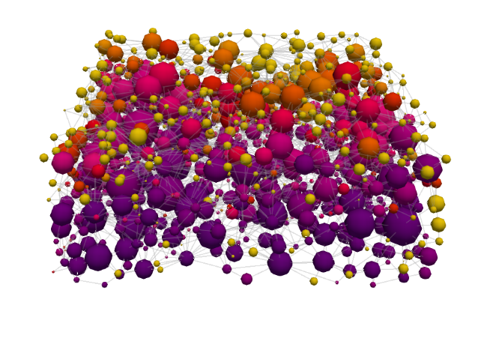
The effect of the electrolyte chemistry on the electrode optimization
The trade-off between electrochemically active surface area and through-plane conductivity
Vanadium electrolyte
TEMPO electrolyte
Generation 1000
Cubic electrode
Flow direction
100 μm
Concentration [mol m⁻³]
99 99.5 100
Conventional
100 μm

Slide 11
Towards realistic battery operation
Unique electrode structures are needed for a given reactor design and operating conditions
Microstructural freedom:
Reactor parameters:
Load
Diameter
change
Merging and
splitting
Chemistry
e⁻
Anode
Cathode
VO²⁺
e⁻
e⁻
A^{(n-1)+}
A^{(n-1)+}
VO₂⁺
Membrane
e⁻
Flow field
A^{n+}
A^{n+}
Ordered
Random
Flow-through Interdigitated

Slide 12
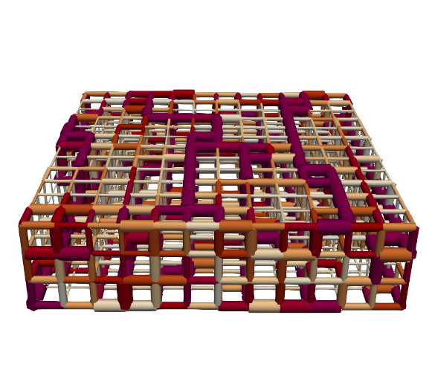
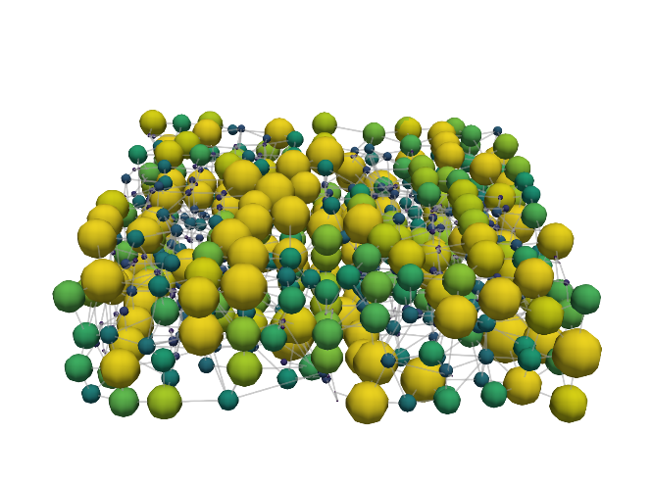
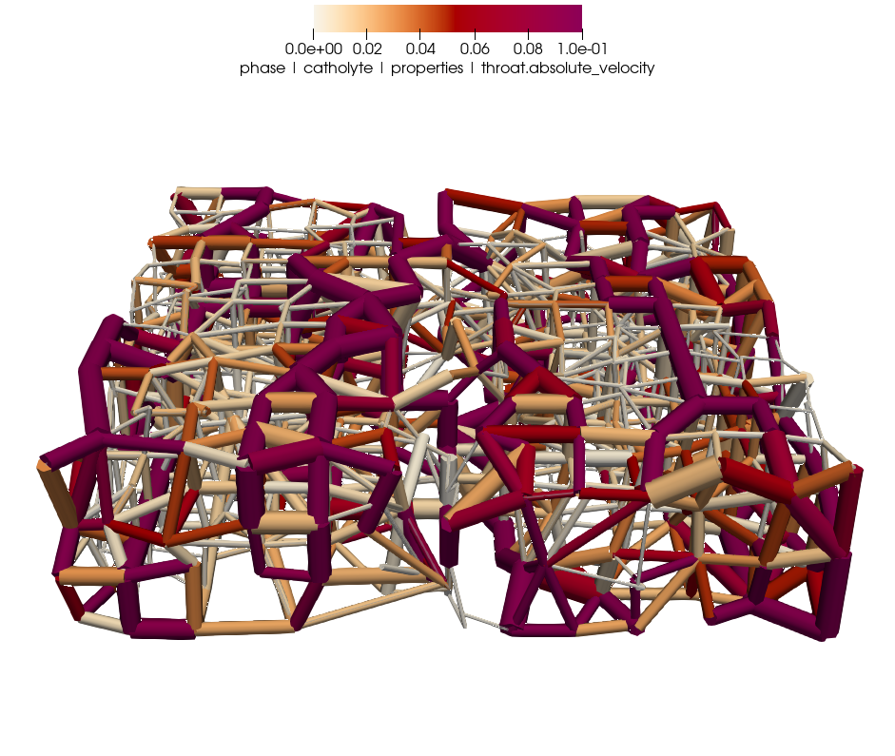
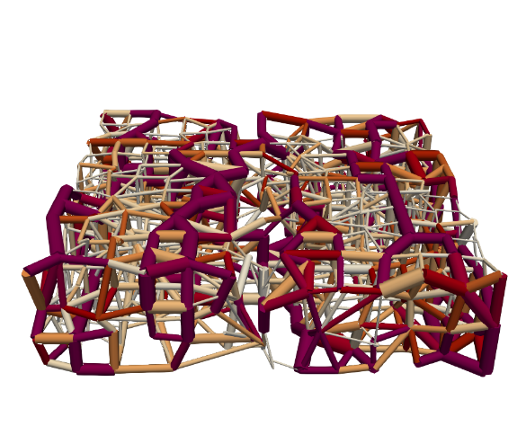
Incorporating design flexibility by pore merging and splitting
Going beyond fixed lattice positions
Mutation
Velocity maps:
Generation 1
Generation 1000
1000 generations
Pore diameter [μm]
Mutation
z
0 10 20 30 40
y
x
Flow direction
100 μm
Absolute velocity [m s⁻¹]
Mutation + Merging and Splitting
0 0.02 0.04 0.06 0.08 0.1

Slide 13
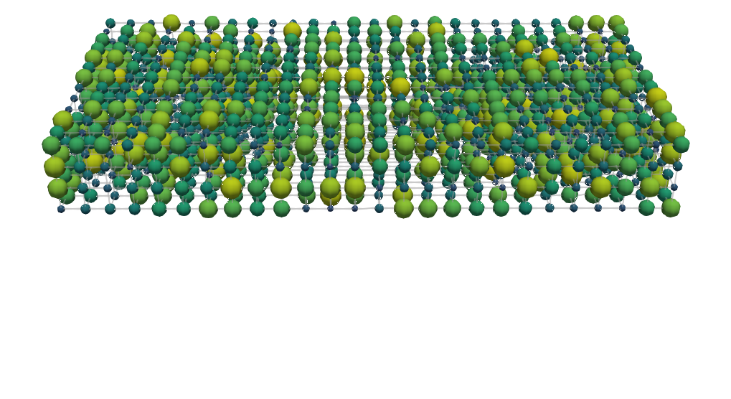
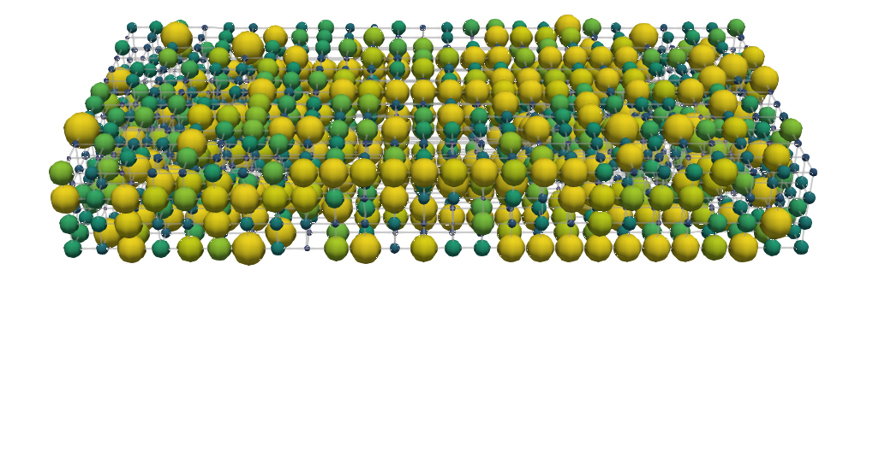
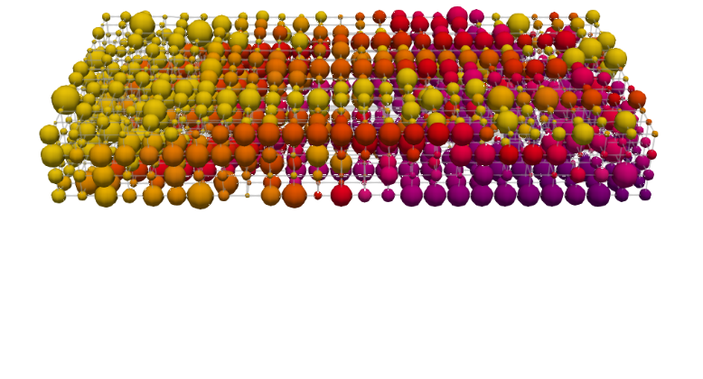
The influence of flow field induced flow pathways in the electrode
Optimization based on the flow field geometry
Flow-through flow field
Species concentration:
Generation 1
Generation 1000
1000 generations
Outlet
Pore diameter [μm]
z
0 10 20 30 40
y
How do we move forward?
Inlet
x
Flow direction
100 μm
Concentration [mol m⁻³]
Interdigitated flow field
99 99.5 100
Outlet
Inlet
Outlet
Rib
Inlet

Slide 14
Engineering porous electrodes for redox flow batteries
Bottom-up design of porous electrodes
Pore network
model
Genetic
optimization
Cell-level
imaging
Additive
manufacturing
500 μm
500 μm
Network extraction
Pore simulations
Parameter analysis
Bottom-up design
Pore-level
Self-evolving
Operando
Neutron radiography
Redox chemistries
3D printing
Structural freedom
Carbon electrodes

Slide 15
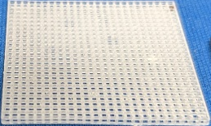
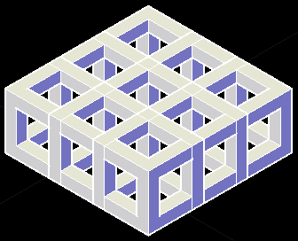
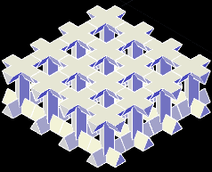
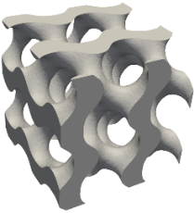
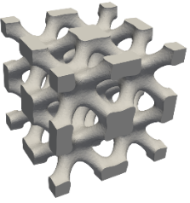

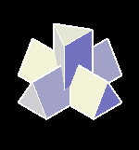
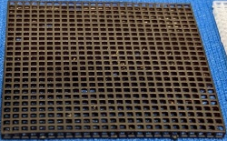
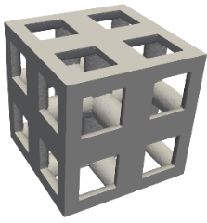
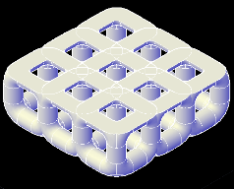
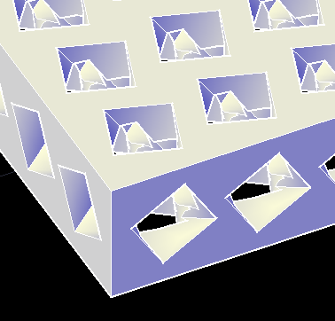





Next step - Engineering porous electrodes for redox flow batteries
Additive manufacturing of porous electrodes
Pillar design impacts mass transport
Advanced designs - TPMS
Square
Triangle
Gyroid
IWP
1 cm
Oxidation
Cubic
lattice
2 mm
Primitive
Diamond
Cylinder
Helix
Carbonization
1 mm
Flow cell testing

Slide 16





Acknowledgments
Gabor Szendrei, Victor de Haas, Rik van Gorp, Jeff Gostick, Mohammad Amin Sadeghi, Mojtaba Barzegari, and Antoni Forner-Cuenca
Contact:
m.v.d.heijden@tue.nl
maximeheijden@outlook.nl
https://maximevdheijden.github.io/
Till December 31st: Starting January 2025:

