Slide 1
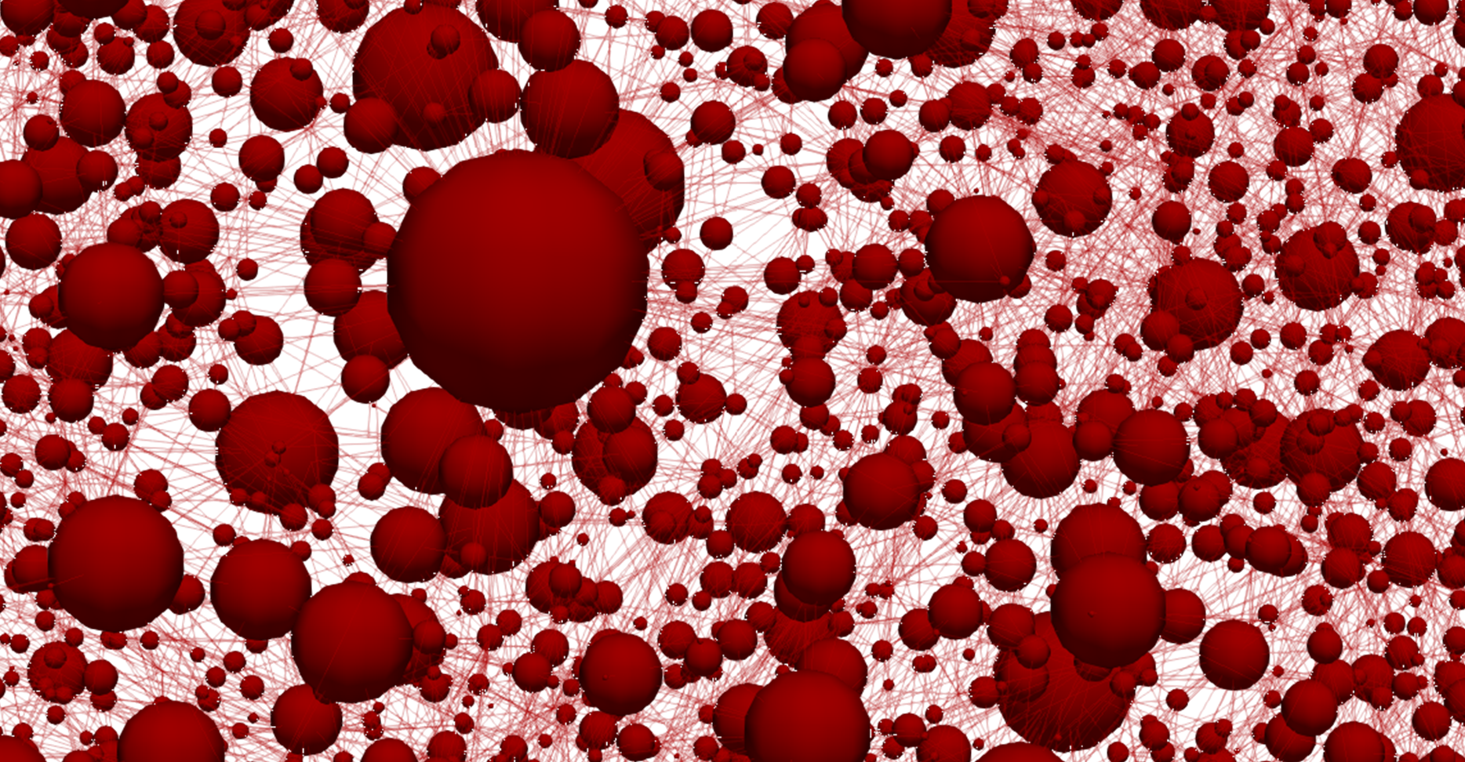
Starting from the bottom: Coupling a genetic algorithm and a pore network model for redox flow battery porous electrode optimization
Maxime van der Heijden, Rik van Gorp, Gabor Szendrei, Victor de Haas, Mohammad Amin Sadeghi, Jeffrey Gostick, and Antoni Forner Cuenca
ModVal 2023 - #19
ModVal 2023 #19, Duisburg, Germany
March 22nd, 2023

Slide 2
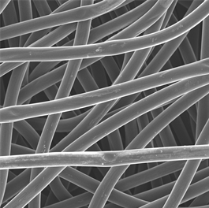

Porous electrode engineering is a multicomplex optimization problem
Key properties:
Surface area ↑
Mass transport ↑
Pressure drop ↓
Mechanical properties ↑
Electrochemical activity ↑
(Electro)chemical stability ↑
Load
e⁻
Anode
Cathode
100 $\text{μm}$
A^{n+}
A^{n+}
Current collector
Membrane
e⁻
Anolyte
Catholyte
A^{(n-1)+}
A^{(n-1)+}
Ions
Ions
A^{(n-1)+} → A^{n+} + e⁻
Pump
Pump

Slide 3
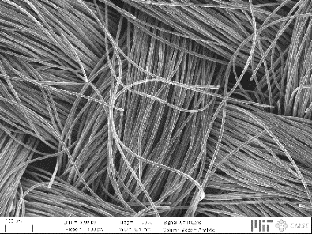
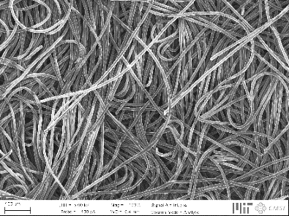
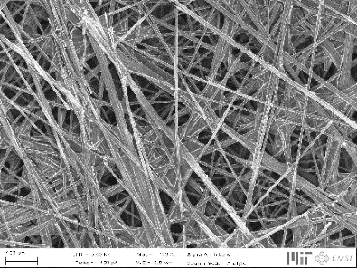
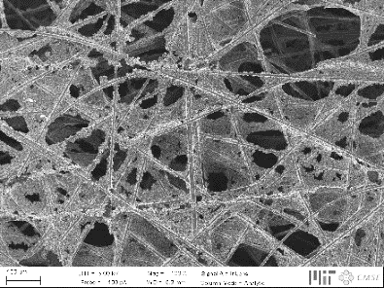
Tailored electrodes for all-liquid systems
Current generation not optimized, affecting three major losses:
↓ Pressure drop
↑ Electrochemical performance
Activation losses
Ohmic losses
Mass transport losses
Hierarchical organization
200 μm

Slide 4


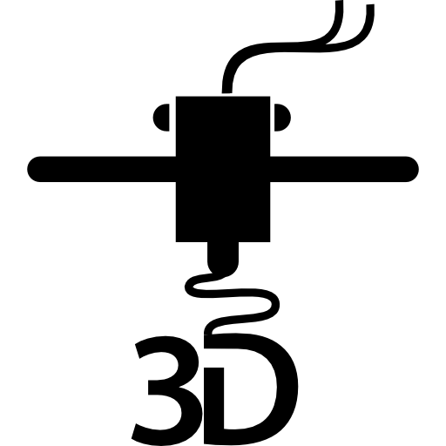
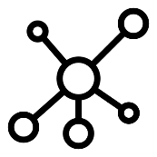
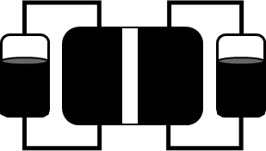
Bottom-up design of porous electrodes
Experimental
characterization
Pore network
model
Genetic
optimization
Advanced
manufacturing
Device
implementation
Battery tests
Chemistries
Imaging
Network extraction
Pore simulations
Parameter analysis
Bottom-up
Theory of evolution
Self-evolving
3D printing
Phase separation
Carbonization
Post-treatment
Durability
Cost analysis

Slide 5
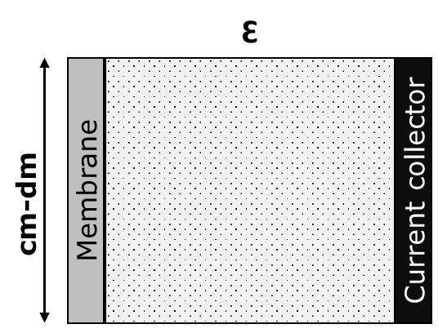
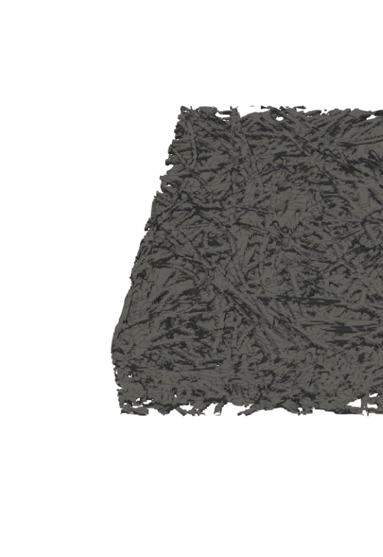
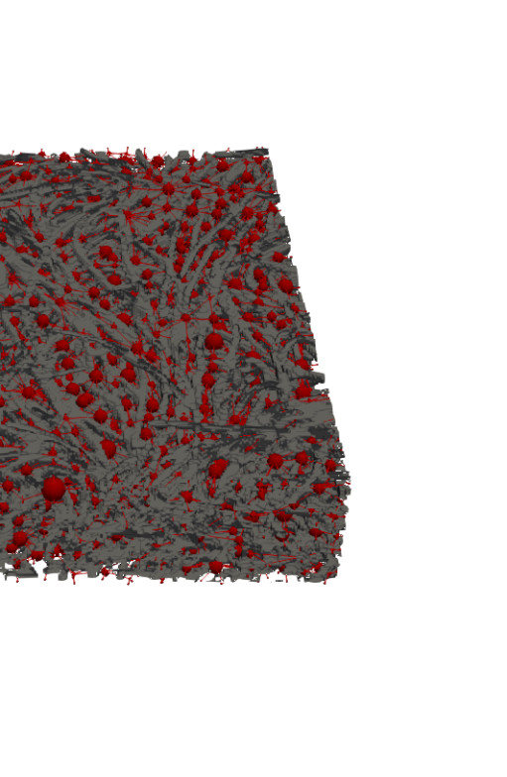
All models are wrong, but some are useful
Level of complexity and detail
Concentration map
0.3 mm
1.0 mm
[mol m⁻³]
Macroscopic continuum model
Pore network model
Lattice Boltzmann model

Slide 6

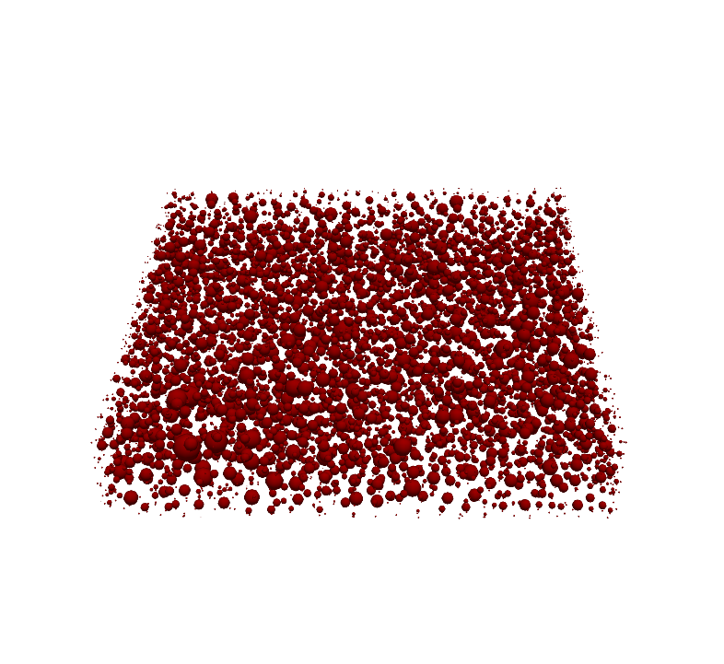
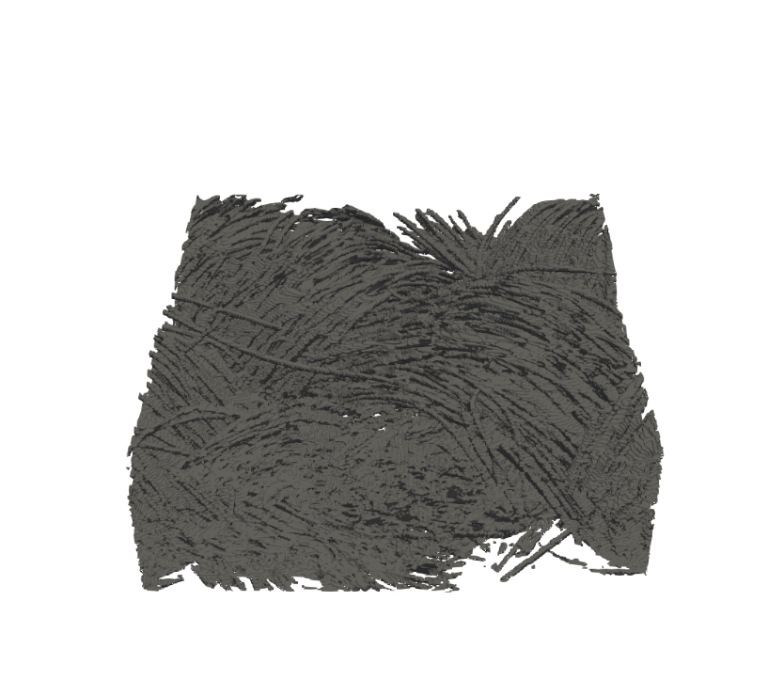
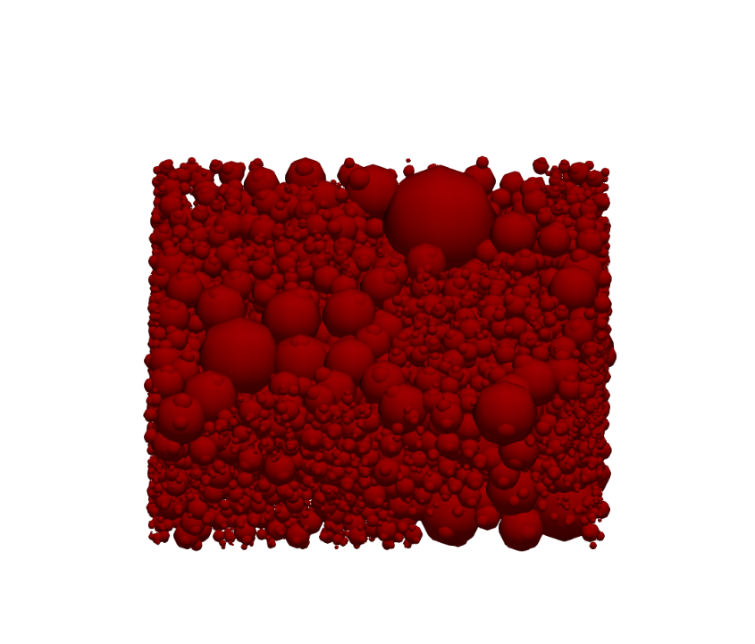
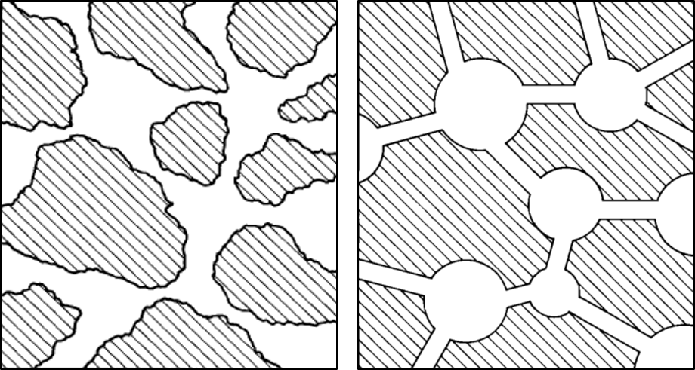
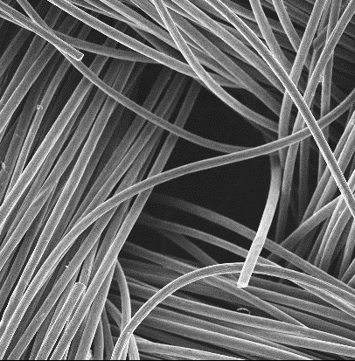



Pore network extraction from a commercial porous electrode
100 $\text{μm}$
X-ray
Tomography
SNOW
Algorithm
z
y
Paper electrode
x
200 μm
100 $\text{μm}$
200 $\text{μm}$
X-ray
Tomography
SNOW
Algorithm
Void
Solid
z
y
Cloth electrode
x
200 μm

Slide 7

Iterative pore network model
Load
Iterative algorithm:
Fluid transport
Charge transport
Species transport
e⁻
Anode
Cathode
A^{n+}
A^{n+}
Coupled
Current collector
Membrane
e⁻
A^{(n-1)+}
A^{(n-1)+}
Ions
Ions

Slide 8
Network-in-series to model species depletion
Iterative algorithm:
Fluid transport
Charge transport
Species transport
Does this model represent reality?
Coupled
17 mm
1 mm

Slide 9
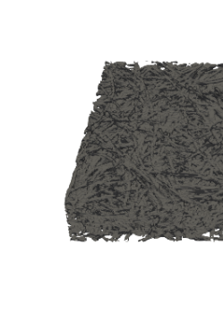
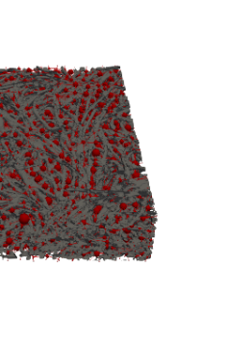
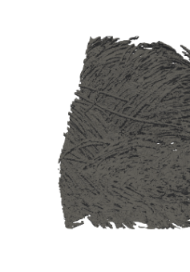
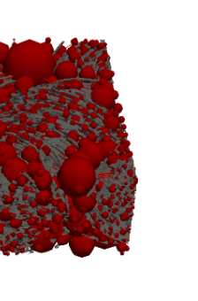
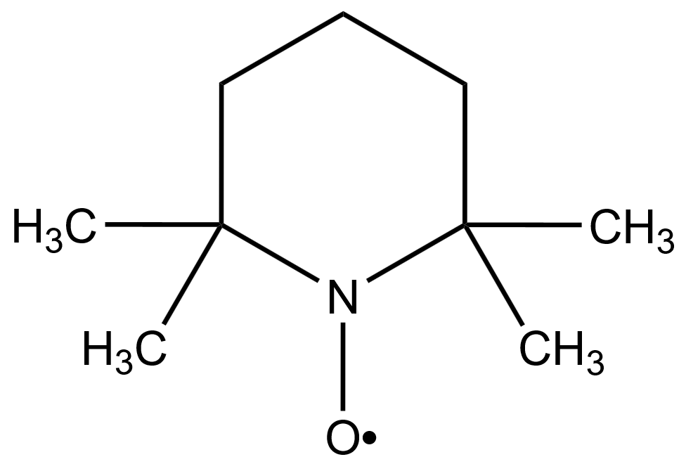
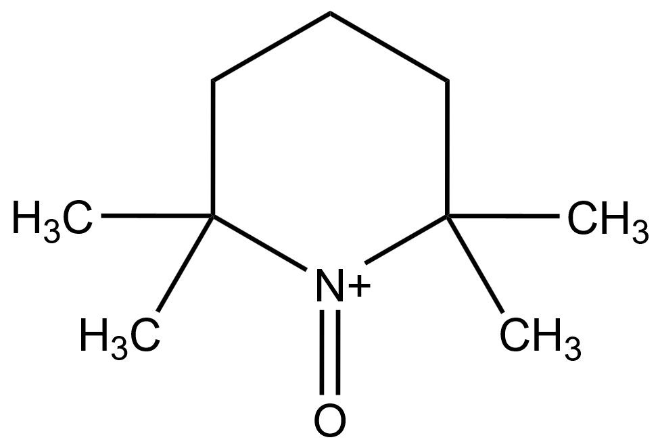
Assessing the versatility and robustness by experimental validation
Symmetric battery design, validated for:
2 Electrodes
3 Velocities
2 Chemistries TEMPO and Iron
Load
e⁻
Anode
Cathode
A^{n+}
A^{n+}
20, 5.0, and 1.5 cm s⁻¹
Current collector
Membrane
e⁻
A^{(n-1)+}
A^{(n-1)+}
Ions
Ions
Fe²⁺
Fe³⁺
Pump

Slide 10
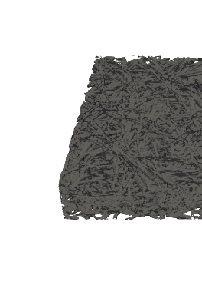
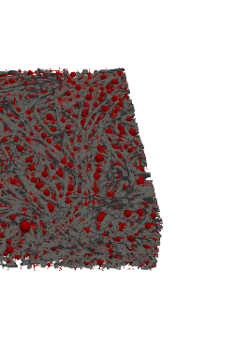
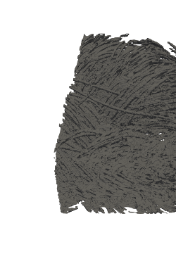
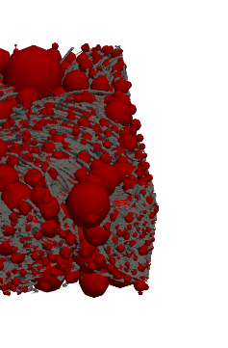
Non-aqueous electrolytes as a model case
Active species: 0.1 M TEMPO. / TEMPO⁺
Salt: 1 M TBAPF₆
Solvent: Acetonitrile
Electrode: Paper
Cloth

Slide 11
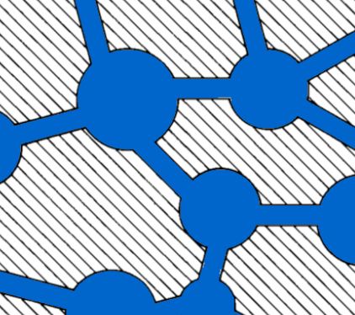

Incomplete wetting of the porous structure frustrates simplified descriptions
Active species: 0.1 M Fe²⁺ / Fe³⁺
Salt: 1 M NaCl
Solvent: Water
Electrode: Paper
Fe²⁺
Fe³⁺
Mass transfer coefficient fitting:
This model is a simplification of reality,
so how can this model be used?
Pore network model: Experiment:

Slide 12
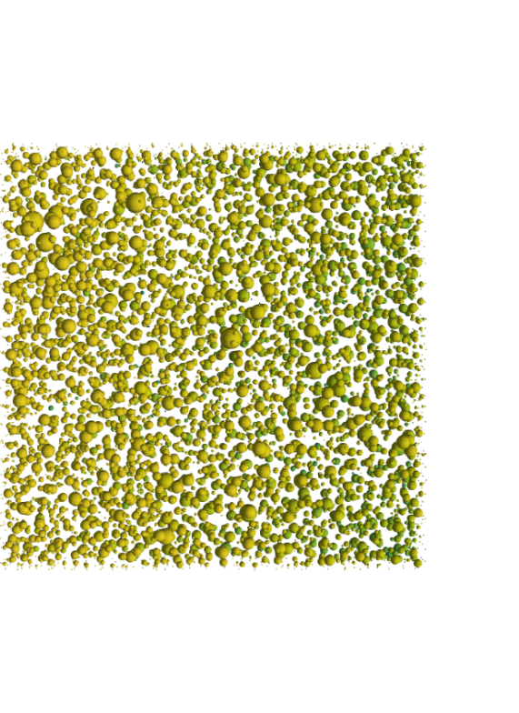
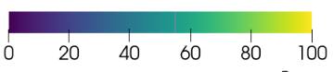
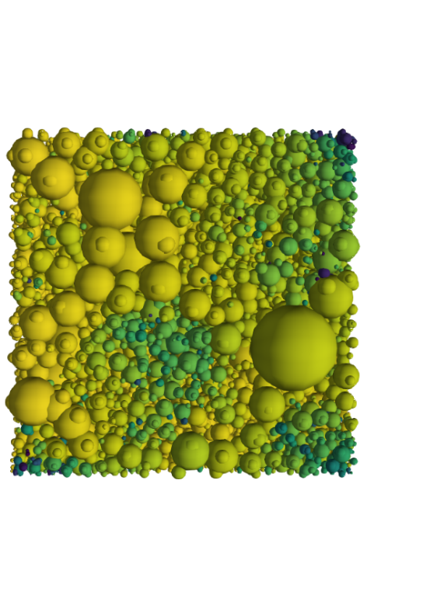
Predicting profiles is the strength of pore network models
0 – 1 mm
Paper electrode
Flow
direction
1.5 cm s⁻¹
0 20 40 60 80 100
Concentration [mol m⁻³]
Cloth electrode
z
x
x
z
y
y

Slide 13
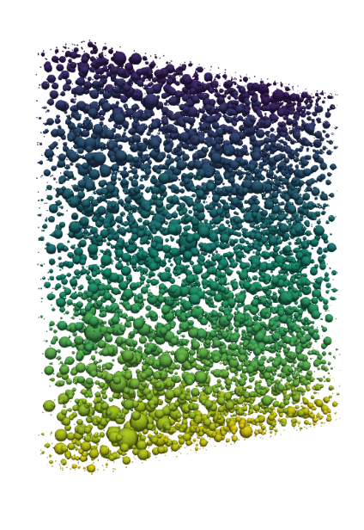
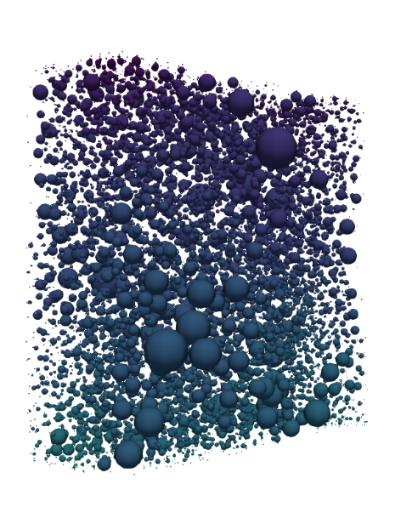
Predicting profiles is the strength of pore network models
0 – 1 mm
Paper electrode
Flow
direction
Membrane
1.5 cm s⁻¹
0 20 40 60 80 100
0 5 10 15 20 25
10³ 10⁴ 10⁵
Concentration [mol m⁻³]
Pressure [MPa]
Current [A m⁻³]
Cloth electrode
z
x
x
y
y
z
x
x
y
y
z
z

Slide 14
Bottom-up design of porous electrodes
Experimental
characterization
Pore network
model
Genetic
optimization
Advanced
manufacturing
Device
implementation
Battery tests
Chemistries
Imaging
Network extraction
Pore simulations
Parameter analysis
Bottom-up
Theory of evolution
Self-evolving
3D printing
Phase separation
Carbonization
Post-treatment
Durability
Cost analysis

Slide 15

Developing a genetic algorithm using the theory of evolution
Gene pool
Population
Parents
$Fitness= \frac{P_{theory}−P_{el}}{P_{theory}+P_{pump}}$
$P_{theory}=1.26 V ∗I$
$P_{el}=η∗I$ → $η=0.5 V$
$P_{pump}=\frac{Q∗∆p}{η_{pump}}$
Generation
Selection
Crossover
N species
1st generation
Selection
Mutation
Criteria
Diameter
Termination
N species
2nd generation

Slide 16


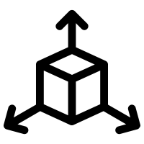

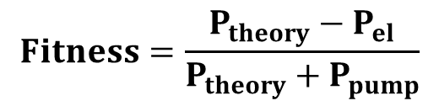
Proof of principle
0.2 M Vanadium, 0.5 V, 1.5 cm s⁻¹
= 50
= 10
= 1000
= [13x13x4]
$$Fitness=\frac{P_{theory}−P_{el}}{P_{theory}+P_{pump}}$$
+ 75% Fitness
- 72% P_{pump}
+ 42% P_{el}
Fitness
Pumping power, P_{pump}
Electrical power, P_{el}

Slide 17
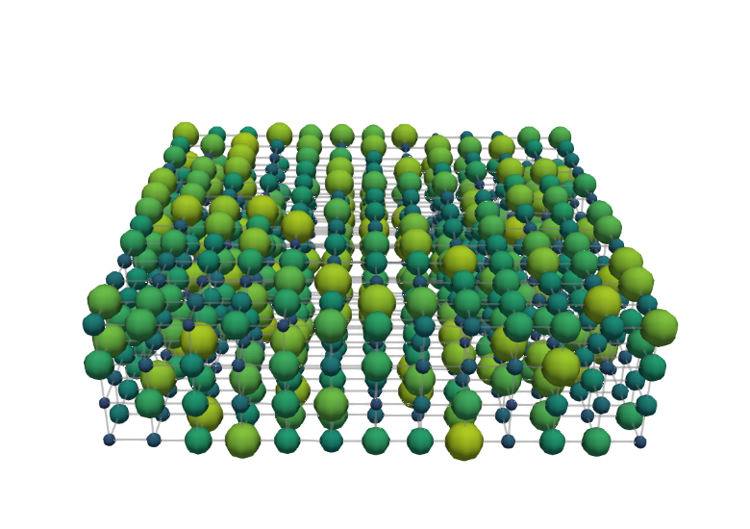
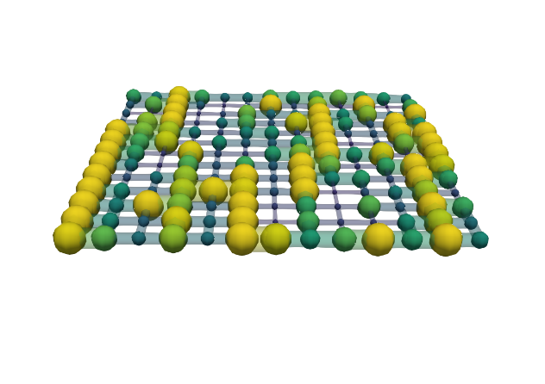
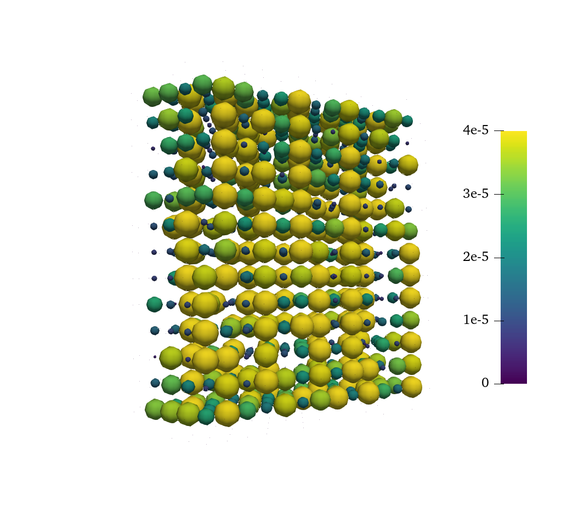
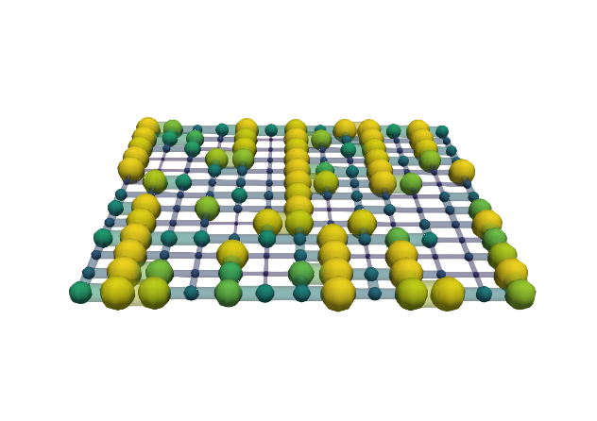
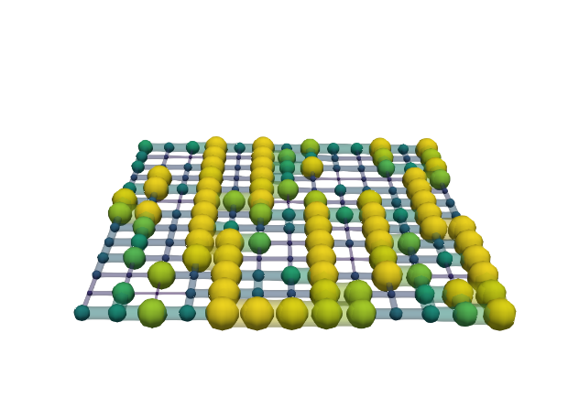
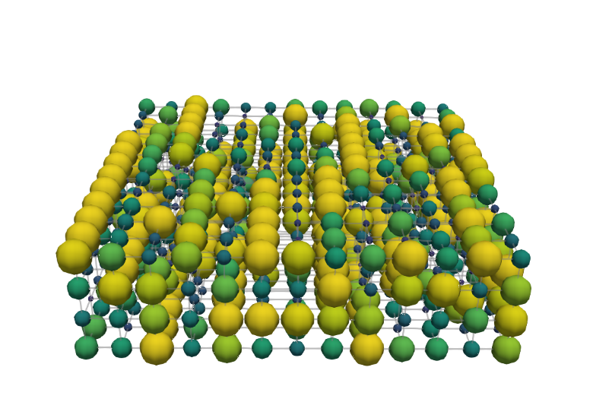
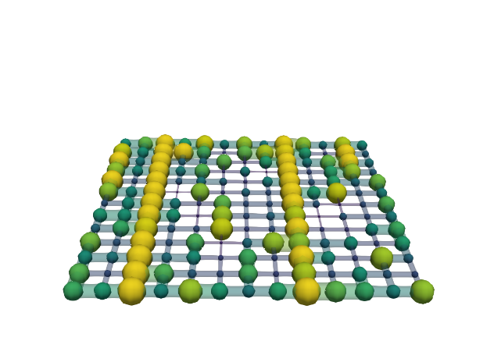
Structure evolution
0.2 M Vanadium, 0.5 V, 1.5 cm s⁻¹
= 50
= 10
= 1000
= [13x13x4]
Generation 0
Can we optimize more realistic structures?
Membrane
Pore diameter [μm]
0 10 20 30 40
Thickness
Current collector
100 μm
Generation 999
Throat radius [μm]
0 4 8 12 16
Flow direction

Slide 18
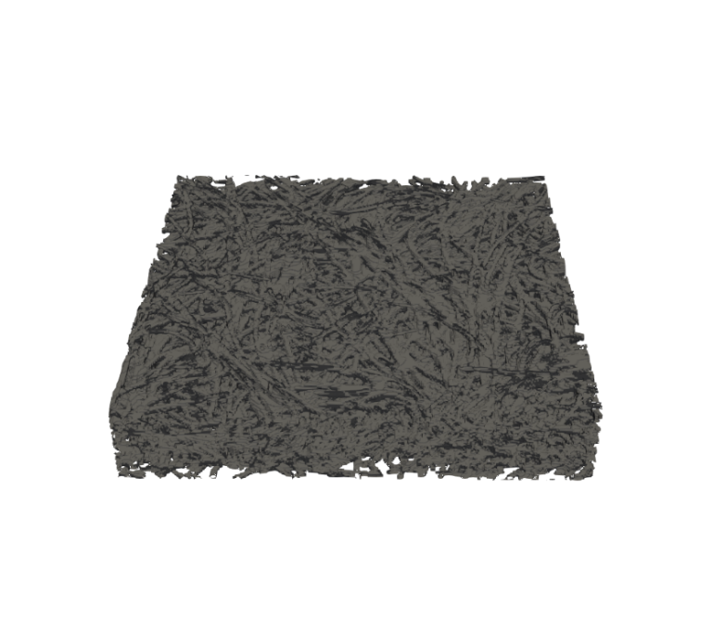
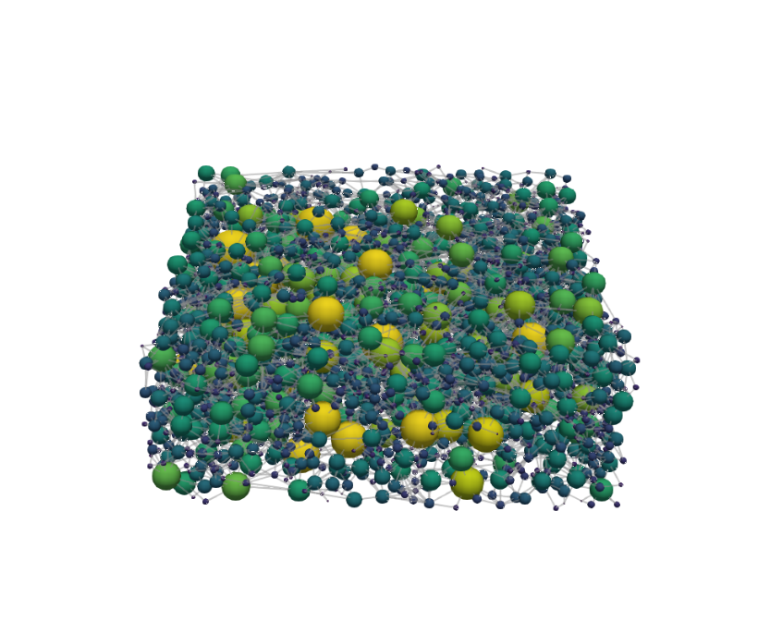
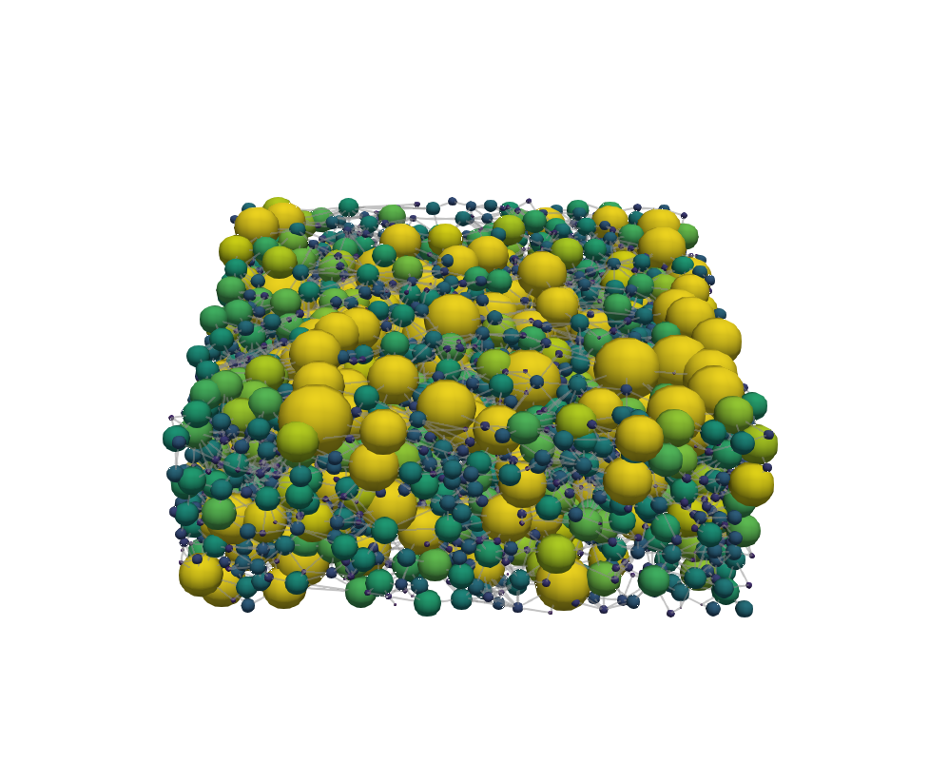
The evolution of advanced network geometries
0.2 M Vanadium, 0.5 V, 1.5 cm s⁻¹
Cubic lattice
Cubic lattice
+ 11% Fitness
- 33% P_{pump}
+ 0% P_{el}
Carbon paper
Generation 0
Generation 0
SNOW
Algorithm
100 μm
Generation 999
Generation 499
Pore diameter [μm]
0 10 20 30 40
Flow direction

Slide 19
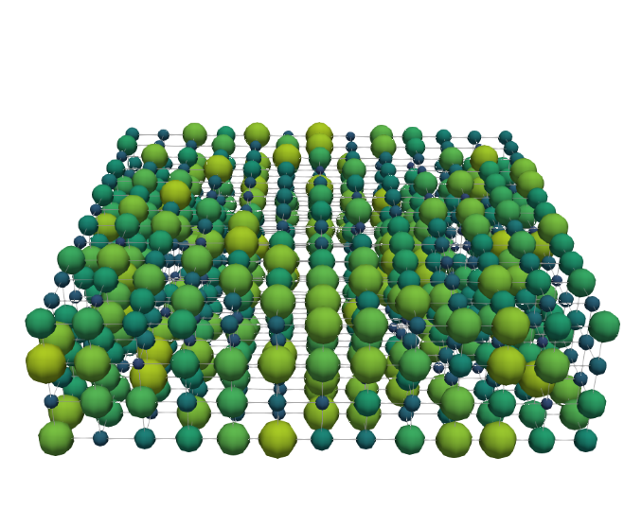
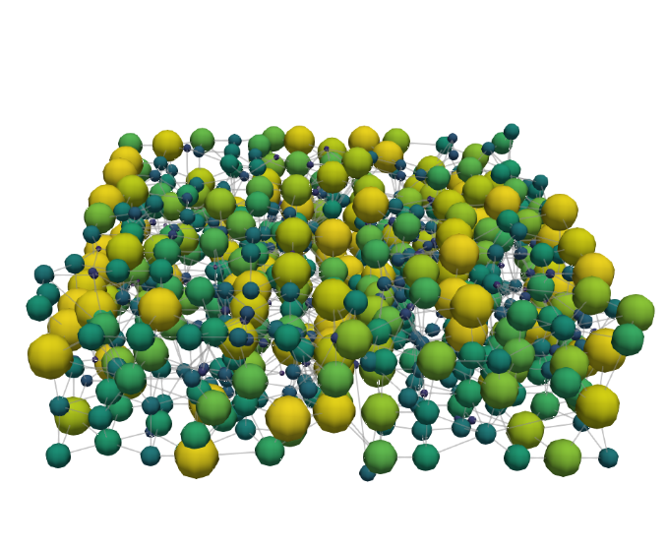
Incorporating design flexibility by pore merging and splitting
0.2 M Vanadium, 0.5 V, 1.5 cm s⁻¹
Pore diameter evolution
+ 39% Fitness
- 56% P_{pump}
+ 9% P_{el}
+ Merging and splitting
Generation 0
Diameter
Generation 0
Merging
100 μm
Generation 999
Generation 999
Splitting
Pore diameter [μm]
0 10 20 30 40
Flow direction

Slide 20
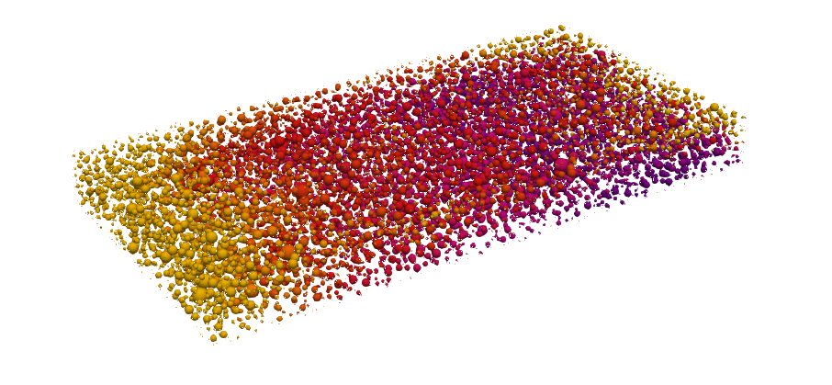
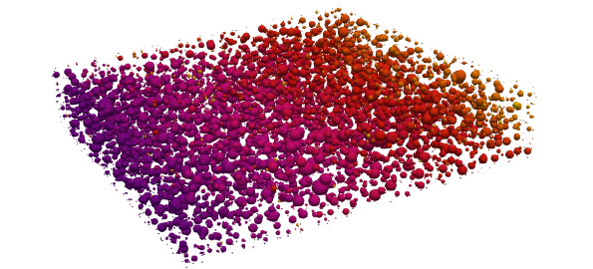




The influence of flow field induced flow pathways in the electrode
Flow-through flow field
Interdigitated flow field
Outlet
Outlet
Membrane
Outlet
Membrane
Inlet
Inlet
z
Inlet
Inlet
500 μm
Rib
80
90
100
y
x
Concentration [mol m⁻³]
Outlet
Membrane
Membrane
Inlet
Outlet
z
0
0.05
0.1
0.15
0.2
Absolute velocity [cm s⁻¹]
Outlet
Rib
Inlet
y

Slide 21


The influence of flow field induced flow pathways on the evolution
0.2 M Vanadium, 0.5 V, 1.5 cm s⁻¹
Flow-through flow field
+ 88% Fitness
- 75% P_{pump}
+ 24% P_{el}
Interdigitated flow field
Generation 0
Generation 0
100 μm
Generation 999
Generation 486
Pore diameter [μm]
0 10 20 30 40
Flow direction
Outlet
Rib
Inlet

Slide 22






The big picture
Experimental
characterization
Pore network
model
Genetic
optimization
Advanced
manufacturing
Device
implementation
+
+
+

Slide 23



Acknowledgments
ModVal 2023 - #19
Contact:
m.v.d.heijden@tue.nl

