Slide 1

Stereolithography 3D Printing As a Versatile Tool to Manufacture Porous Electrodes for Redox Flow Batteries
Maxime van der Heijden, Marit Kroese, Jacky Olinga, Zandrie Borneman, and Antoni Forner-Cuenca
Abstract number: #L09-2889
244th ECS Meeting
October 10th, 2023

Slide 2
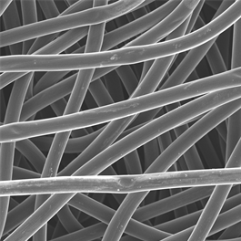

Porous electrode engineering is a complex multiscale optimization problem
Load
e⁻
Anode
Cathode
100 $\text{μm}$
A^{n+}
A^{n+}
Current collector
Membrane
e⁻
Anolyte
Catholyte
A^{(n-1)+}
A^{(n-1)+}
Ions
Ions
A^{(n-1)+} → A^{n+} + e⁻
Pump
Pump

Slide 3
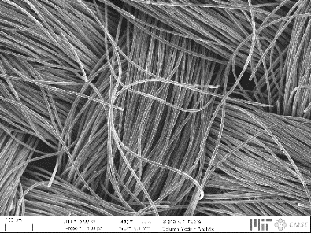
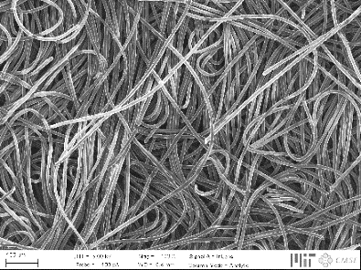
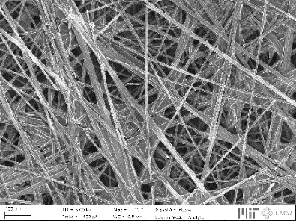
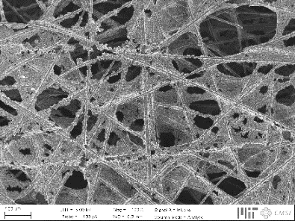
Tailored electrodes for all-liquid systems
Current generation not optimized, affecting three major losses:
↓ Pressure drop
↑ Electrochemical performance
Activation losses
Ohmic losses
Mass transport losses
Hierarchical organization
200 μm

Slide 4
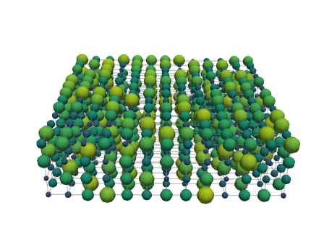
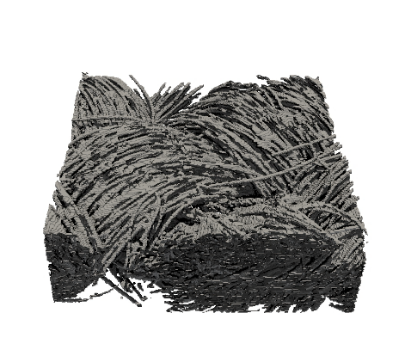
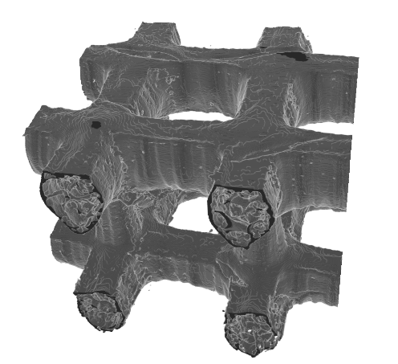
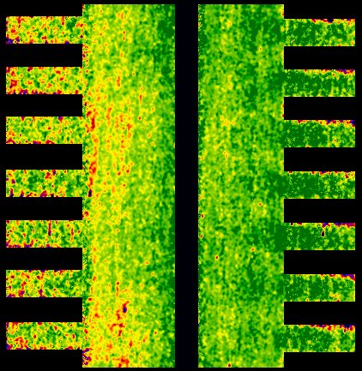
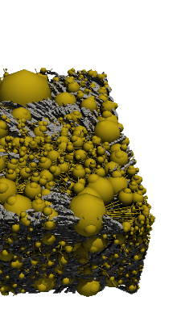
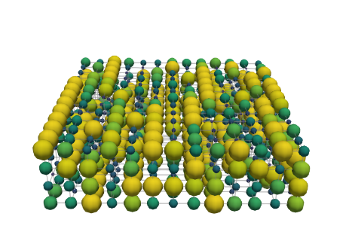
Bottom-up design of porous electrodes
Experimental
characterization
Pore network
model
Genetic
optimization
Advanced
manufacturing
Device
implementation
[1]
[2]
[3]
[4]
500 μm
500 μm
Battery tests
Redox chemistries
Imaging
Network extraction
Pore simulations
Parameter analysis
Bottom-up
Theory of evolution
Self-evolving
3D printing
Pillar design
Carbonization
Post-treatment
Durability
Cost analysis

Slide 5
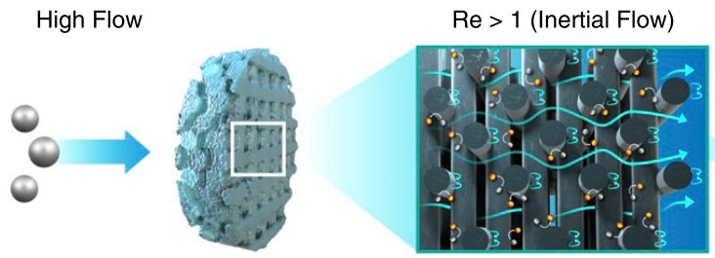
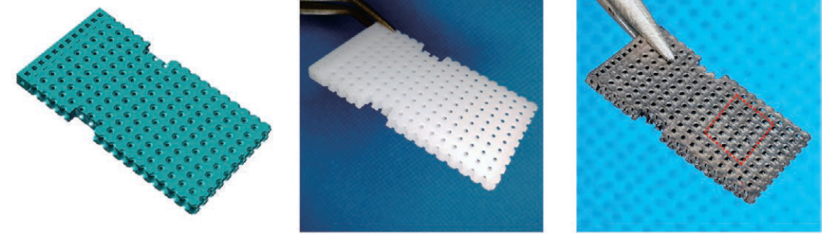
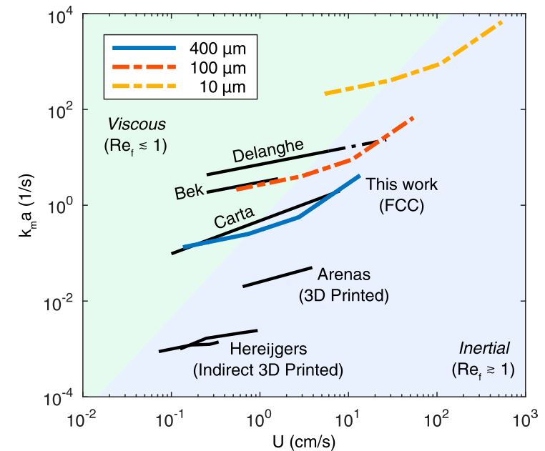
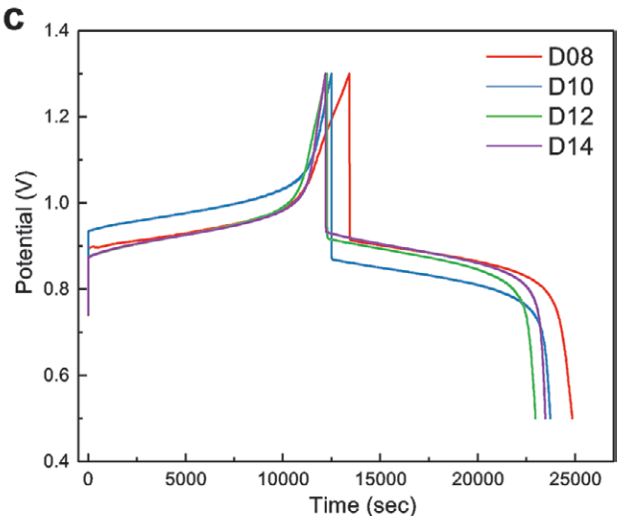
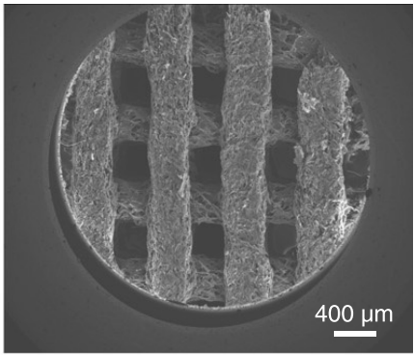
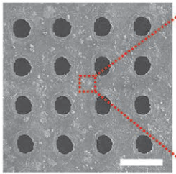
Additive manufacturing of ordered porous carbon electrodes for redox flow batteries
What is the impact of the electrode structure on
the mass transport properties of ordered lattice
structures in flow cells?
1 mm
Stereolithography
VRFB (0.1 M VOSO₄ in 3M H₂SO₄):
10 mA cm⁻² 0.5 - 1.3 V
Direct ink writing
ilim: 1 - 50 mM ferrocyanide in 1M KCl
Wang, P. et al., Adv. Mater. Technol., 5 (5), 1901030 (2020)

Slide 6
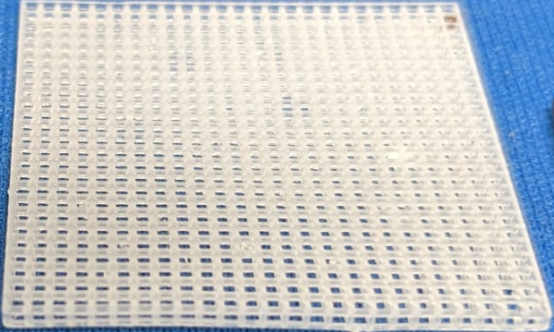
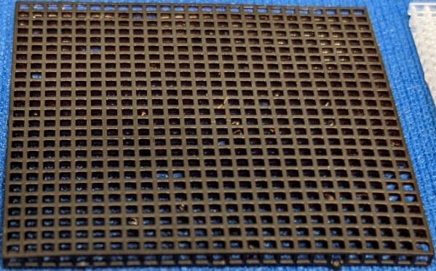
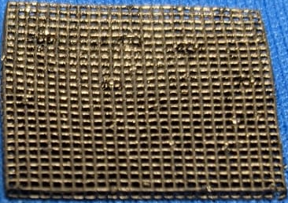
From 3D printing plastic to conductive electrodes
Oxidation
250 °C
5 h
1 °C min⁻¹
Carbonization
850 °C
1 h
5 °C min⁻¹
Flow cell
testing
1 cm
1 cm
1 mm
500 μm
0.1 M TEMPO / TEMPO⁺ in 1 M TBAPF₆ in acetonitrile

Slide 7

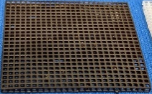



Proof-of-principle stereolithography printing
$∆$Air
$∆$N₂
Test
Printing platform
XY spot size 85 μm
Z resolution 25 μm
Methacrylate(s) 25-45 wt%
Acrylate(s) 45-65 wt%
Urethane Dimethacrylate 7-10 wt%
Photo initiator < 0.9 wt%
Cured model
Liquid resin
Resin tank
UV light
300 μm pillars
900 x 900 x 900 μm³ pores
Light source
Mirror
Lens

Slide 8
Carbonization results in shrinkage
$∆$Air
$∆$N₂
Test
Top
Printed Carbonized
Porosity [%] 77 59
Internal surface area [m⁻¹] 2700 4700-6600
Carbon content [atom%]* 77 82
Oxygen content [atom%]* 20 12
Nitrogen content [atom%]* 3 1
Conductivity [S m⁻¹] 0 85
Oxidation T
Carbonization T
Bottom
*X-ray photoelectron spectroscopy
Side
Oxidation: 11% isotropic shrinkage
Carbonization: 45% anisotropic shrinkage
500 μm
Carbonized

Slide 9
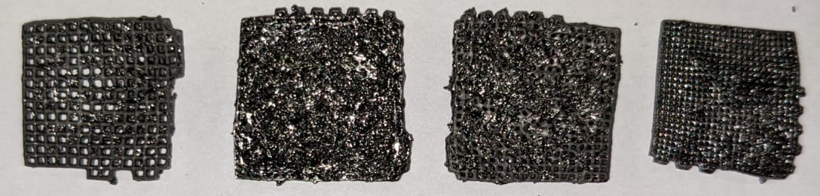
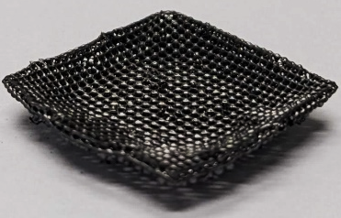
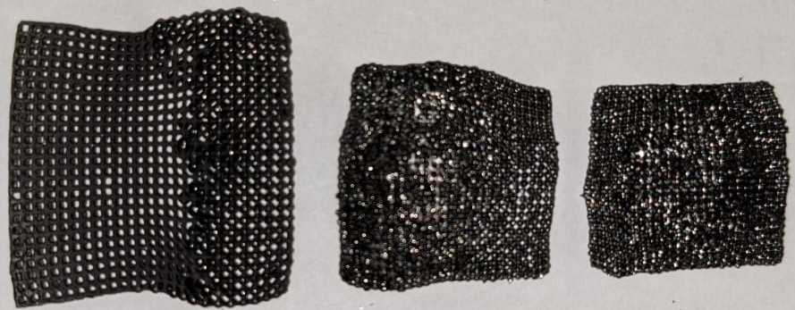
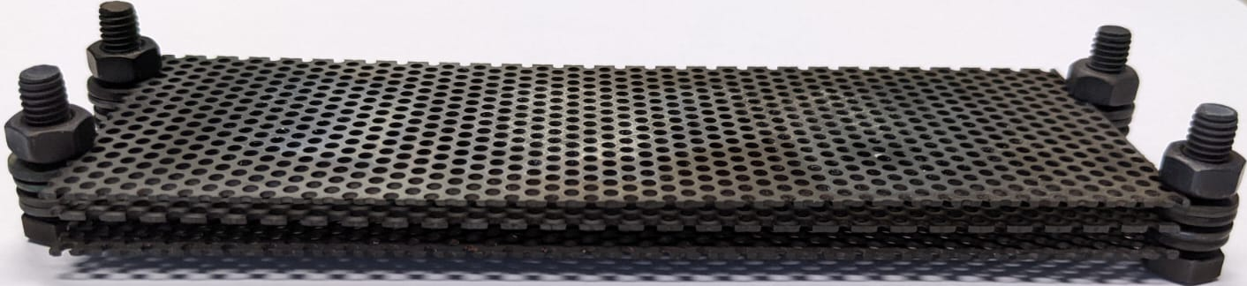
Tweaking the carbonization process
→ manufacturing guidelines
Porosity
Thermal sequence
Sample holder
Printing direction vs. the printing platform
$∆$Air
$∆$N₂
Test
3D print porosity:
How do the 3D printed electrodes perform
compared to commercial materials?
Horizontal
Vertical
Diagonal
Sample holder:
Printing platform
Platform direction
Thermal sequence:
1 cm
3D print
The printing direction impacts the electrode performance through a change in morphology, resulting in enhanced performance for diagonally printed electrodes.
Cell architecture: 3D printed electrode, square pillars, flow-through flow field

Slide 10

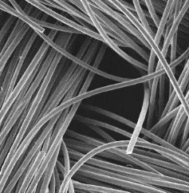



Electrochemical and hydraulic performance of 3D printed electrodes
3D print
Paper
Cloth
3D printed Commercial
Conductivity [S m⁻¹] 85 122
Ohmic resistance [Ω] 1.5 0.9
Porosity [%] 59 80
Pore size distribution [μm] 490-530 2-40
Thickness [μm] 1000 210
Internal surface area [m⁻¹] 4700-6600 72000
1000 $\text{μm}$
100 $\text{μm}$
100 $\text{μm}$
How can we further enhance mass transfer
rates of 3D printed electrodes?
Pressure drop:
Mass transport:
Dimensionless:
3D printed, 0.70
Paper, 0.85
Cloth, 0.88
3D printed electrodes: ↓internal surface area, ↓pressure drop, and ↑mass transfer coefficient.
Cell architecture: square pillars, horizontal printing direction, flow-through flow field

Slide 11
Interaction between flow field and electrode determines reactor performance
Flow through
Interdigitated
Outlet
Outlet
IDFF, 0.65
Inlet
Inlet
FTFF, 0.70
Porous
electrode
Flow direction
Channel
Rib
Cell architecture: 3D printed electrode, square pillars, horizontal printing direction
Interdigitated vs. flow-through flow fields:
↑pressure drop, but also ↑mass transfer coefficient.
Desing based on reactor architecture and operating conditions

Slide 12
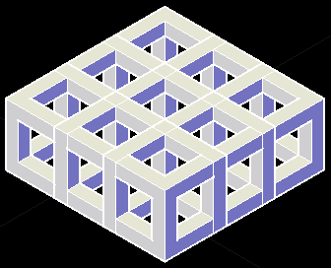
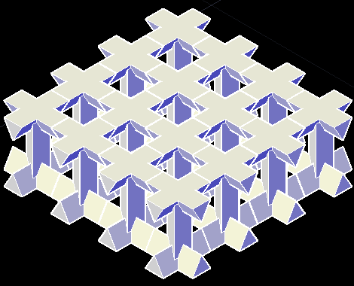
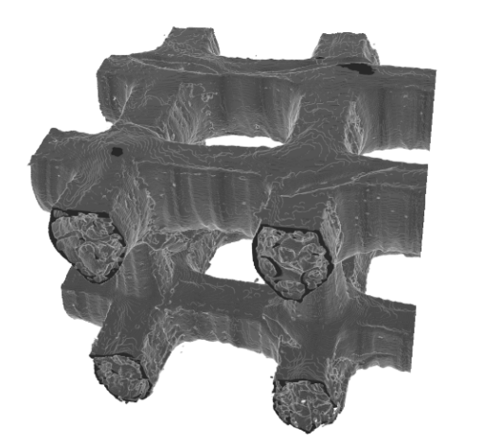
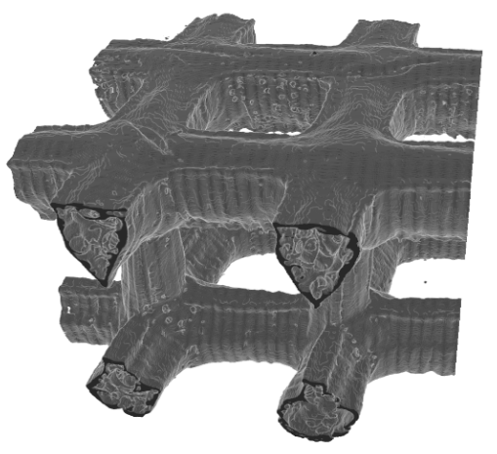


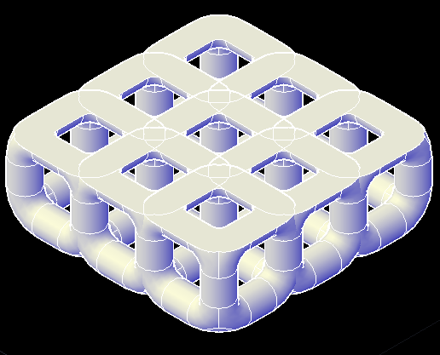
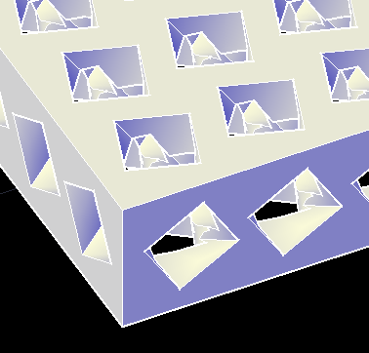
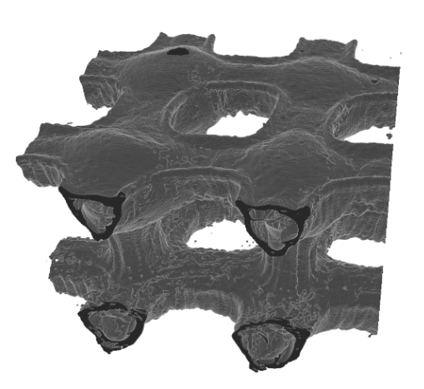
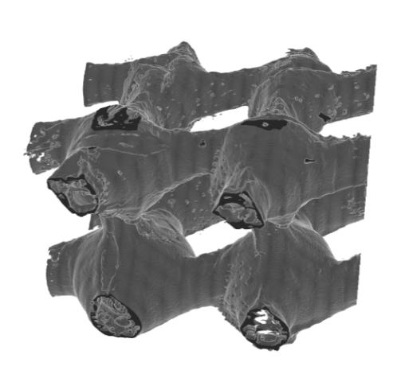
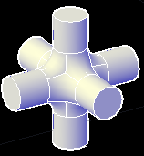
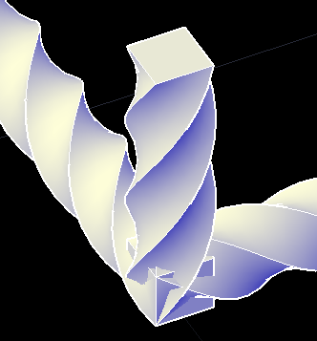
Engineering the pillar geometry can improve mass transfer rates
Square
Square
Triangle
Square
Triangle
Square Triangle Cylinder Helix
Internal
surface area [m⁻¹] 6600 5800 5900 7700
Exponent [-] 0.70 0.74 0.65 0.70
Helical or triangular pillar shapes enhance mass transfer rates
2 mm
Triangle, 0.74
Helix, 0.70
Helix, 0.70
500 μm
Cylinder
Helix
Cylinder
Helix
Cylinder, 0.65
Square, 0.70
Cylinder, 0.65
Square, 0.70
Triangle, 0.74

Slide 13


3D printing of flow battery electrodes
$∆$Air
$∆$N₂
Test
Proof-of-principle
Manufacturing guidelines
Porosity, thermal sequence, sample holder, printing direction vs. the printing platform
Enhanced mass transport and decreased pressure drop
Desing based on reactor architecture and operating conditions
Pillar structures promise increased mass transfer rates
3D print
Paper
Flow through
Interdigitated
Triangle
Helix

Slide 14
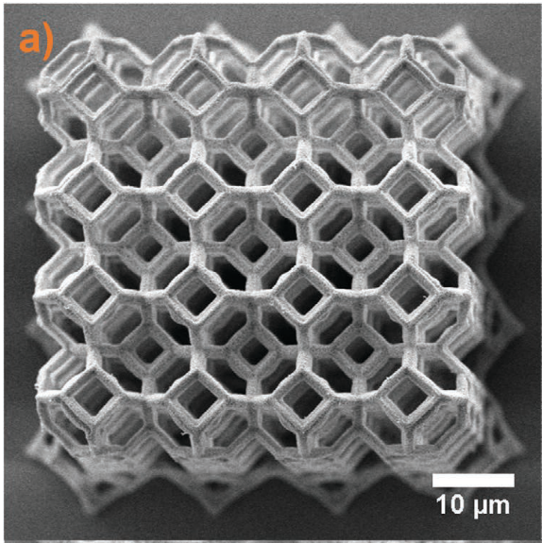
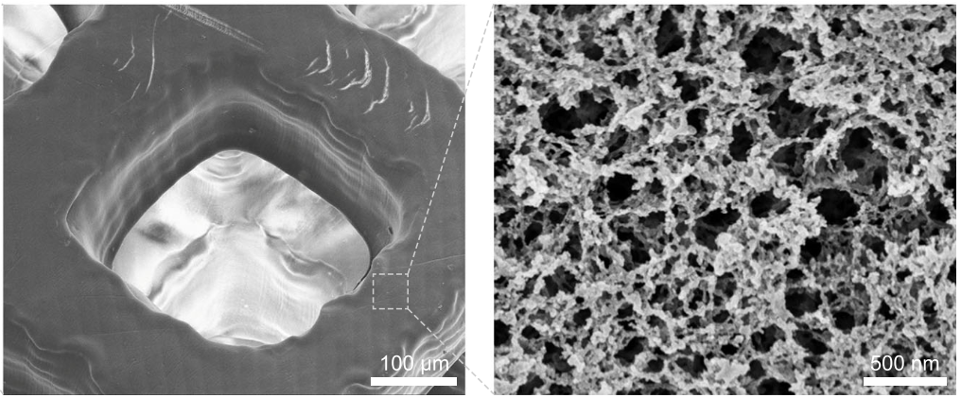
Towards next-generation flow battery electrodes
Fine-tune resin formulation and carbonization steps
Finer resolutions
Multi-scale electrode structures
Combined with topology optimizers
Goal: excellent electrochemical performance and low hydraulic resistance

Slide 15

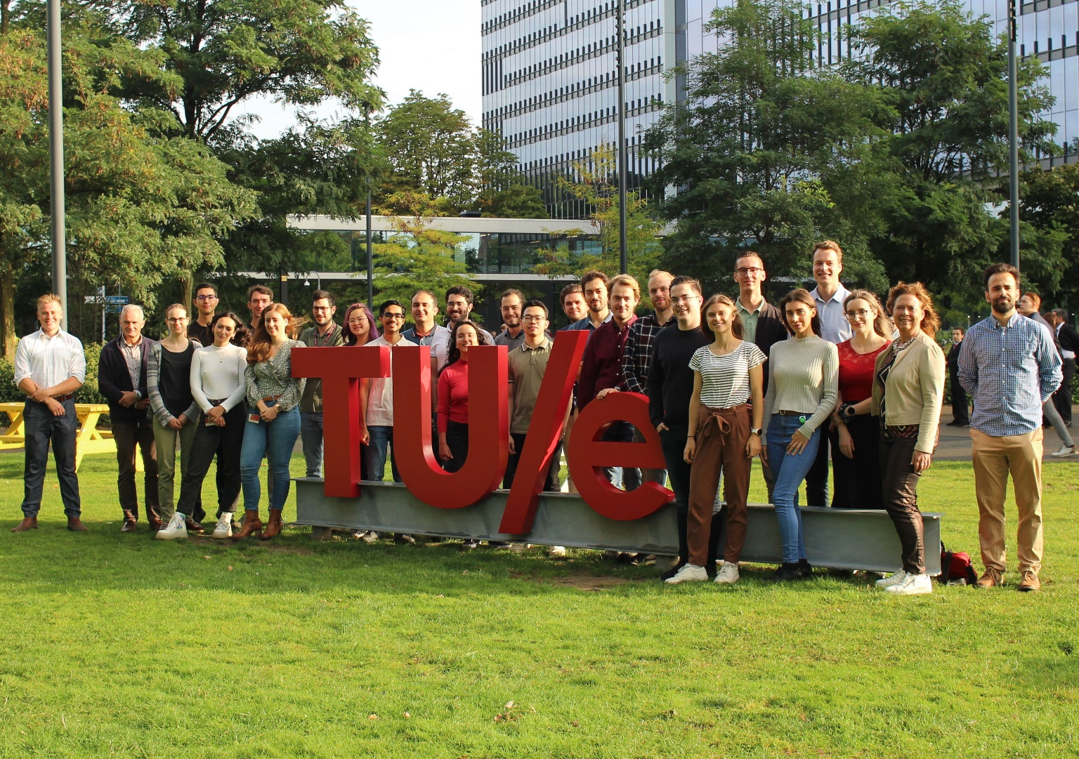


Acknowledgments
Contact:
m.v.d.heijden@tue.nl

Slide 16
Cyclic voltammetry data

