Slide 1
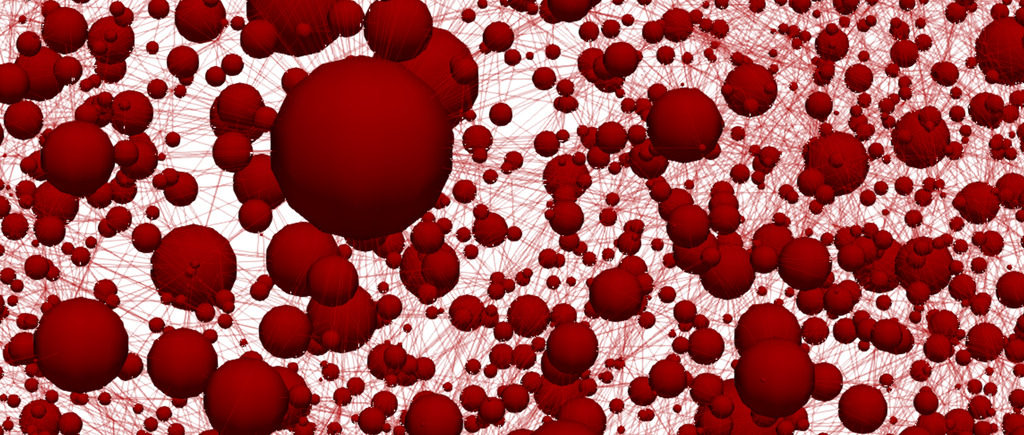
Towards bottom-up design of porous electrode microstructures for redox flow batteries
Maxime van der Heijden, Rik van Gorp, Gabor Szendrei, Zandrie Borneman, Antoni Forner Cuenca
Porous media Tea Time Talks – 18th of May

Slide 2
Demand for storage
1
Reduction of fossil fuels
Need for low-cost, large-scale energy storage technologies
Demand
Oil
Power [a.u]
Wind
Energy share (worldwide)
Renewables
Nuclear
Solar
1970
2020
2040
0
6
12
18
24
Time [years]
Time [h]
BP Statistical Review of World Energy Statistical Review of World,” Ed. BP Stat. Rev. World Energy, 2019.

Slide 3
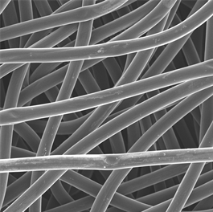

Redox flow batteries
Rechargeable
Decoupled energy (tank size) and power (reactor size): upscaling possibilities
Currently too expensive
100 $\text{μm}$

Slide 4
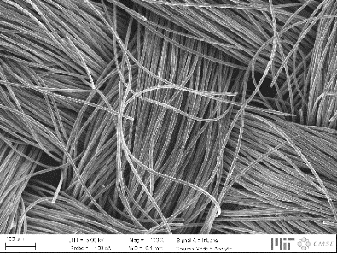
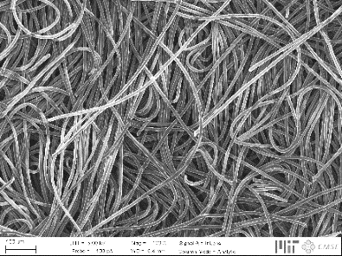
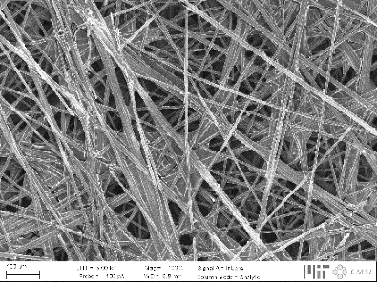
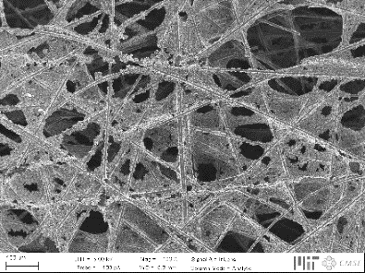
Porous fibrous electrodes
↓ Pressure drop
↑ Electrochemical performance
Key properties:
Surface area ↑
Pressure drop ↓
Mass transport ↑
Mechanical properties ↑
Electrochemical activity ↑
(Electro)chemical stability ↑
Current generation not optimized, resulting in three major losses:
100 $\text{μm}$
Activation losses
Ohmic losses
Mass transport losses
Hierarchical organization

Slide 5


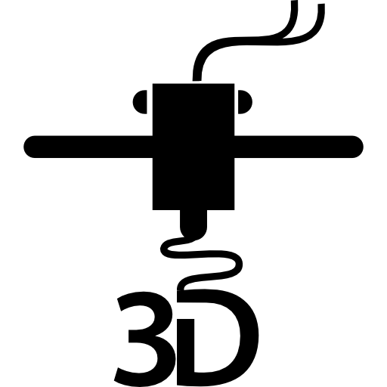

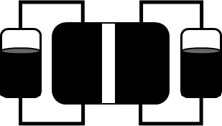
Towards artificial design
Experimental
characterization
Pore network
model
Genetic
optimization
Advanced
manufacturing
Device
implementation

Slide 6
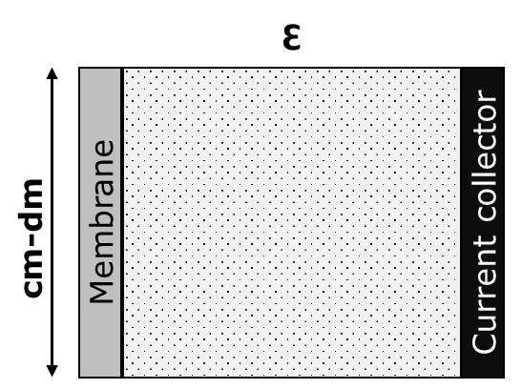
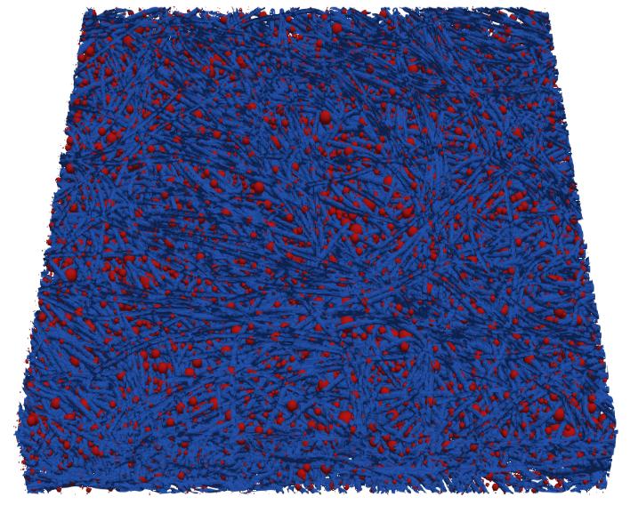
Numerical modeling
Level of complexity and detail
Concentration map
0.3 mm
1.0 mm
Macroscopic continuum model
Pore network model
Lattice Boltzmann model
Finite Element model

Slide 7
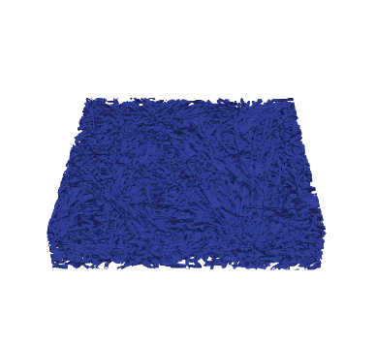
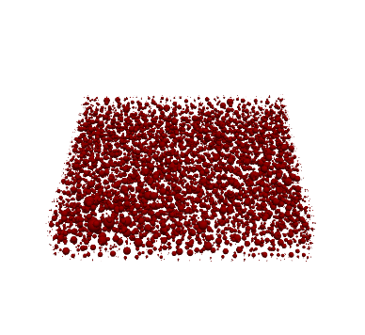

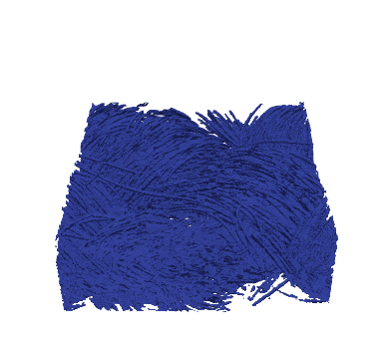
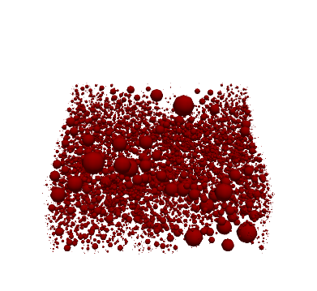
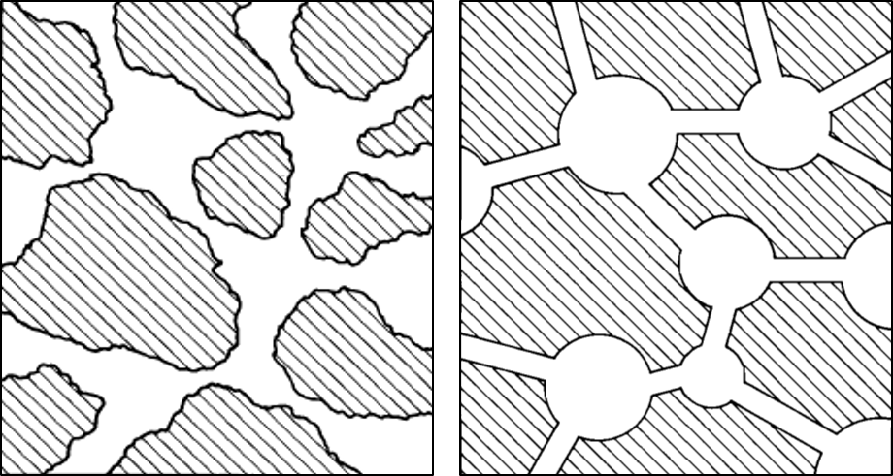
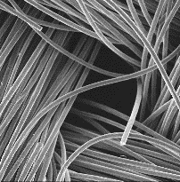


Pore network model
Load
Iterative Algorithm:
Fluid transport
Charge transport
Species transport
100 $\text{μm}$
X-ray
Tomography
SNOW
Algorithm
Anode
Cathode
Non-woven
Coupled
A^{n+}
A^{n+}
Reality:
PNM:
Current collector
Membrane
e⁻
A^{(n-1)+}
A^{(n-1)+}
Void
Solid
H⁺
H⁺
Woven

Slide 8
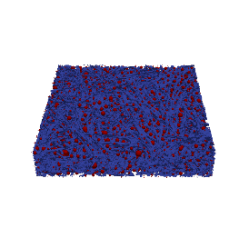
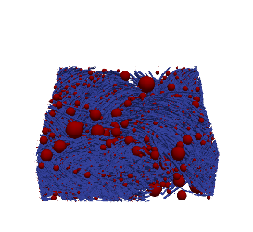
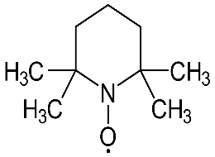
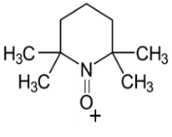
Pore network model validation
Electrode: Non-woven Woven Non-woven
Active species: 0.1 M TEMPO. / TEMPO⁺ 0.1 M Fe²⁺ / Fe³⁺
Salt: 1 M TBAPF₆ 1 M NaCl
Solvent: Acetonitrile Water
Fe²⁺
Fe³⁺
Mass transfer fitting

Slide 9
Towards artificial design
Experimental
characterization
Pore network
model
Genetic
optimization
Advanced
manufacturing
Device
implementation

Slide 10
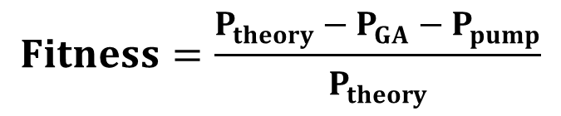
Genetic algorithm
Gene pool
Population
Parents
Generation
Selection
Crossover
$$Fitness=\frac{P_{theory}−P_{GA}−P_{pump}}{P_{theory}}$$
N species
1st generation
Selection
Mutation
Criteria
Termination
N species
2nd generation

Slide 11


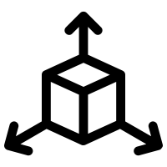

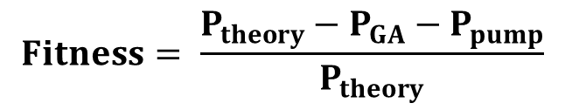
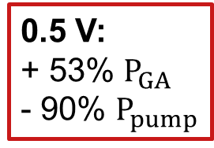
Fitness evolution
= 50
= 10
= 1000
= [4x32x4]
$$Fitness= \frac{P_{theory}−P_{GA}−P_{pump}}{P_{theory}}$$
0.5 V:
+ 53% $P_{GA}$
- 90% $P_{pump}$

Slide 12
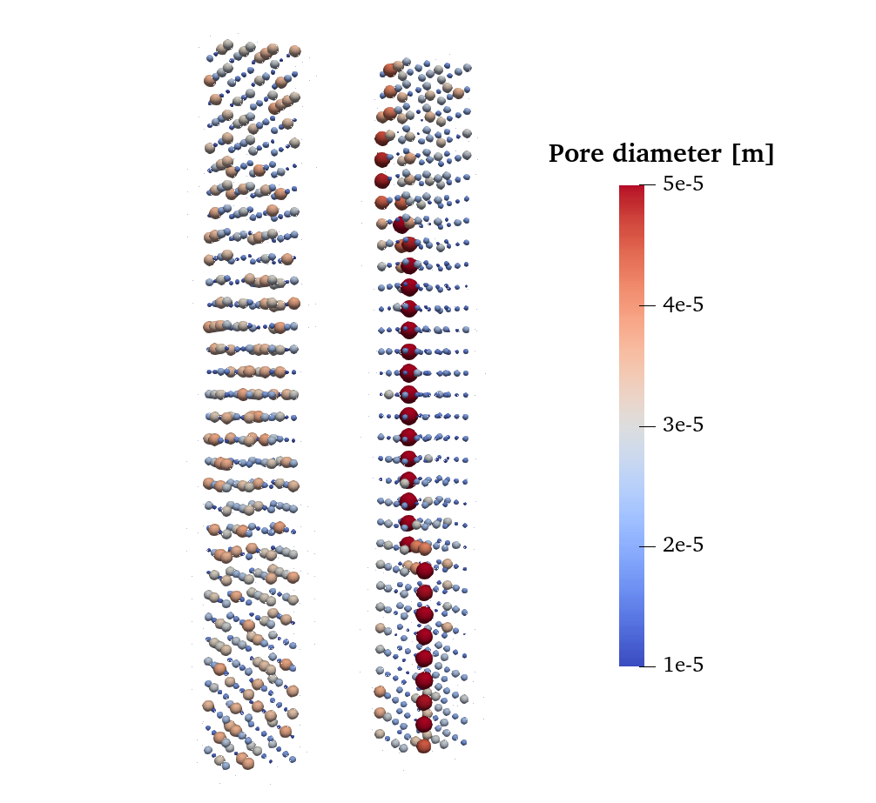
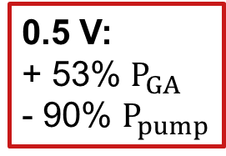
Fluid pathways
Thickness:
Current collector
to membrane
0.5 V:
+ 53% $P_{GA}$
- 90% $P_{pump}$
Resulting microstructure features a bimodal PSD.
Constant (low) porosity:
↓ Tortuosity: ↓ ohmic losses
↑ Hierarchical organization: ↓ mass transfer losses
Flow direction
Generation: 0
999

Slide 13
The big picture
Experimental
characterization
Pore network
model
Genetic
optimization
Advanced
manufacturing
Device
implementation

Slide 14
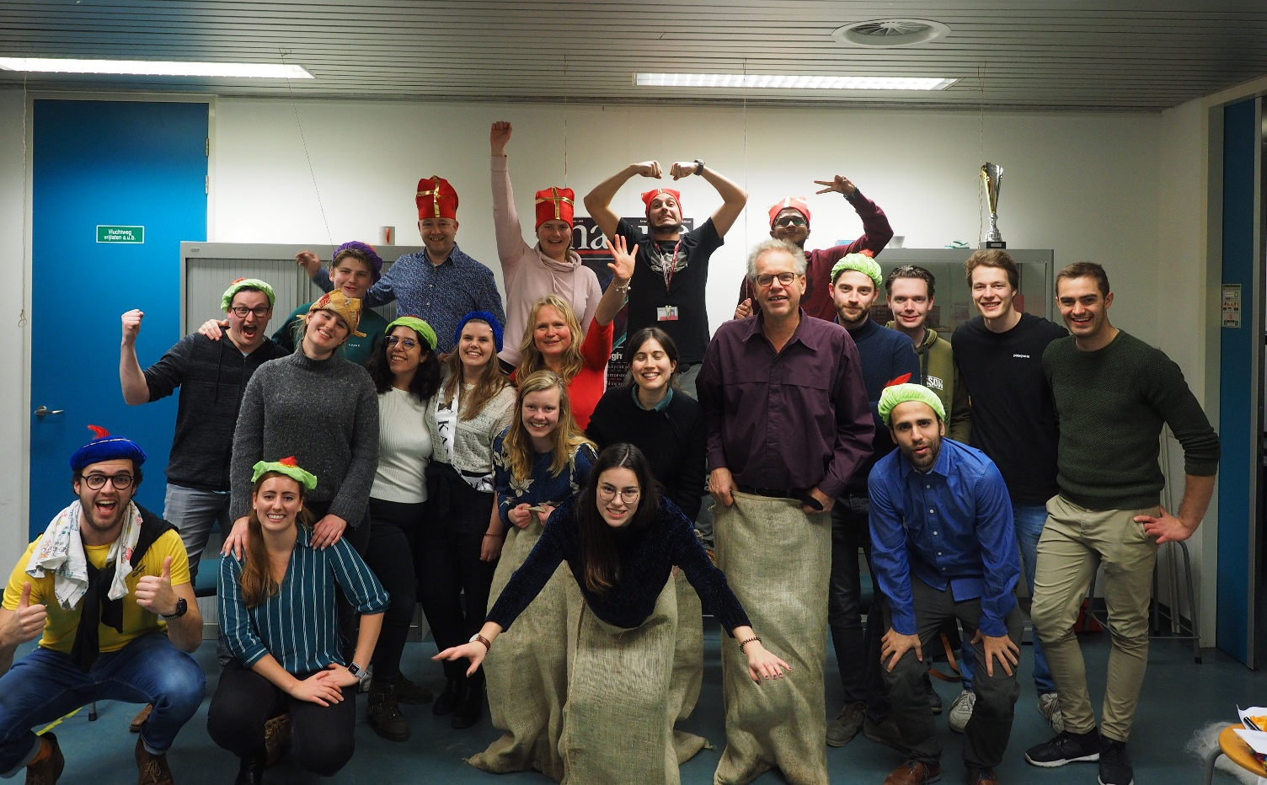

Acknowledgements
Rik van Gorp
Gabor Szendrei
Antoni Forner Cuenca
Zandrie Borneman
Amin Sadeghi
Jeff Gostick
MMP members
NWO
Contact information: m.v.d.heijden@tue.nl

