Slide 1
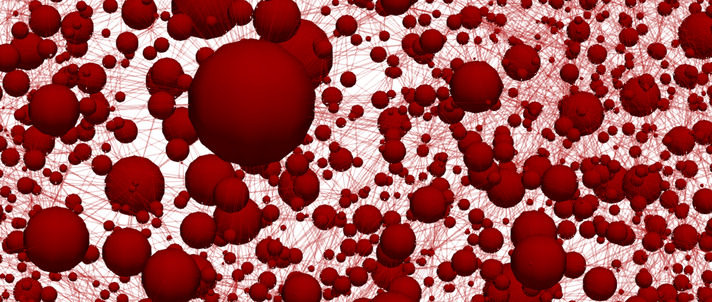
Towards bottom-up design of porous electrode microstructures coupling evolutionary algorithms and pore network modelling
Maxime van der Heijden, Rik van Gorp, Gabor Szendrei, Mohammad Amin Sadeghi, Jeffrey Gostick, Antoni Forner Cuenca
NPS – 5th of April 2022

Slide 2








Large scale energy storage
Energy storage
Renewable energy
Electrical grid
Energy demand
00:00
12:00
00:00

Slide 3
Redox flow batteries
Load
Tanks
  Electrolyte: active species, supporting salt, and solvent
Reactor
  Electrodes
  Membrane
  Flow fields
  Current collector
e⁻
Anode
Cathode
A^{n+}
A^{n+}
Current collector
Membrane
e⁻
Anolyte
Catholyte
A^{(n-1)+}
A^{(n-1)+}
Ions
Ions
Pump
Pump

Slide 4
Redox flow batteries
Load
e⁻
Rechargeable
Decoupled energy (tank size) and power (reactor size): upscaling possibilities
Currently too expensive
Anode
Cathode
A^{n+}
A^{n+}
Current collector
Membrane
e⁻
Anolyte
Catholyte
A^{(n-1)+}
A^{(n-1)+}
Ions
Ions
Pump
Pump

Slide 5
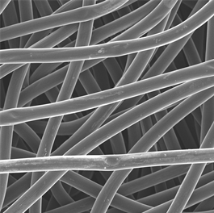

Redox flow batteries
Porous electrodes
Key properties:
Surface area ↑
Pressure drop ↓
Mass transport ↑
Mechanical properties ↑
Electrochemical activity ↑
(Electro)chemical stability ↑
Load
e⁻
Anode
Cathode
100 $\text{μm}$
A^{n+}
A^{n+}
Current collector
Membrane
e⁻
Anolyte
Catholyte
A^{(n-1)+}
A^{(n-1)+}
Ions
Ions
A^{(n-1)+} → A^{n+} + e⁻
Pump
Pump

Slide 6
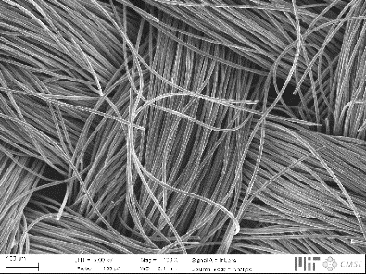
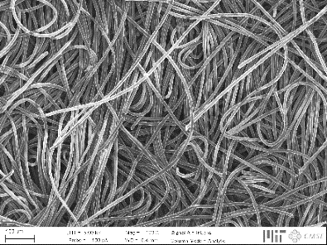
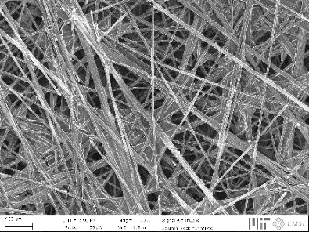
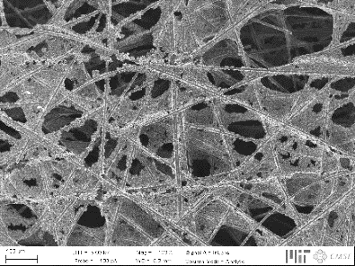
Porous electrodes
100 $\text{μm}$
↓ Pressure drop
↑ Electrochemical performance
Hierarchical organization
A^{(n-1)+} → A^{n+} + e⁻

Slide 7
Porous electrodes
Current generation not optimized, affecting three major losses:
Activation losses
Ohmic losses
Mass transport losses
Hierarchical organization

Slide 8


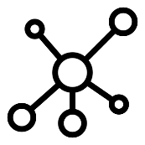
Bottom-up design of porous electrodes
Experimental
characterization
Pore network
model
Genetic
optimization
Battery tests
Chemistries
Imaging
Network extraction
Pore simulations
Parameter analysis
Bottom-up
Evolution theory
Self-evolving

Slide 9
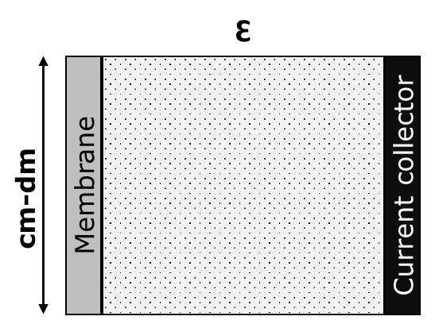
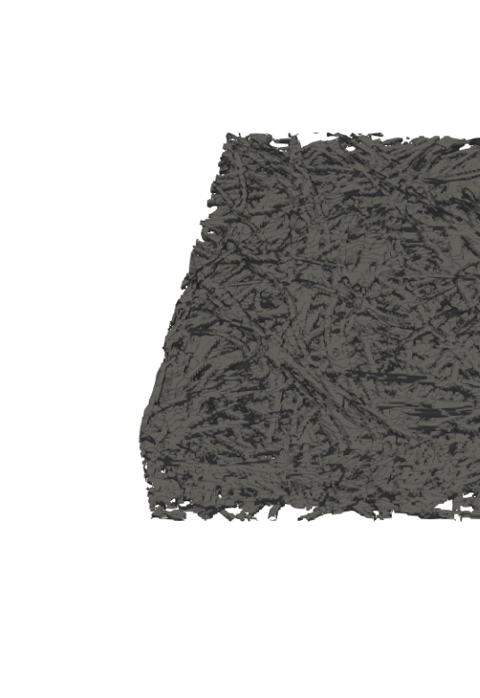
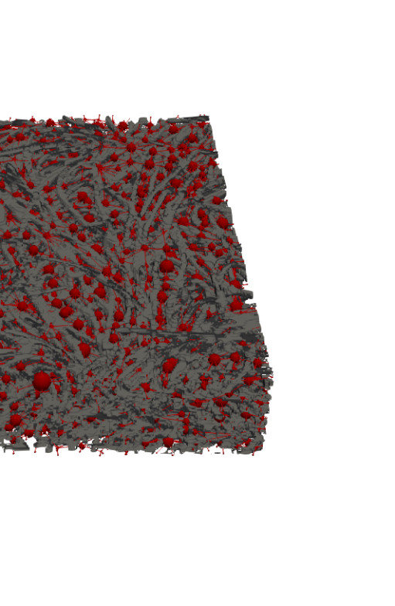
Numerical modeling
Level of complexity and detail
Concentration map
0.3 mm
1.0 mm
Macroscopic continuum model
Pore network model
Lattice Boltzmann model

Slide 10

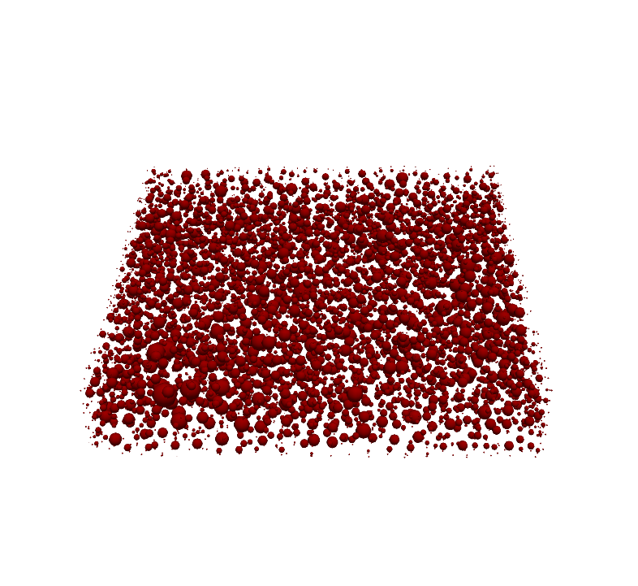
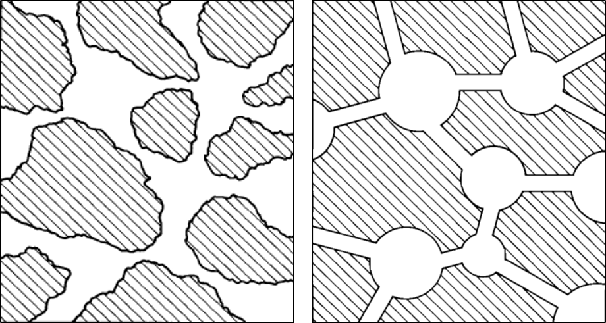


Network extraction
100 $\text{μm}$
X-ray
Tomography
SNOW
Algorithm
z
y
Paper electrode
x
200 μm
100 $\text{μm}$
Void
Solid

Slide 11
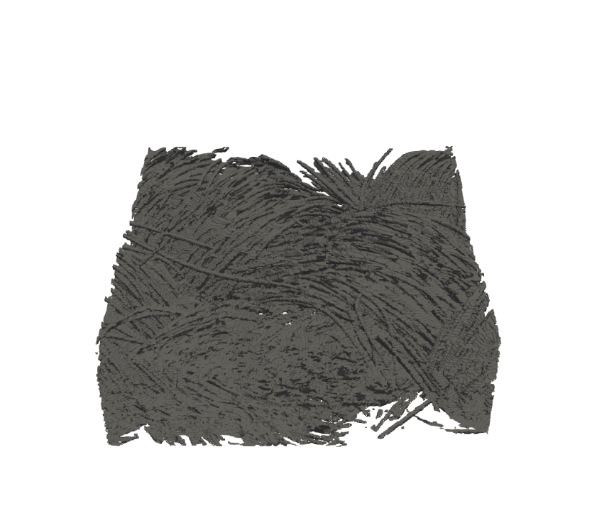
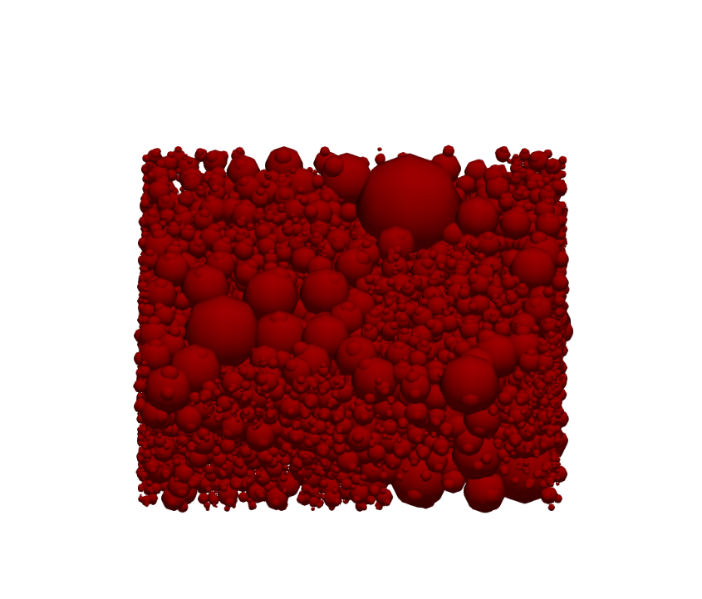
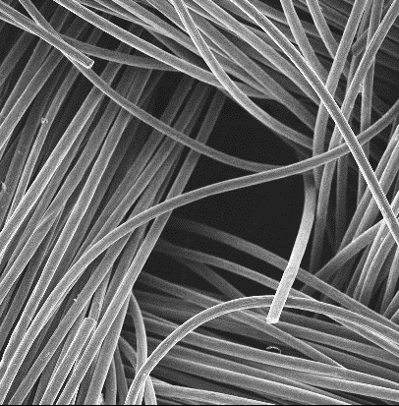

Network extraction
100 $\text{μm}$
X-ray
Tomography
SNOW
Algorithm
z
y
Paper electrode
x
200 μm
100 $\text{μm}$
200 $\text{μm}$
X-ray
Tomography
SNOW
Algorithm
z
y
Cloth electrode
x
200 μm

Slide 12
Pore network model
Load
Iterative algorithm:
Fluid transport
Species transport
Charge transport
e⁻
Anode
Cathode
Coupled
A^{n+}
A^{n+}
Current collector
Membrane
e⁻
A^{(n-1)+}
A^{(n-1)+}
Ions
Ions

Slide 13

Pore network model
Iterative algorithm:
Fluid transport
Species transport
Charge transport
Coupled

Slide 14
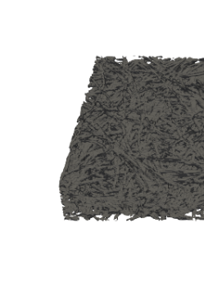
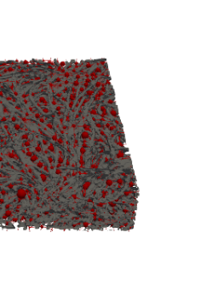
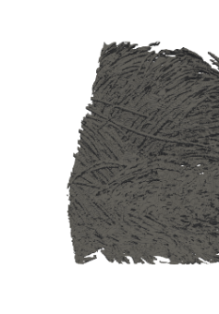
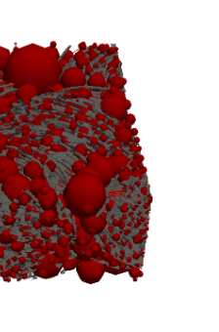
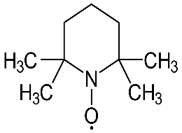
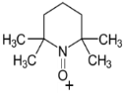
Experimental validation
13
Symmetric battery design, validated for:
2 Electrodes
3 Velocities
2 Chemistries
Load
e⁻
Anode
Cathode
A^{n+}
A^{n+}
20, 5.0, and 1.5 cm s⁻¹
Current collector
Membrane
e⁻
A^{(n-1)+}
A^{(n-1)+}
Ions
Ions
Fe²⁺
Fe³⁺
Pump

Slide 15
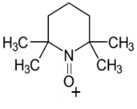
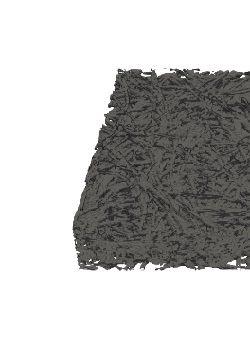
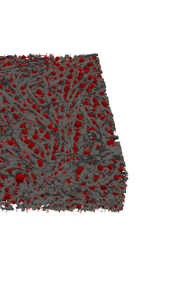
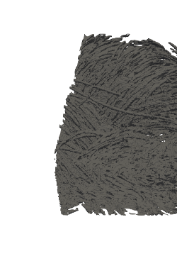
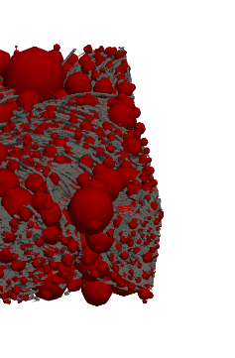
Model validation – non-aqueous electrolyte
Active species: 0.1 M TEMPO. / TEMPO⁺
Salt: 1 M TBAPF₆
Solvent: Acetonitrile
Electrode: Paper
Cloth

Slide 16
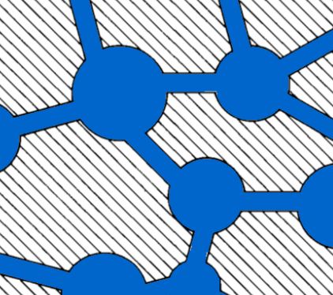

Model validation – aqueous electrolyte
Active species: 0.1 M Fe²⁺ / Fe³⁺
Salt: 1 M NaCl
Solvent: Water
Electrode: Paper
Fe²⁺
Fe³⁺
Pore network model: Experiment:

Slide 17
Model validation – aqueous electrolyte
Active species: 0.1 M Fe²⁺ / Fe³⁺
Salt: 1 M NaCl
Solvent: Water
Electrode: Paper
Fe²⁺
Fe³⁺
Mass transfer coefficient fitting:

Slide 18
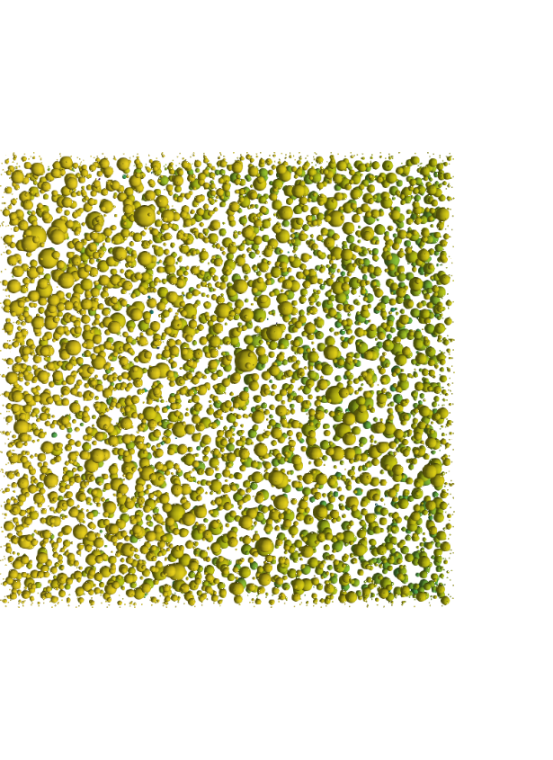
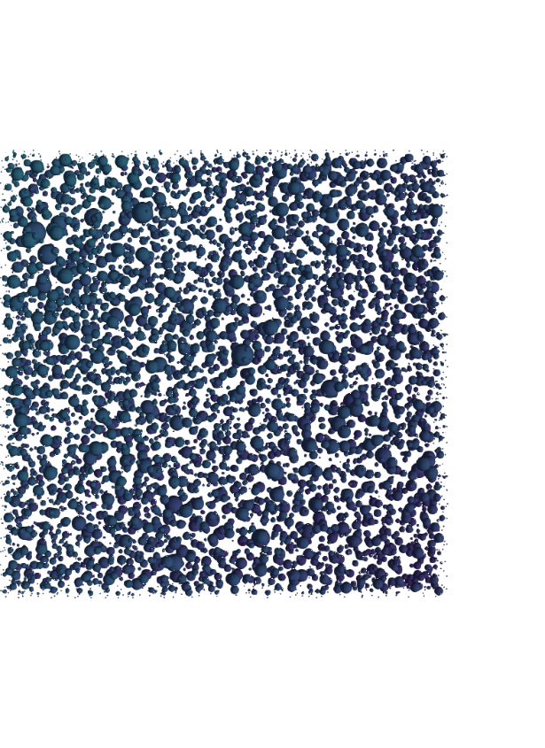
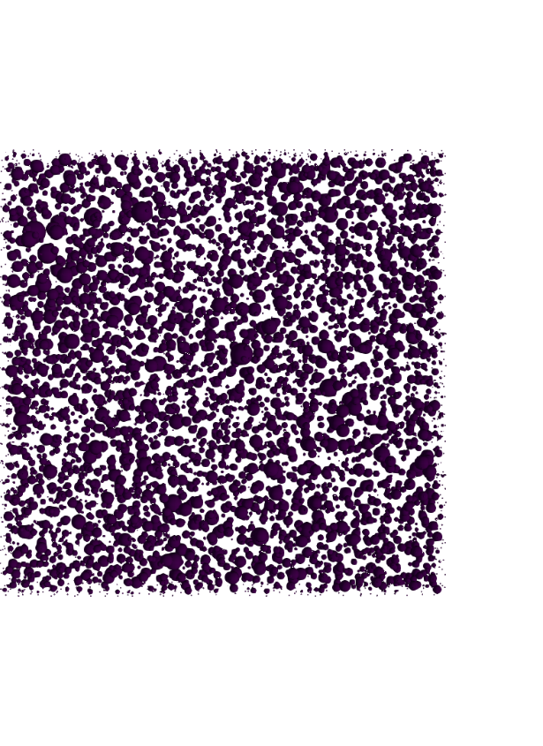
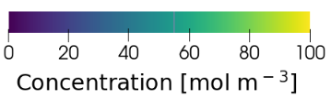
Concentration profiles
0 – 1 mm
8 – 9 mm
16 – 17 mm
Paper electrode
Inlet
Outlet
z
x
x
y
z
y
Concentration [mol m⁻³]

Slide 19
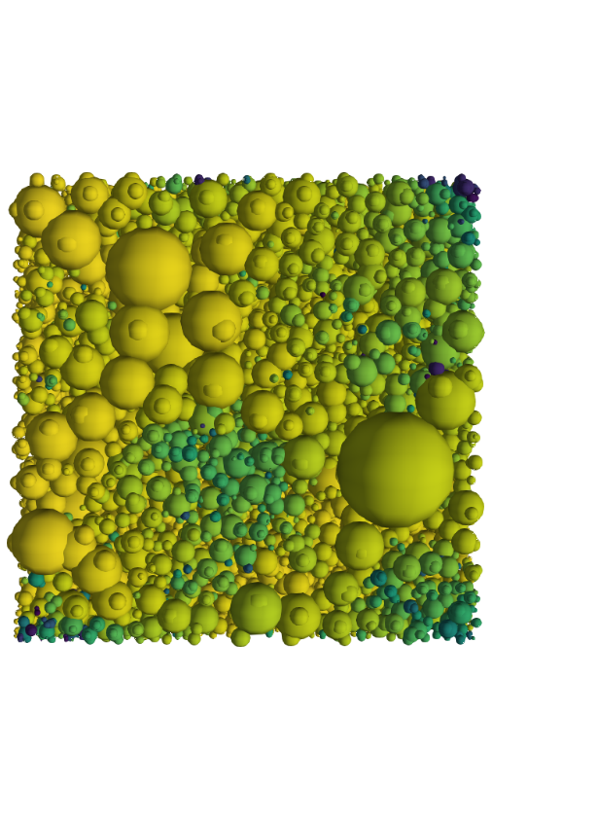
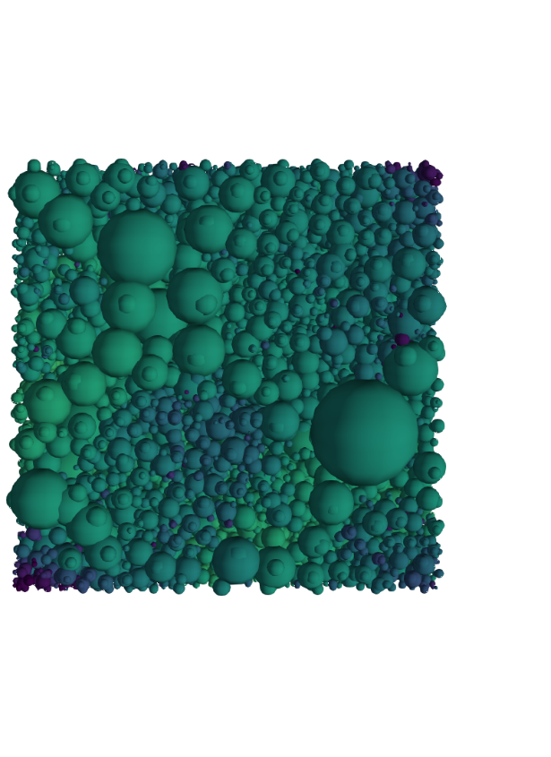
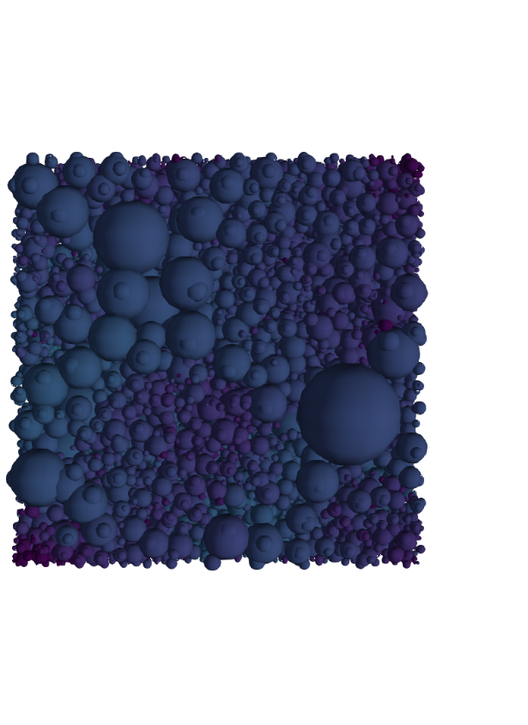
Concentration profiles
0 – 1 mm
8 – 9 mm
16 – 17 mm
Paper electrode
Inlet
Outlet
z
x
x
y
z
y
Cloth electrode
Inlet
Outlet
Concentration [mol m⁻³]

Slide 20
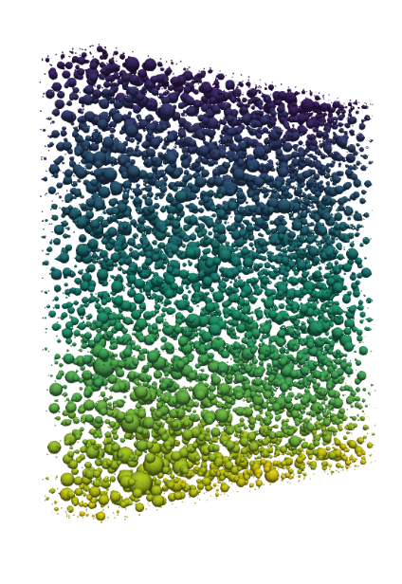
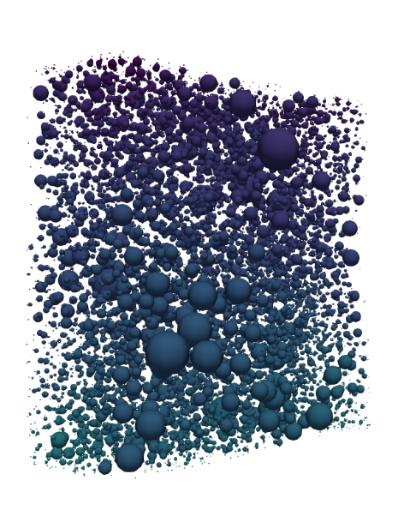
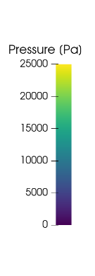
Pressure profiles
Paper electrode
Cloth electrode
Current collector
Membrane
y
x
z

Slide 21
Current profiles
20 cm s⁻¹
Paper electrode
Current
collector
Membrane
z
y
y
x
x
z
Cloth electrode

Slide 22
Current profiles
20 cm s⁻¹
1.5 cm s⁻¹
Paper electrode
Current
collector
Membrane
z
y
y
x
x
z
Cloth electrode

Slide 23
Operating envelopes
Fe²⁺
Fe³⁺
Paper electrode
Cloth electrode
P_{pump} = 0.1P_{el}
P_{pump} = 0.1P_{el}
P_{pump} = P_{el}
P_{pump} = P_{el}

Slide 24
Bottom-up design of porous electrodes
Experimental
characterization
Pore network
model
Genetic
optimization
Battery tests
Chemistries
Imaging
Network extraction
Pore simulations
Parameter analysis
Bottom-up
Evolution theory
Self-evolving

Slide 25
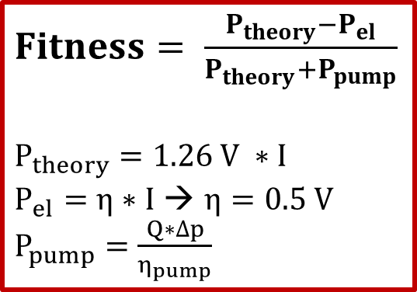
Genetic algorithm
Gene pool
Population
Parents
$Fitness= \frac{P_{theory}−P_{el}}{P_{theory}+P_{pump}}$
$P_{theory}=1.26 V ∗I$
$P_{el}=η∗I$ → $η=0.5 V$
$P_{pump}=\frac{Q∗∆p}{η_{pump}}$
Generation
Selection
N species
1st generation

Slide 26
Genetic algorithm
Gene pool
Population
Parents
Generation
Selection
Crossover
N species
1st generation
Selection
Mutation
Criteria
Termination
N species
2nd generation

Slide 27


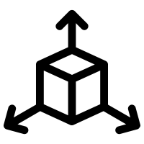

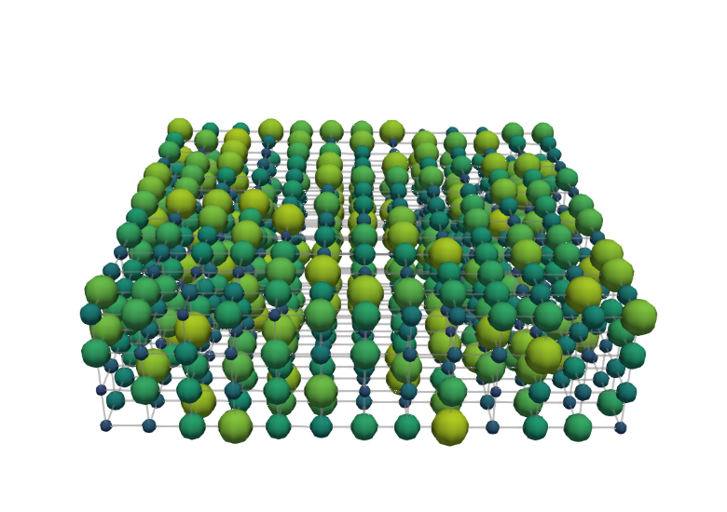
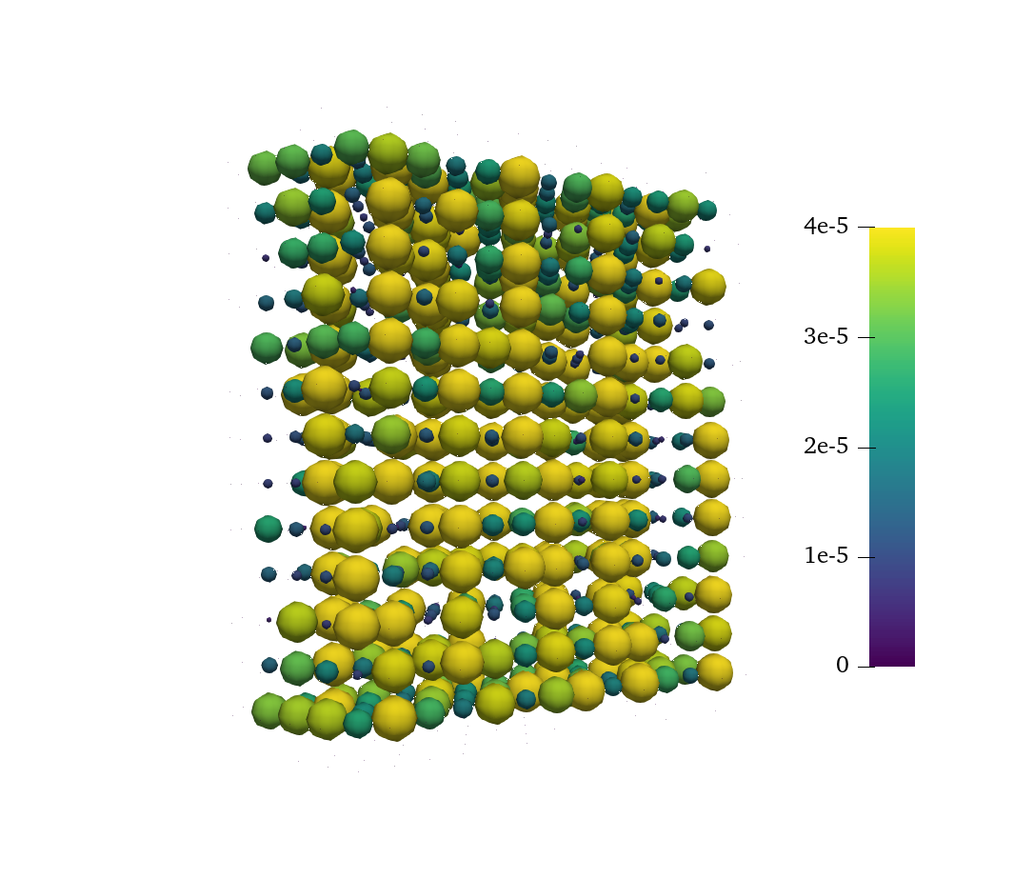
Structure evolution
0.2 M Vanadium, 0.5 V, 1.5 cm s⁻¹
= 50
= 10
= 1000
= [13x13x4]
Generation 0
Membrane
Pore diameter [μm]
0 10 20 30 40
Thickness
Current collector
100 μm
Flow direction

Slide 28
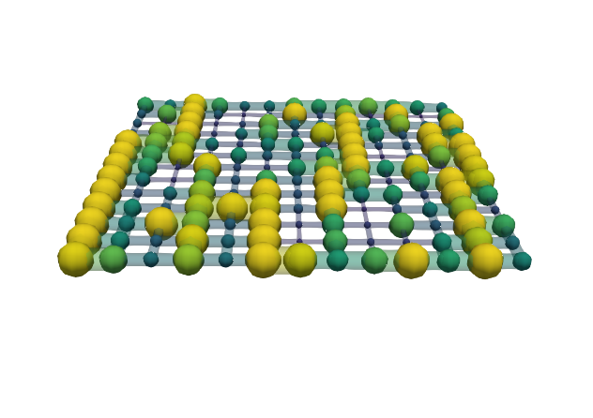
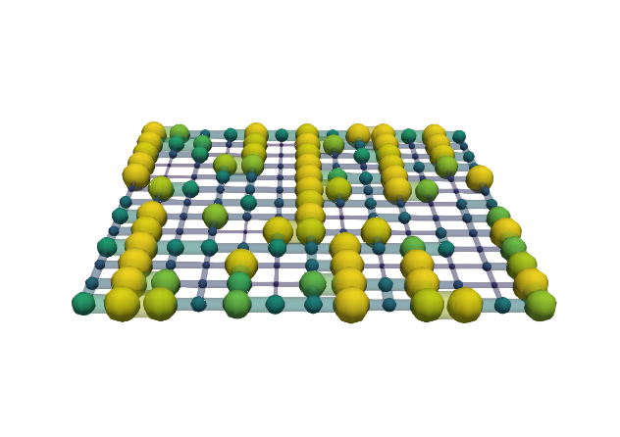
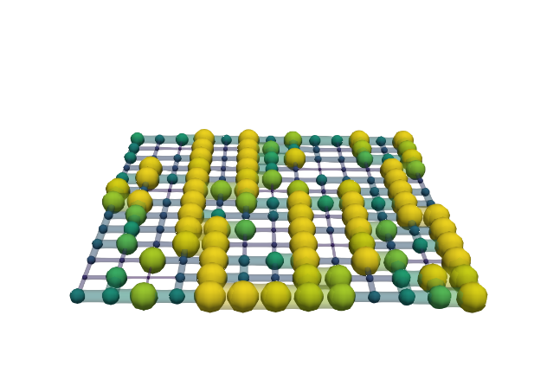
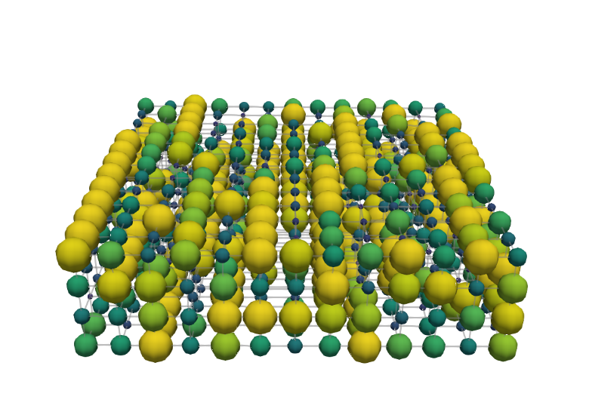
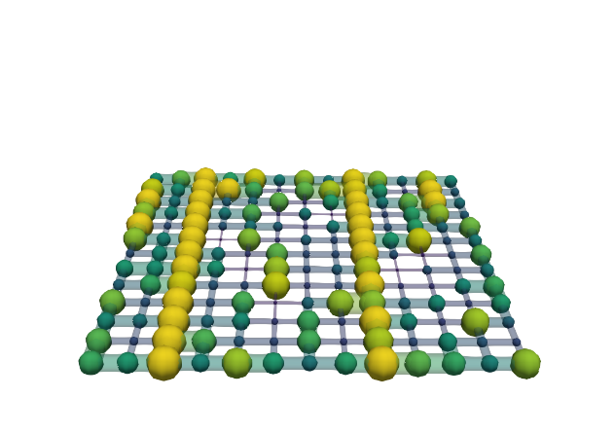
Structure evolution
0.2 M Vanadium, 0.5 V, 1.5 cm s⁻¹
= 50
= 10
= 1000
= [13x13x4]
Generation 0
Membrane
Pore diameter [μm]
0 10 20 30 40
Thickness
Current collector
100 μm
Generation 999
Throat radius [μm]
0 4 8 12 16
Flow direction

Slide 29
Structure evolution
0.2 M Vanadium, 0.5 V, 1.5 cm s⁻¹
= 50
= 10
= 1000
= [13x13x4]
Generation 0
Membrane
Thickness
Current collector
100 μm
Generation 999
Flow direction

Slide 30
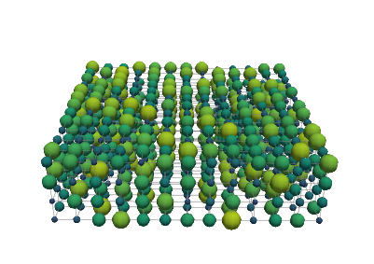


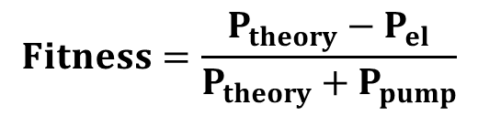
Fitness evolution
0.2 M Vanadium, 0.5 V, 1.5 cm s⁻¹
= 50
= 10
= 1000
= [13x13x4]
$$Fitness=\frac{P_{theory}−P_{el}}{P_{theory}+P_{pump}}$$
+ 75% Fitness
- 72% P_{pump}
+ 42% P_{el}
Fitness
Pumping power, P_{pump}
Electrical power, P_{el}

Slide 31
Bottom-up design of porous electrodes
Experimental
characterization
Pore network
model
Genetic
optimization
Battery tests
Chemistries
Imaging
Network extraction
Pore simulations
Parameter analysis
Bottom-up
Evolution theory
Self-evolving

Slide 32
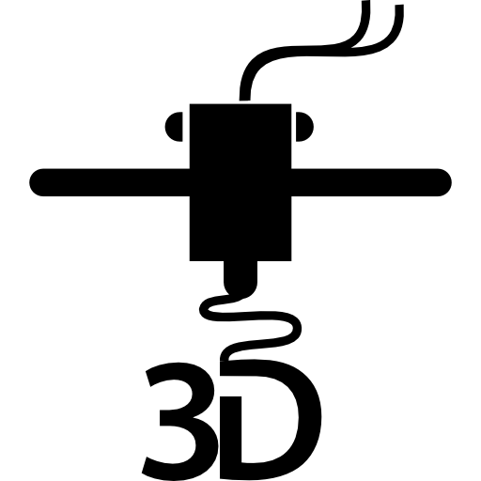
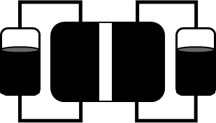



The big picture
Experimental
characterization
Pore network
model
Genetic
optimization
Advanced
manufacturing
Device
implementation
+
+
+

Slide 33


Acknowledgments
MMP group
NWO

