Slide 1

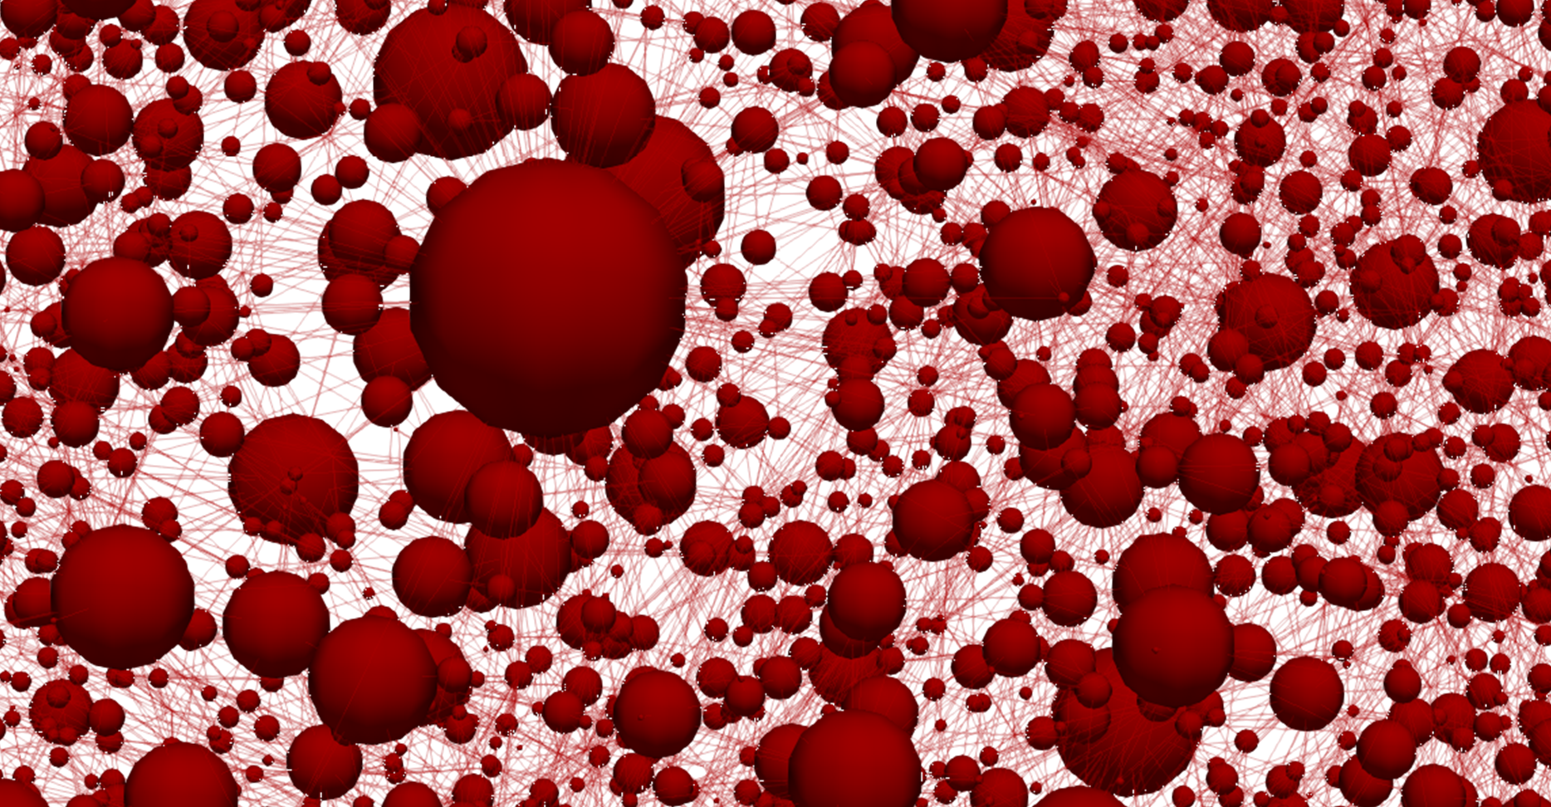
Towards bottom-up design of porous electrode microstructures
An approach coupling evolutionary algorithms and pore network modelling
Maxime van der Heijden, Rik van Gorp, Gabor Szendrei, Mohammad Amin Sadeghi, Jeffrey Gostick, Antoni Forner Cuenca
241st ECS Meeting, Vancouver, BC, Canada
June 1st, 2022

Slide 2
Redox flow batteries for large-scale energy storage
Load
e⁻
Rechargeable
Decoupled energy (tank size) and power (reactor size): upscaling possibilities
Currently too expensive
Anode
Cathode
A^{n+}
A^{n+}
Current collector
Membrane
e⁻
Anolyte
Catholyte
A^{(n-1)+}
A^{(n-1)+}
Ions
Ions
Pump
Pump

Slide 3
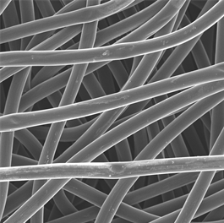

Porous electrodes engineering is a multicomplex optimization problem
Key properties:
Surface area ↑
Pressure drop ↓
Mass transport ↑
Mechanical properties ↑
Electrochemical activity ↑
(Electro)chemical stability ↑
Load
e⁻
Anode
Cathode
100 $\text{μm}$
A^{n+}
A^{n+}
Current collector
Membrane
e⁻
Anolyte
Catholyte
A^{(n-1)+}
A^{(n-1)+}
Ions
Ions
A^{(n-1)+} → A^{n+} + e⁻
Pump
Pump

Slide 4
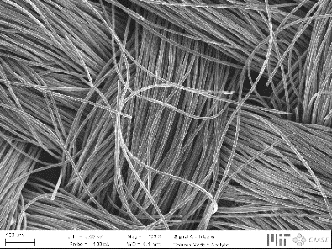
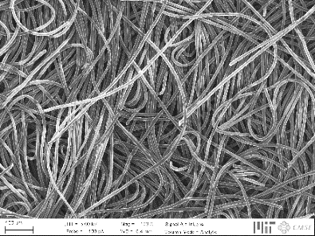
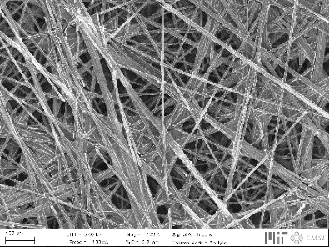
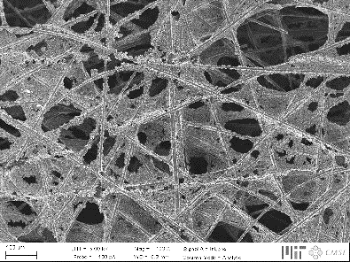
Tailored electrodes for all-liquid systems
Current generation not optimized, affecting three major losses:
↓ Pressure drop
↑ Electrochemical performance
Activation losses
Ohmic losses
Mass transport losses
Hierarchical organization
200 μm

Slide 5



Bottom-up design of porous electrodes
Experimental
characterization
Pore network
model
Genetic
optimization
Battery tests
Chemistries
Imaging
Network extraction
Pore simulations
Parameter analysis
Bottom-up
Evolution theory
Self-evolving

Slide 6
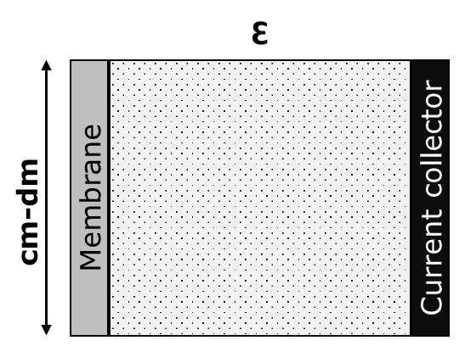
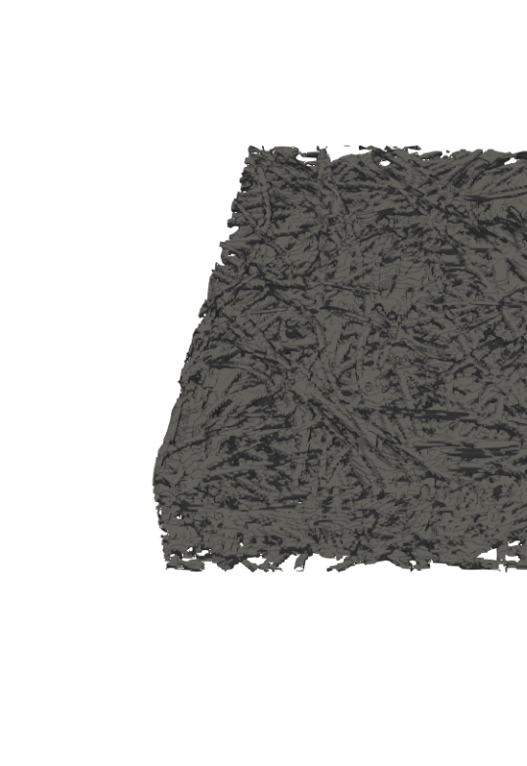
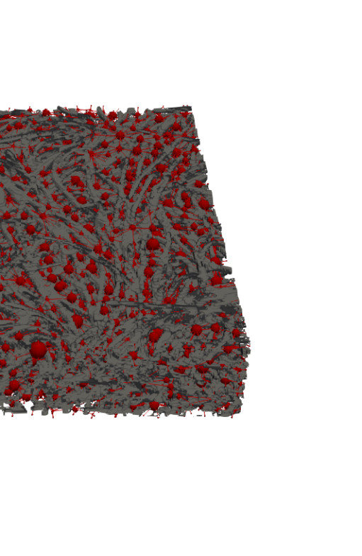
“All models are wrong, but some are useful”
Level of complexity and detail
Concentration map
0.3 mm
1.0 mm
[mol m⁻³]
Macroscopic continuum model
Pore network model
Lattice Boltzmann model

Slide 7

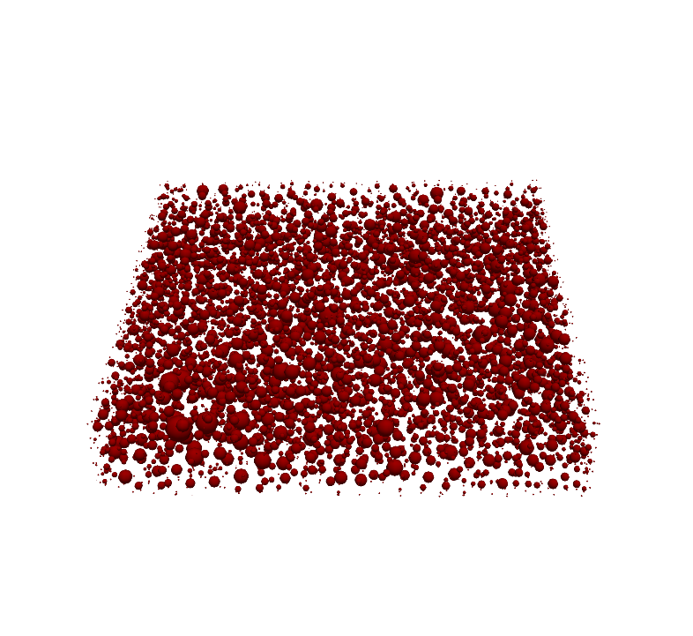
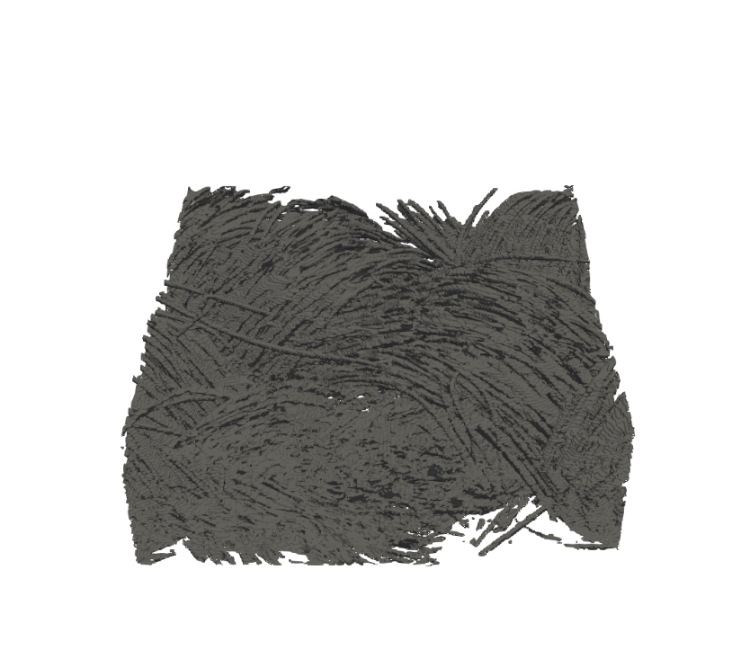
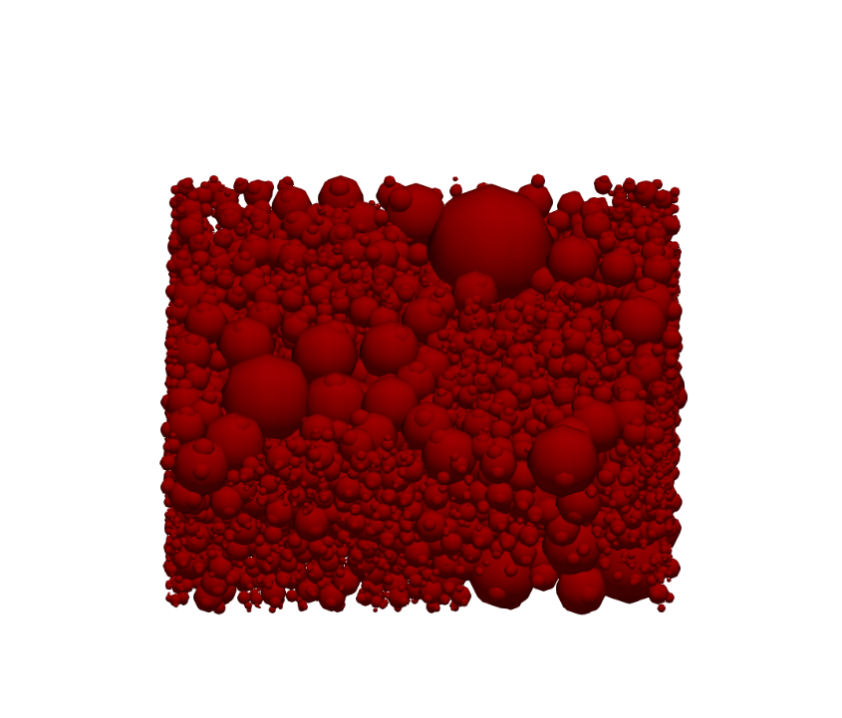
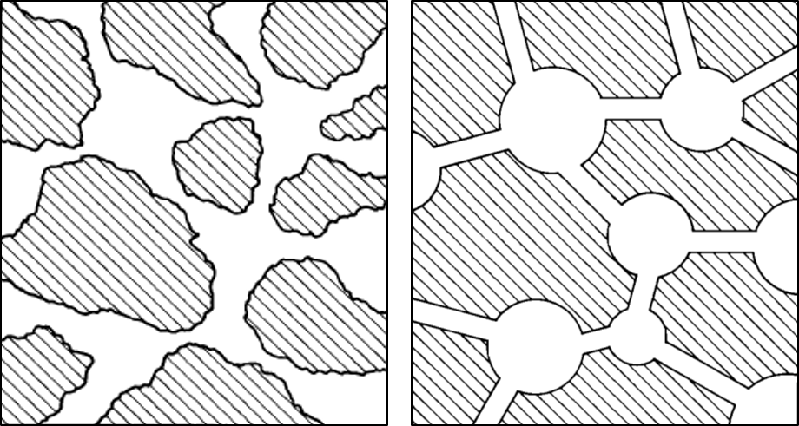
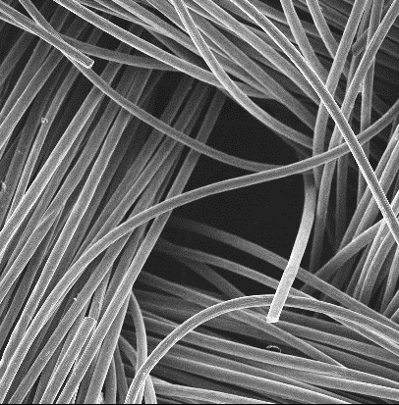



Pore network extraction from a commercial porous electrode
100 $\text{μm}$
X-ray
Tomography
SNOW
Algorithm
z
y
Paper electrode
x
200 μm
100 $\text{μm}$
200 $\text{μm}$
X-ray
Tomography
SNOW
Algorithm
Void
Solid
z
y
Cloth electrode
x
200 μm

Slide 8
Iterative pore network model
Load
Iterative algorithm:
Fluid transport
Species transport
Charge transport
e⁻
Anode
Cathode
A^{n+}
A^{n+}
Coupled
Current collector
Membrane
e⁻
A^{(n-1)+}
A^{(n-1)+}
Ions
Ions

Slide 9

Network-in-series to model species depletion
Iterative algorithm:
Fluid transport
Species transport
Charge transport
Coupled
17 mm
1 mm

Slide 10
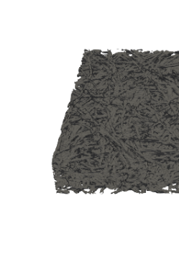
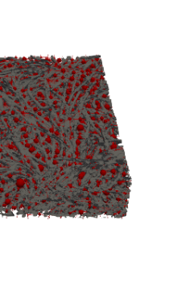
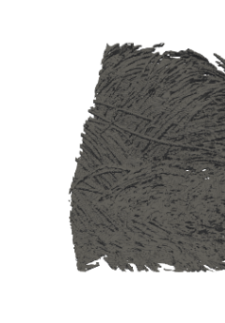
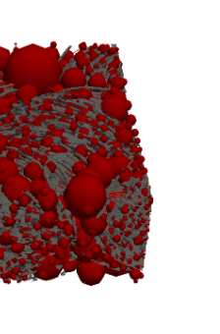
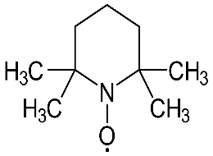
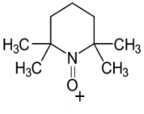
Assessing the versatility by experimental validation
Symmetric battery design, validated for:
2 Electrodes
3 Velocities
2 Chemistries
Load
e⁻
Anode
Cathode
A^{n+}
A^{n+}
20, 5.0, and 1.5 cm s⁻¹
Current collector
Membrane
e⁻
A^{(n-1)+}
A^{(n-1)+}
Ions
Ions
Fe²⁺
Fe³⁺
Pump

Slide 11
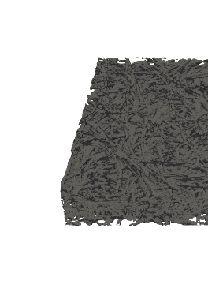
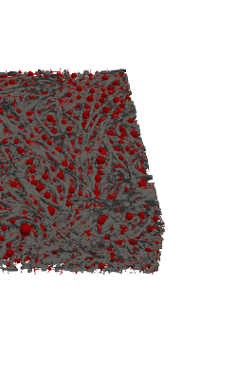
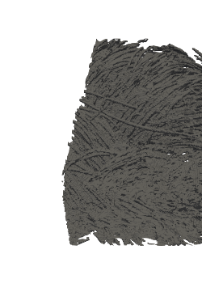
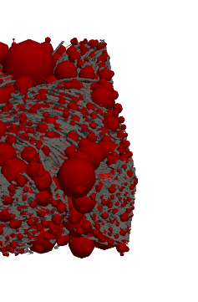
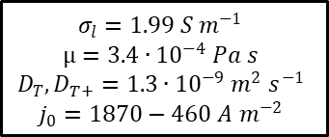
Non-aqueous electrolytes as a model case
Active species: 0.1 M TEMPO. / TEMPO⁺
Salt: 1 M TBAPF₆
Solvent: Acetonitrile
Electrode: Paper
Cloth
$σ_{l}=1.99 S m^{−1}$
$μ=3.4∙{10}^{−4} Pa s$
$D_{T}, D_{T+}=1.3∙{10}^{−9}{ m}^{2}$ $s^{−1}$
$j_{0}=1870−460 A m^{−2}$

Slide 12
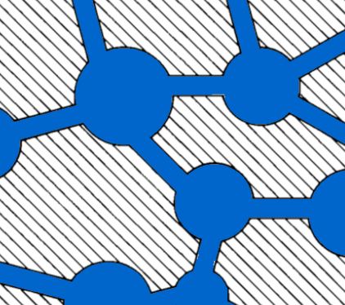

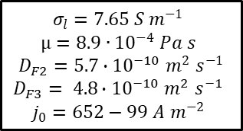
Incomplete wetting of the porous structure frustrates simplified descriptions
Active species: 0.1 M Fe²⁺ / Fe³⁺
Salt: 1 M NaCl
Solvent: Water
Electrode: Paper
Fe²⁺
Fe³⁺
Mass transfer coefficient fitting:
Pore network model: Experiment:
$σ_{l}=7.65 S m^{−1}$
$μ=8.9∙{10}^{−4} Pa s$
$D_{F2}=5.7∙{10}^{−10}{ m}^{2}$ $s^{−1}$
$D_{F3}= 4.8∙{10}^{−10}{ m}^{2}$ $s^{−1}$
$j_{0}=652−99 A m^{−2}$

Slide 13
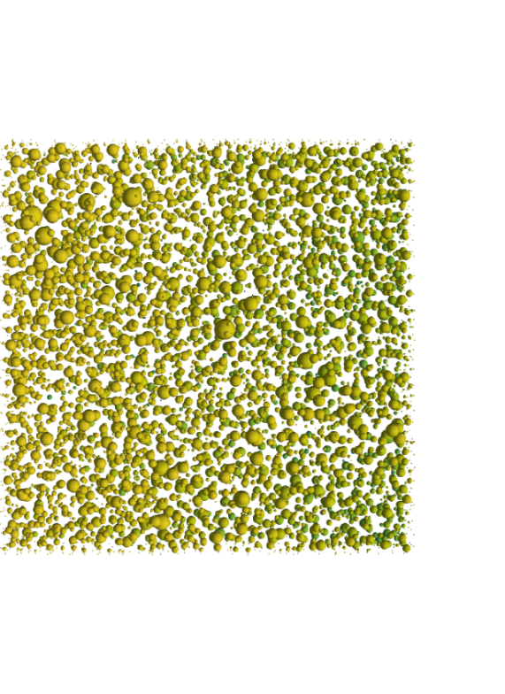
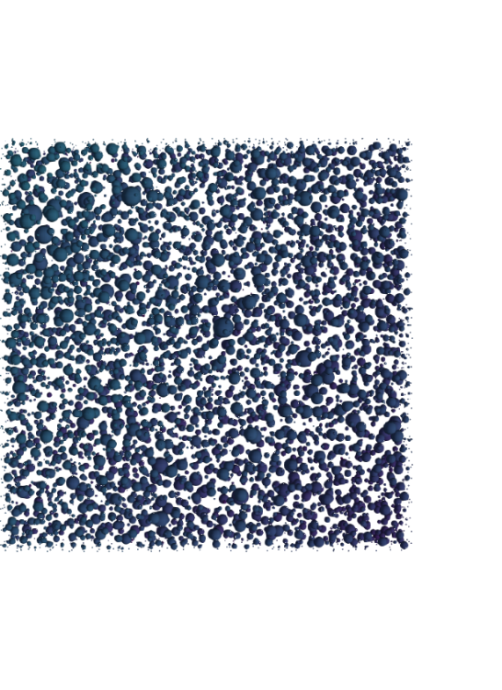
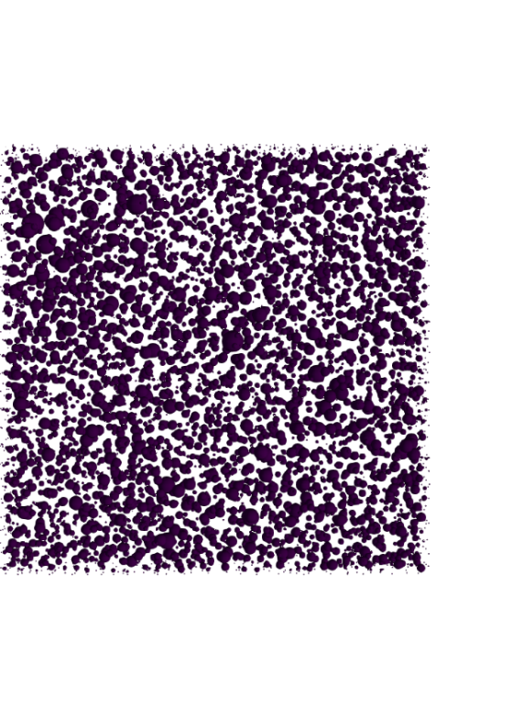
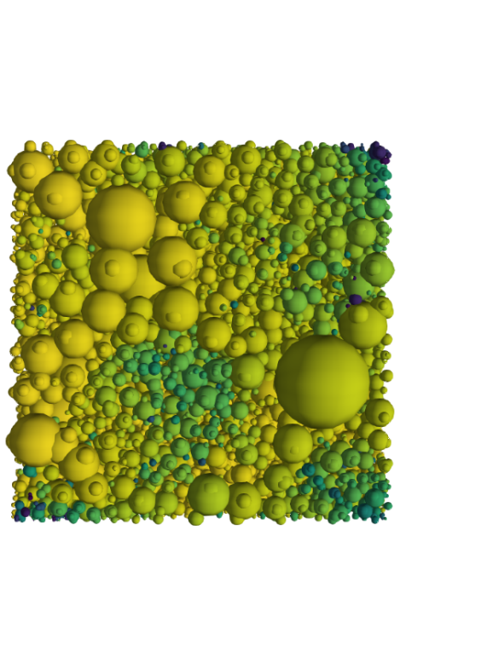
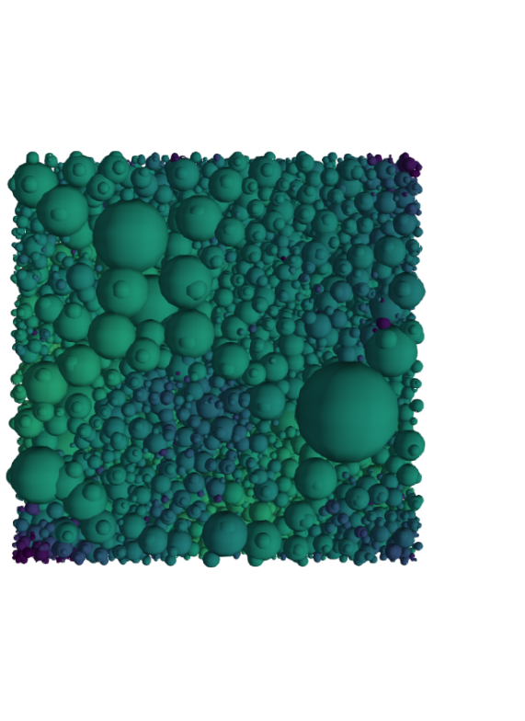
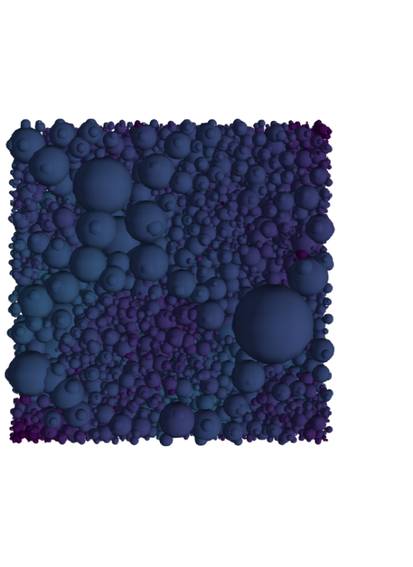
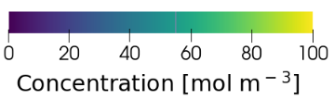
Local reactant depletion
0 – 1 mm
8 – 9 mm
16 – 17 mm
Paper electrode
Inlet
Outlet
z
x
x
y
z
y
Cloth electrode
Inlet
Outlet
Concentration [mol m⁻³]

Slide 14
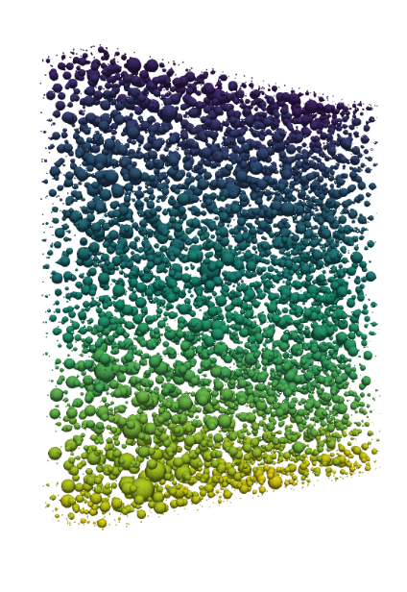
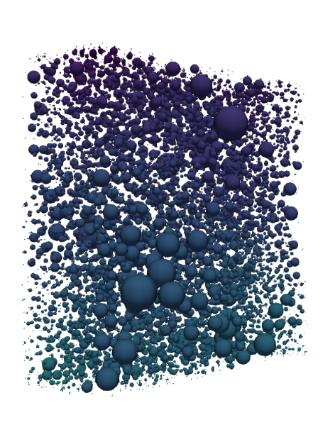
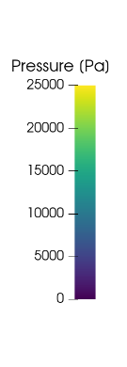
Bimodal pore structure for lower pressure drops
Paper electrode
Cloth electrode
Current collector
Membrane
y
x
z
 | Paper | Cloth
K_{IP}[μm²] | 4.2 | 44
K_{TP} [μm²] | 1.2 | 21
K_{IP}:K_{TP} | 3.4 | 2.1

Slide 15
Are commercial electrodes too thick?
20 cm s⁻¹
1.5 cm s⁻¹
Paper electrode
1 V: 266 mA cm⁻²
168 mA cm⁻²
Current
collector
Membrane
Membrane
z
y
y
x
x
z
Cloth electrode
280 mA cm⁻²
232 mA cm⁻²

Slide 16
Screening operation envelopes
Fe²⁺
Fe³⁺
Paper electrode
Cloth electrode
P_{pump} = 0.1P_{el}
P_{pump} = 0.1P_{el}
P_{pump} = P_{el}
P_{pump} = P_{el}

Slide 17
Bottom-up design of porous electrodes
Experimental
characterization
Pore network
model
Genetic
optimization
Battery tests
Chemistries
Imaging
Network extraction
Pore simulations
Parameter analysis
Bottom-up
Evolution theory
Self-evolving

Slide 18

Evolutionary theory
Gene pool
Population
Parents
$Fitness= \frac{P_{theory}−P_{el}}{P_{theory}+P_{pump}}$
$P_{theory}=1.26 V ∗I$
$P_{el}=η∗I$ → $η=0.5 V$
$P_{pump}=\frac{Q∗∆p}{η_{pump}}$
Generation
Selection
Crossover
N species
1st generation
Selection
Mutation
Criteria
Termination
N species
2nd generation

Slide 19


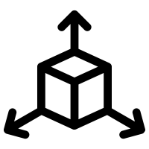

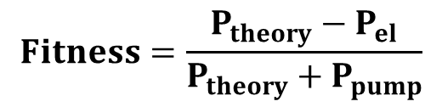
Proof of principle
0.2 M Vanadium, 0.5 V, 1.5 cm s⁻¹
= 50
= 10
= 1000
= [13x13x4]
$$Fitness=\frac{P_{theory}−P_{el}}{P_{theory}+P_{pump}}$$
+ 75% Fitness
- 72% P_{pump}
+ 42% P_{el}
Fitness
Pumping power, P_{pump}
Electrical power, P_{el}

Slide 20
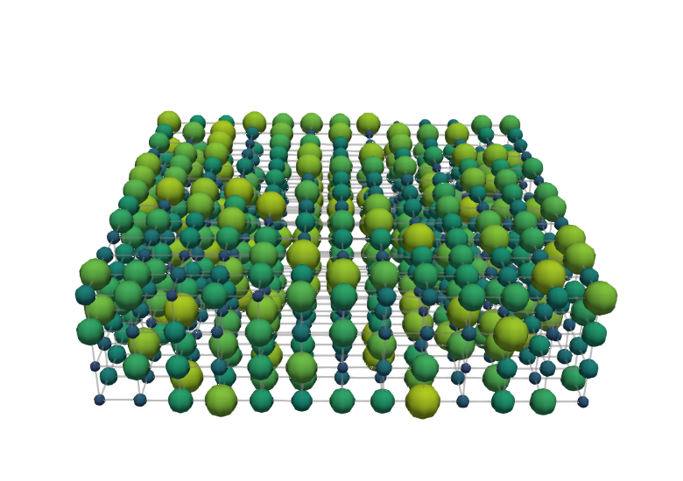
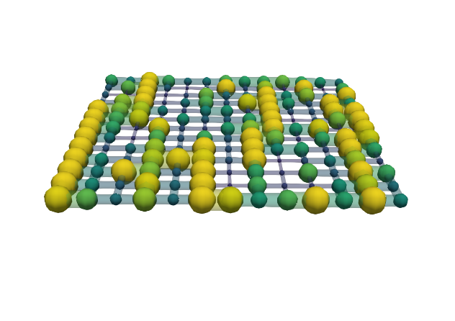
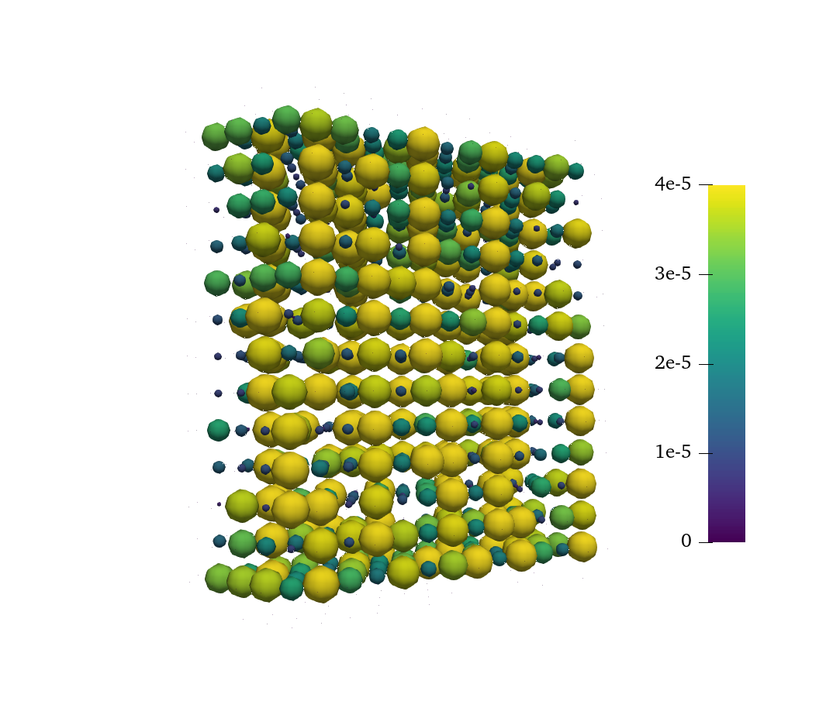
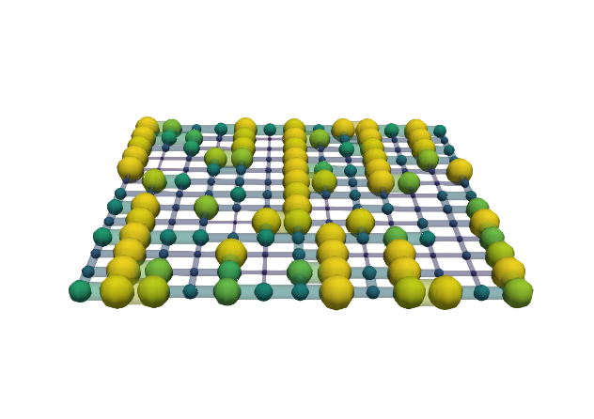
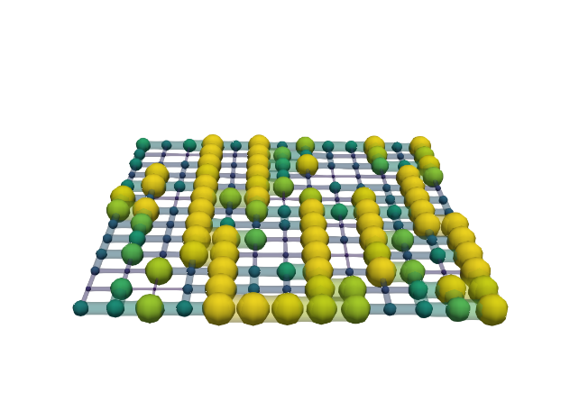
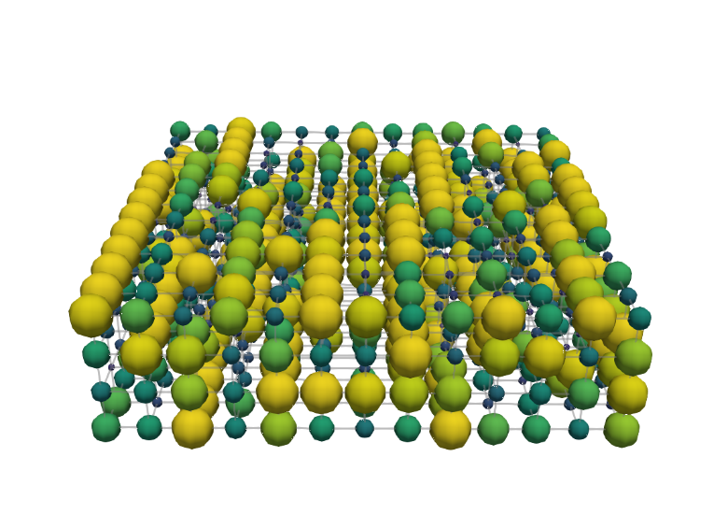
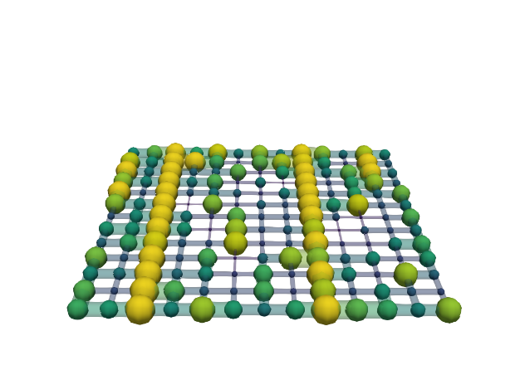
Structure evolution
0.2 M Vanadium, 0.5 V, 1.5 cm s⁻¹
= 50
= 10
= 1000
= [13x13x4]
Generation 0
Membrane
Pore diameter [μm]
0 10 20 30 40
Thickness
Current collector
100 μm
Generation 999
Flow direction
Throat radius [μm]
0 4 8 12 16
Flow direction

Slide 21
Bottom-up design of porous electrodes
Experimental
characterization
Pore network
model
Genetic
optimization
Battery tests
Chemistries
Imaging
Network extraction
Pore simulations
Parameter analysis
Bottom-up
Evolution theory
Self-evolving

Slide 22
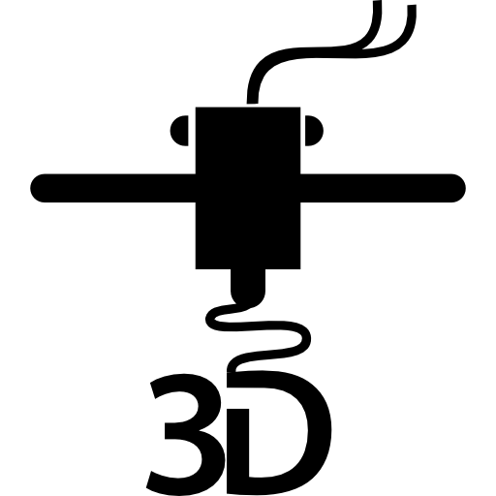
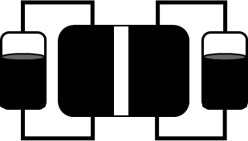
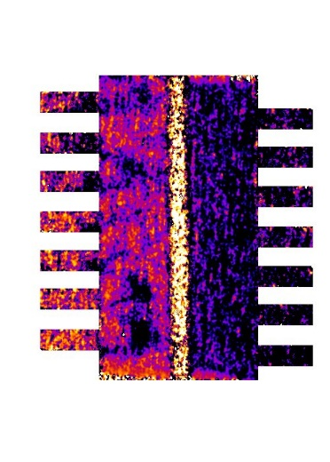


The big picture
Experimental
characterization
Pore network
model
Genetic
optimization
Advanced
manufacturing
Device
implementation
+
+
+

Slide 23




Acknowledgments
Contact:
m.v.d.heijden@tue.nl
Electrochemical Materials and Systems

